Slide 1
e-Baltic
Installation Manual

Slide 2
e-Baltic
Roof Curb installation

Slide 3
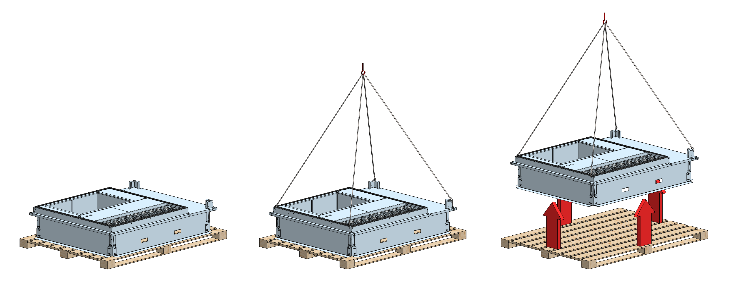
e-Baltic
ROOF CURB INSTALLATION
The Roof Curb is delivered on a pallet and must be lifted to the Building’s roof for installation.

Slide 4
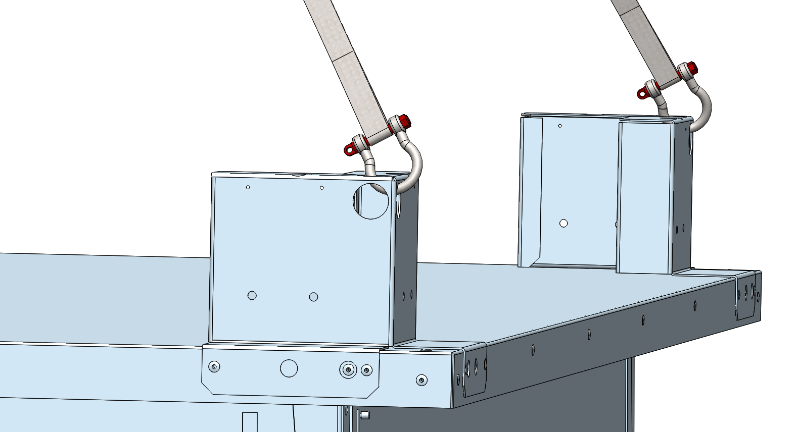
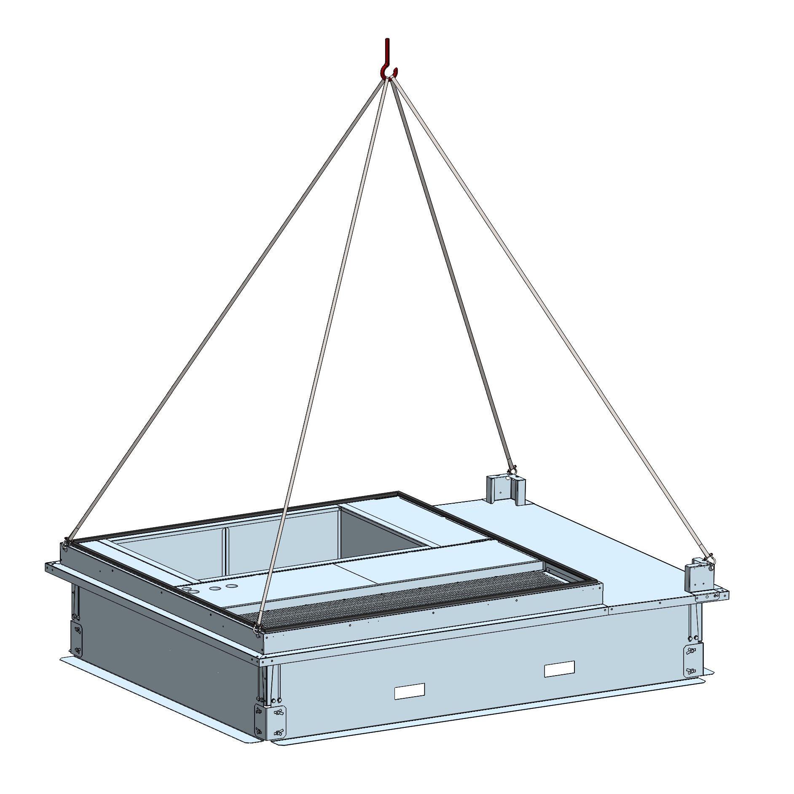
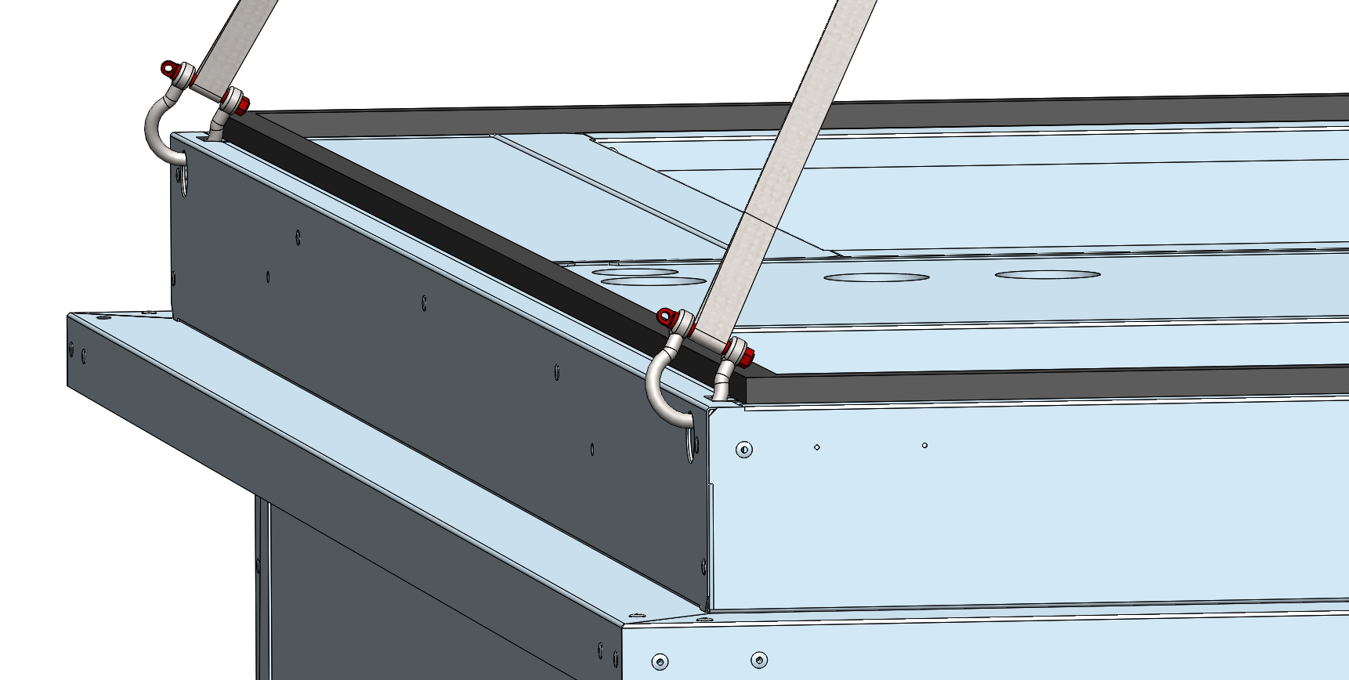
e-Baltic
ROOF CURB INSTALLATION
Make sure to attach the lifting hooks on the correct position.
The roof curb has 4 lifting lugs, one on each corner.

Slide 5
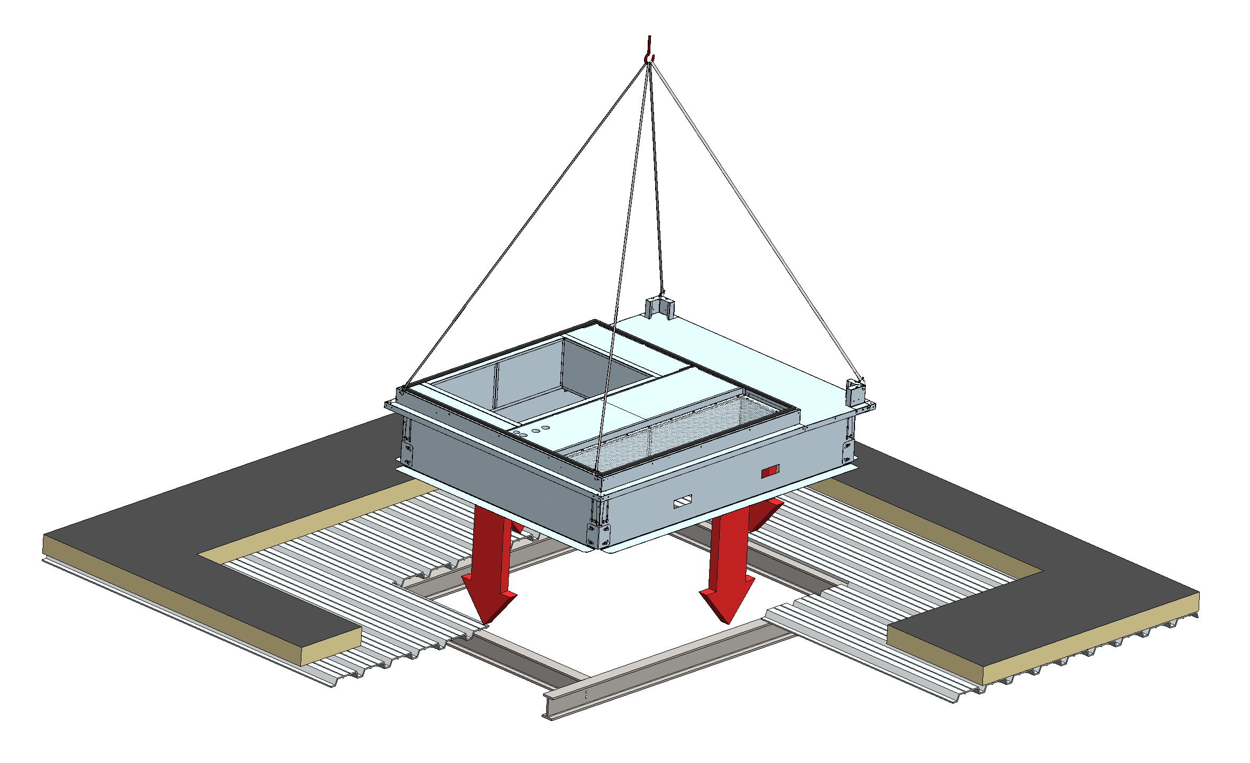
e-Baltic
ROOF CURB INSTALLATION
Carefully lay the roof curb on the roof beams.

Slide 6
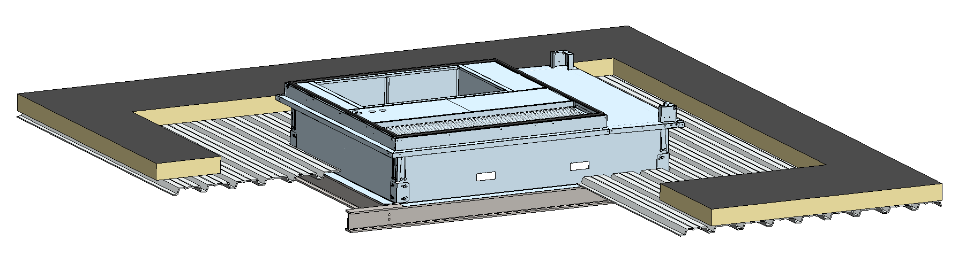
e-Baltic
ROOF CURB INSTALLATION
The base of the roof curb must rest on the roof beams.
The entire roof curb’s surface must be in contact with the beams (no discontinuous contact).
ROOF INSULATION
ROOF PANELS
ROOF BEAMS

Slide 7
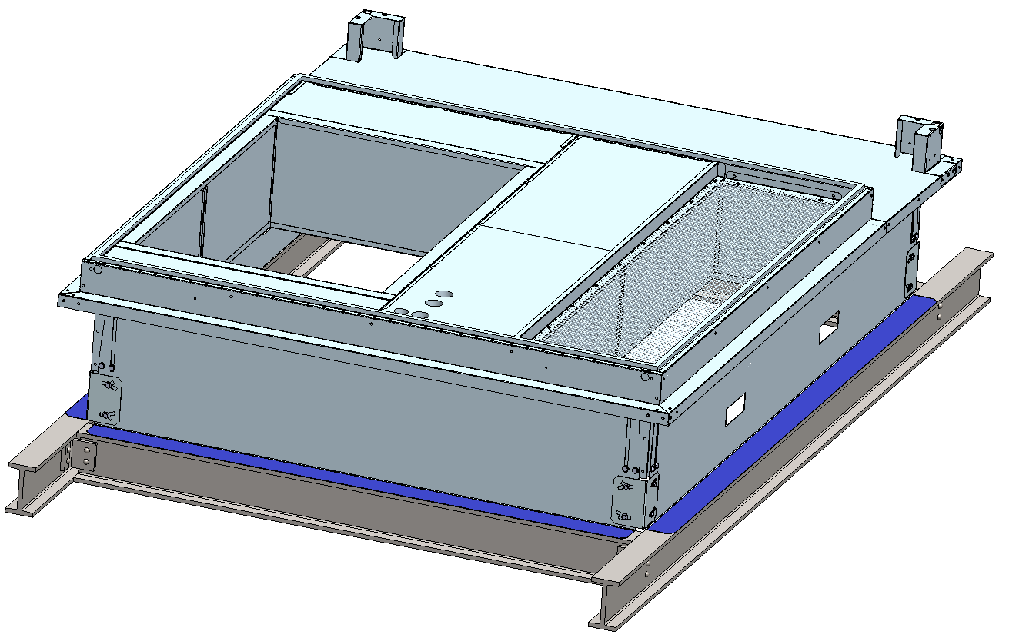
e-Baltic
ROOF CURB INSTALLATION
Fix the roof curb on the building’s frame with screws, welding or assembly accessories.
THE ROOF CURB MUST BE FULLY SECURED TO THE BUILDING’S FRAME.

Slide 8
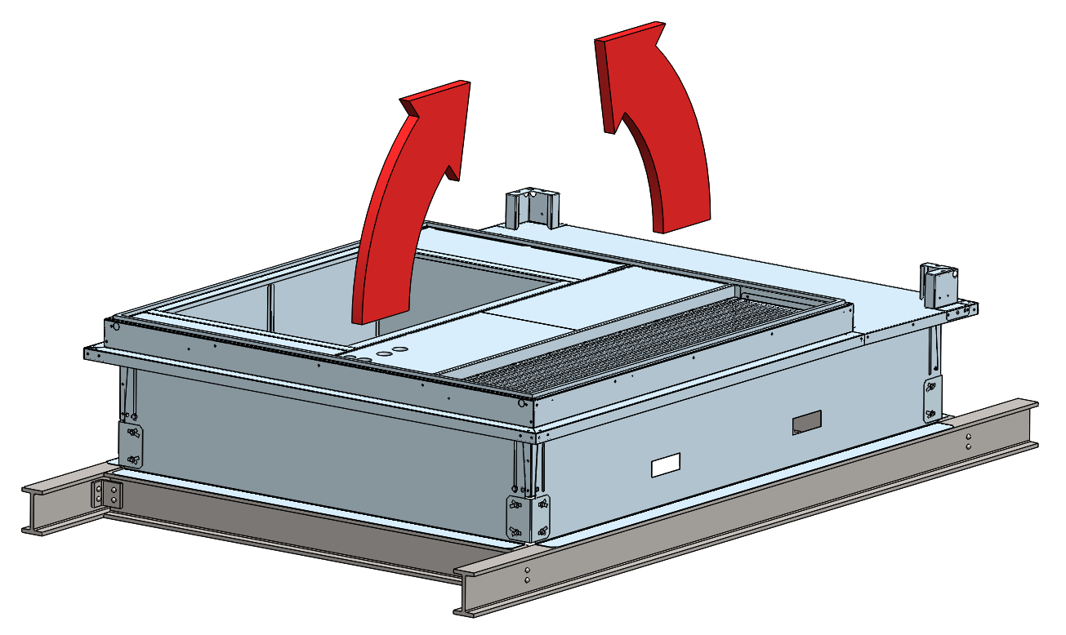
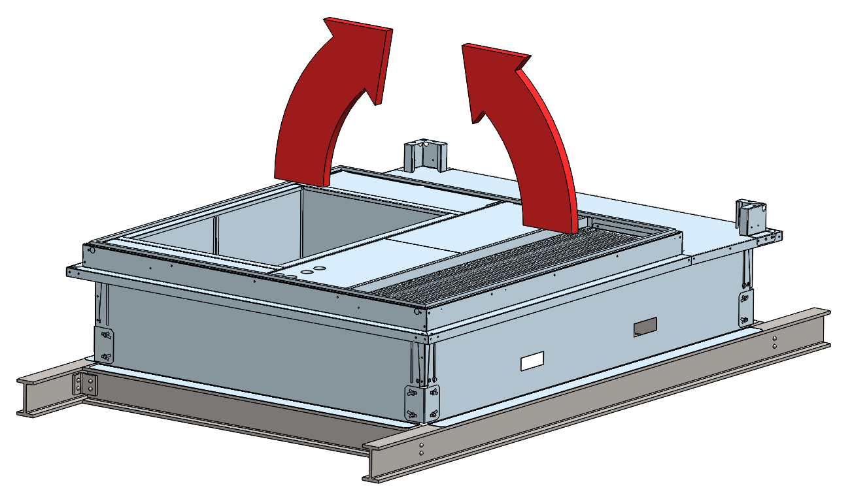
e-Baltic
ROOF CURB INSTALLATION
The adjustable roof curb allows angle adjustments on both directions.
CASE 1
CASE 2

Slide 9
e-Baltic
ROOF CURB INSTALLATION
The adjustable roof curb allows angle adjustments on both directions.
CASE 1
CASE 2

Slide 10
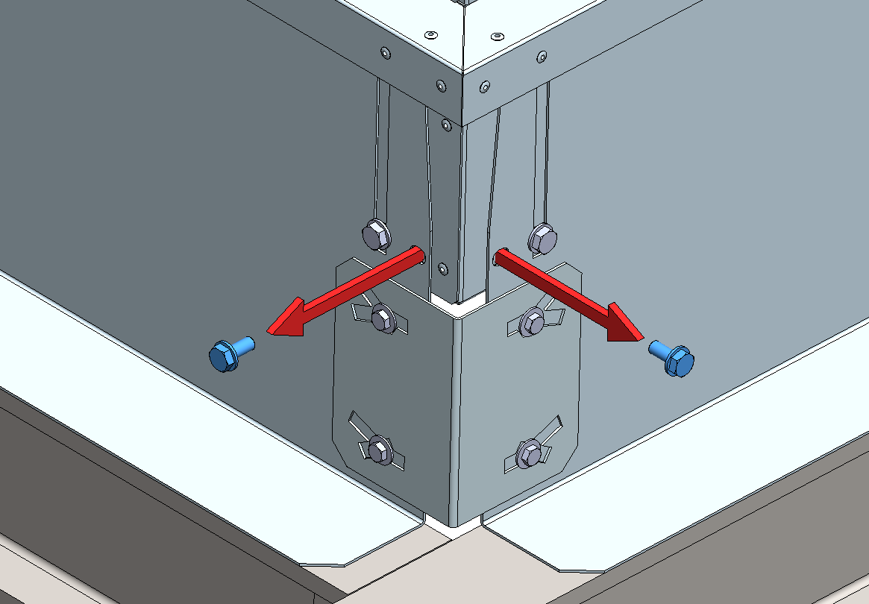
e-Baltic
ROOF CURB INSTALLATION
CASE 1
STEP 1 :
Remove the screws that secure the mud flaps to the roof curb.
2 screws on each corner

Slide 11
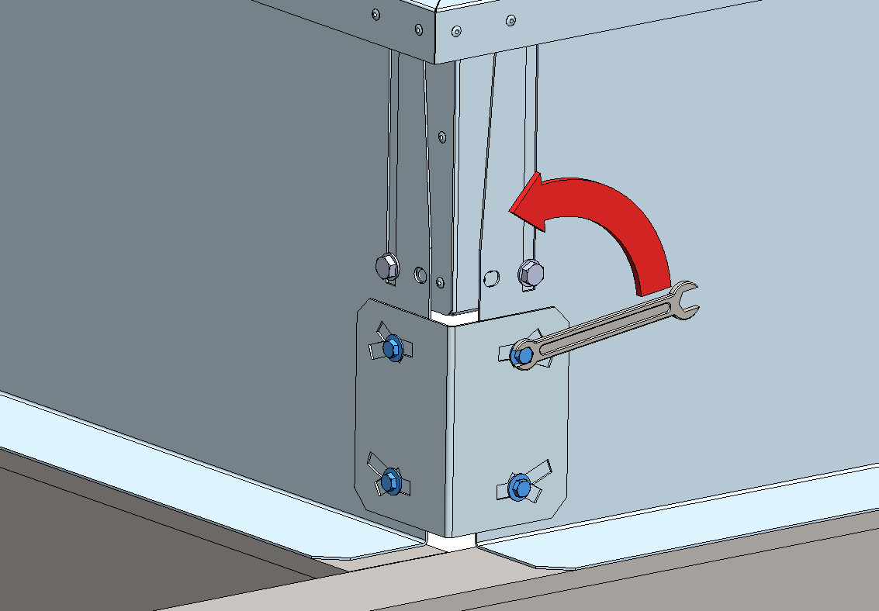
e-Baltic
ROOF CURB INSTALLATION
CASE 1
STEP 2 :
Loosen the screws of the four joints uniting the mud flaps.
Be careful to not remove them.

Slide 12
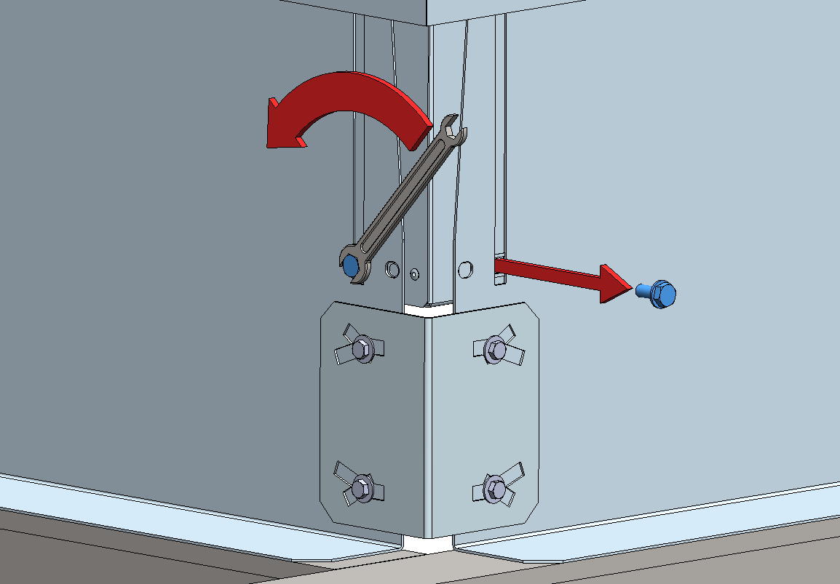
e-Baltic
ROOF CURB INSTALLATION
CASE 1
STEP 3 :
Loosen the screws from the flaps that will bend to adjust to the angle of the ceiling.
Remove the screws from the flap that follows the angle of the ceiling.

Slide 13
e-Baltic
ROOF CURB INSTALLATION
The adjustable roof curb allows angle adjustments on both directions.
CASE 1
CASE 2

Slide 14
e-Baltic
ROOF CURB INSTALLATION
CASE 2
STEP 1 :
Remove the screws that secure the mud flaps to the roof curb.
2 screws on each corner

Slide 15
e-Baltic
ROOF CURB INSTALLATION
CASE 2
STEP 2 :
Loosen the screws of the four joints uniting the mud flaps.
Be careful to not remove them.

Slide 16
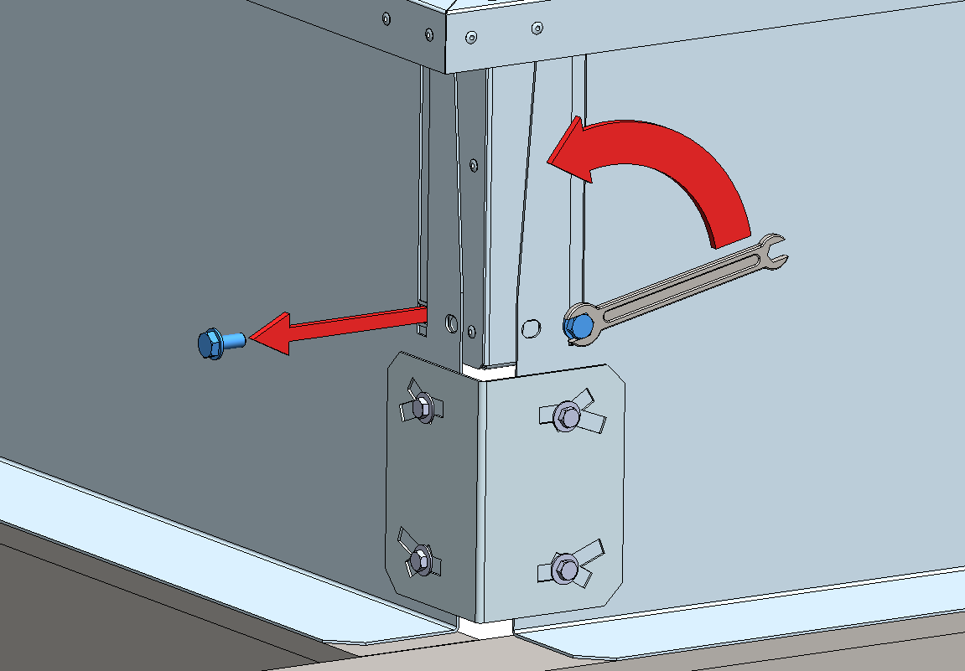
e-Baltic
ROOF CURB INSTALLATION
CASE 2
STEP 3 :
Loosen the screws from the flaps that will bend to adjust to the angle of the ceiling.
Remove the screws from the flap that follows the angle of the ceiling.

Slide 17
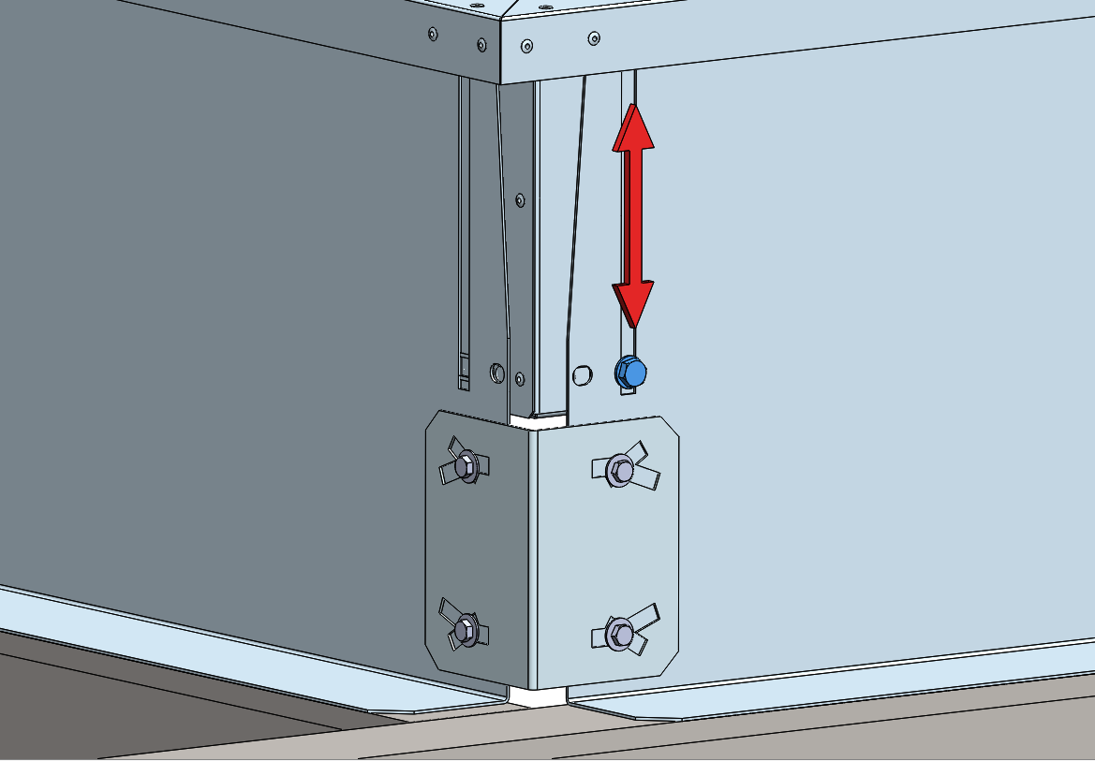
e-Baltic
ROOF CURB INSTALLATION
CASE 2
The remaining screws will be used as guides for the roof curb alignment.

Slide 18
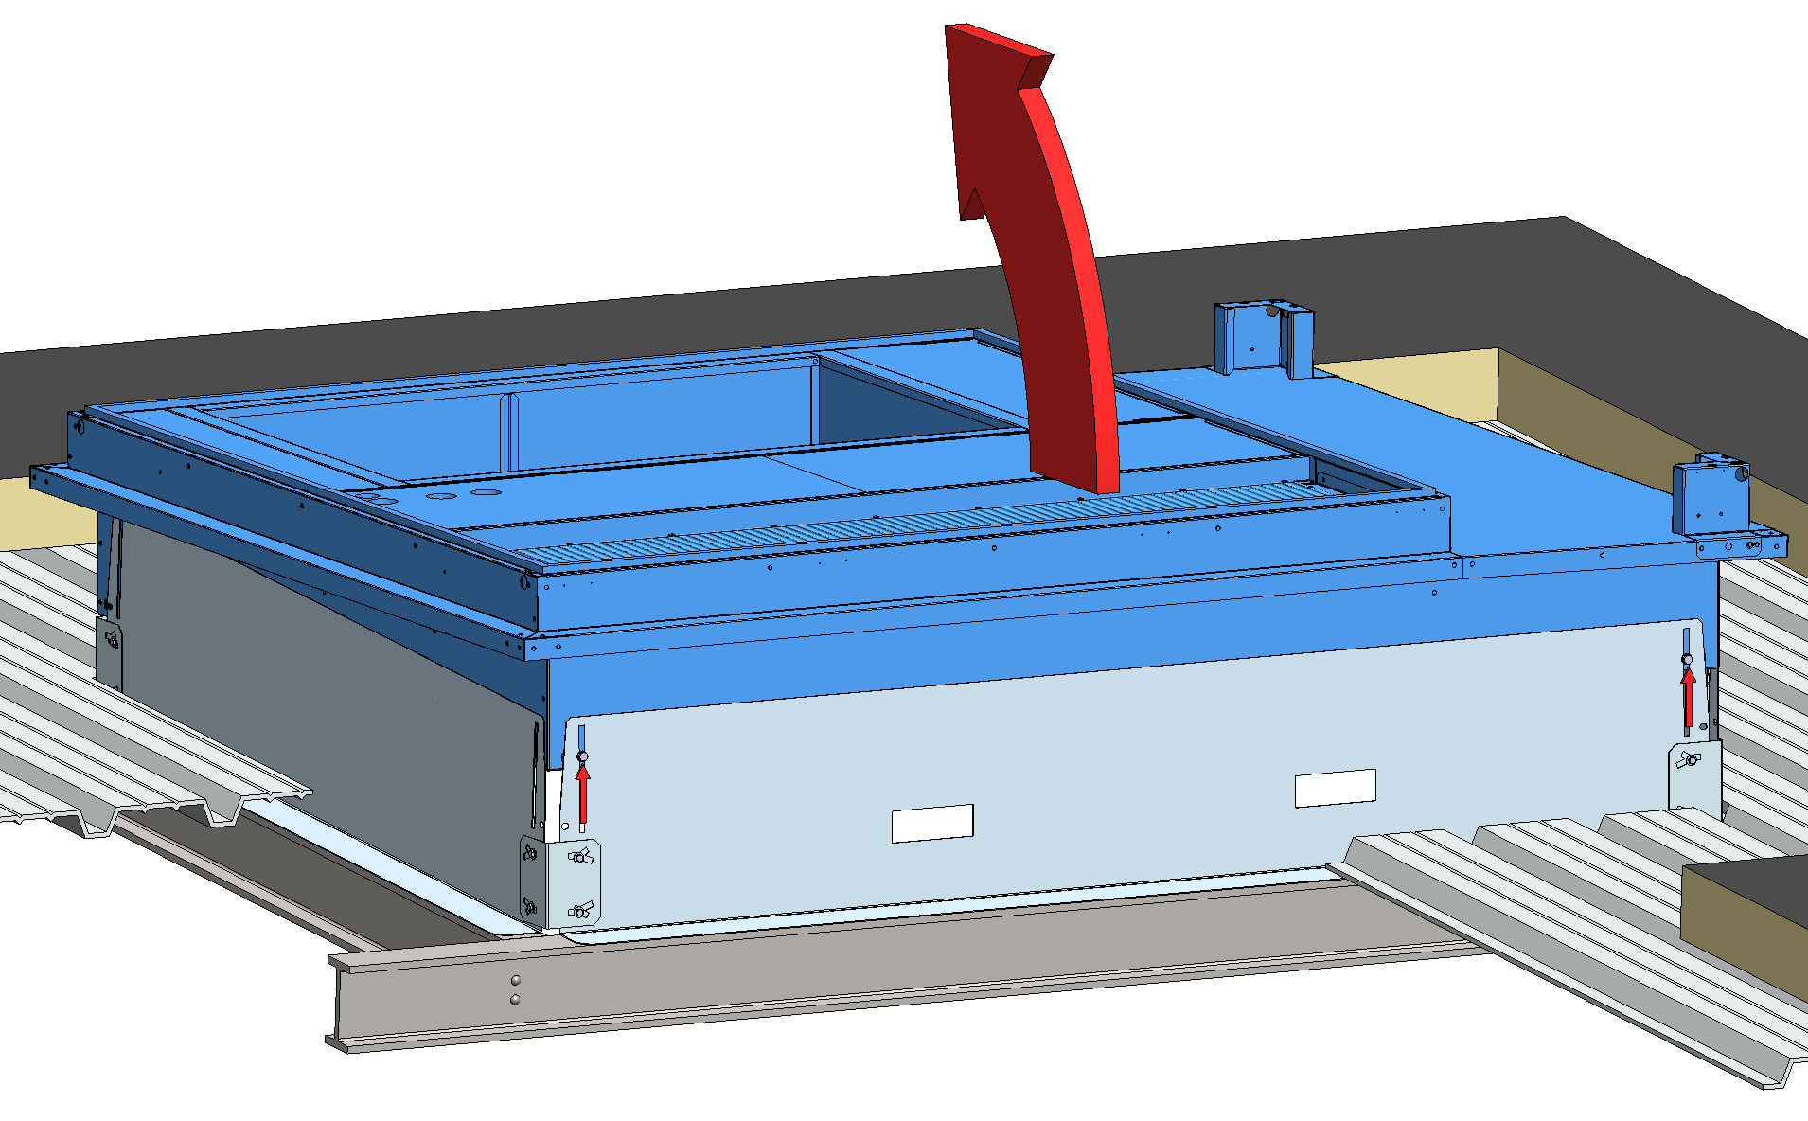
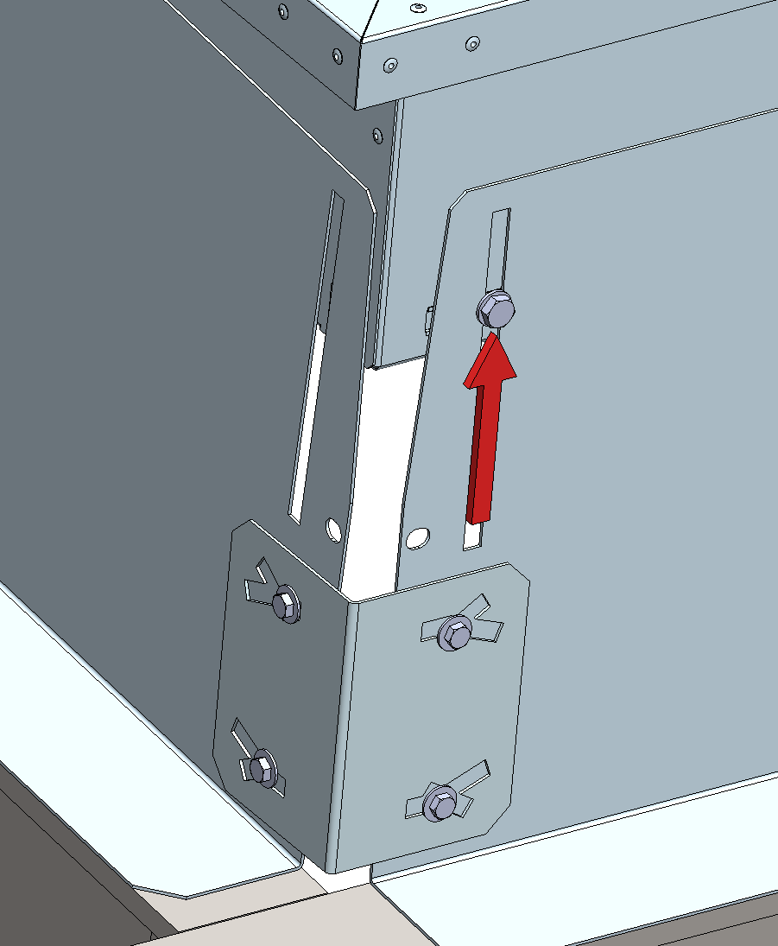
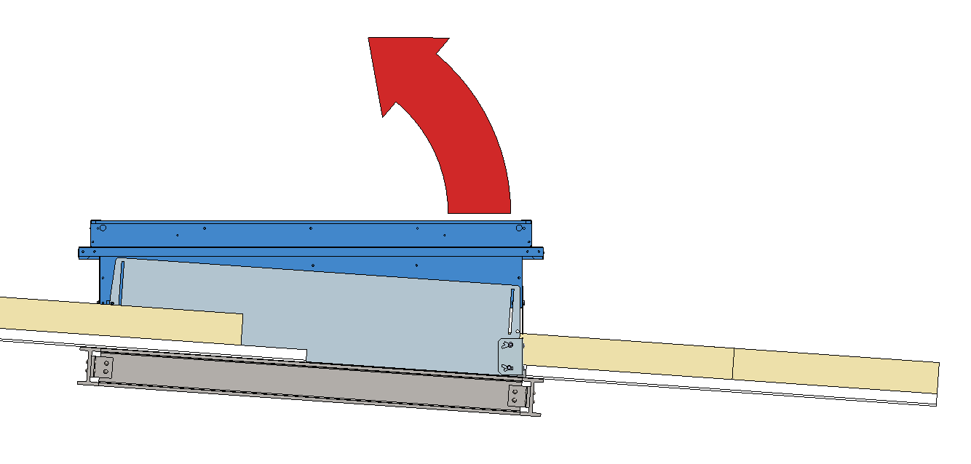
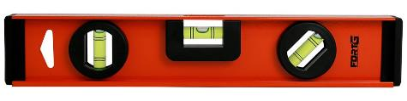
e-Baltic
ROOF CURB INSTALLATION
Align the roof curb in a horizontal position to correct the angle of the ceiling.
Make sure to use a level on this operation.
This operation may require several adjustments, loosening and tightening the screws until the horizontal position is reached.

Slide 19
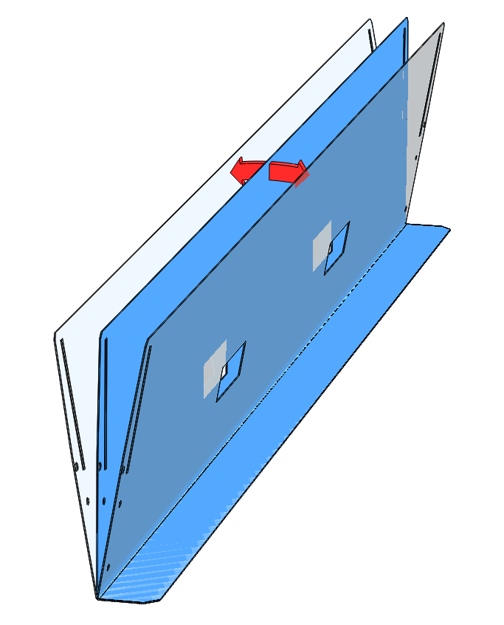
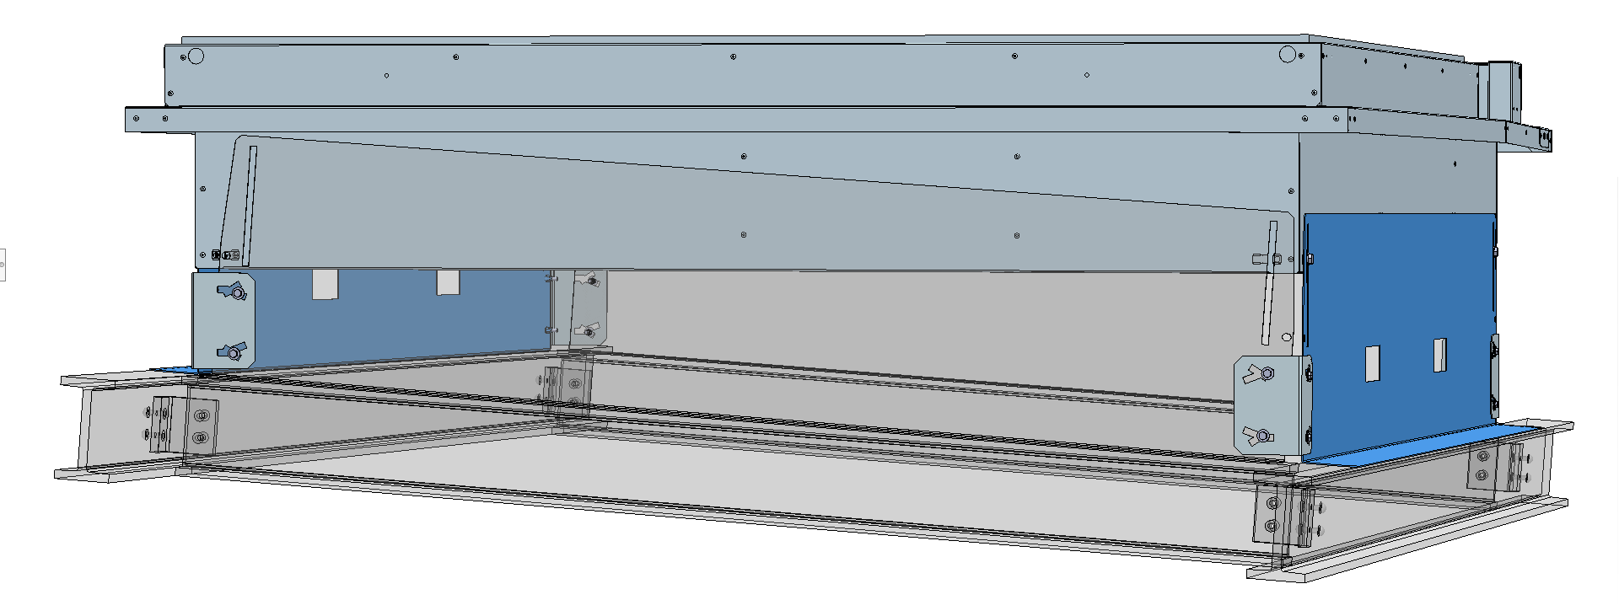
e-Baltic
ROOF CURB INSTALLATION
During the roof curb alignment, the mud flaps will bend to adjust the angle of the roof.

Slide 20
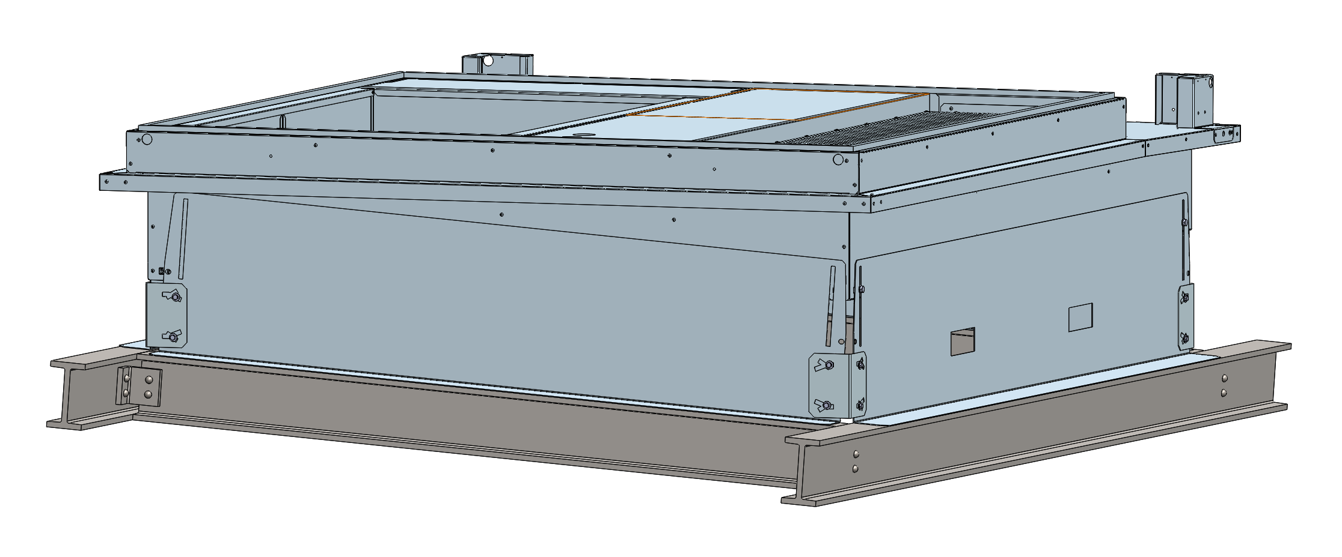
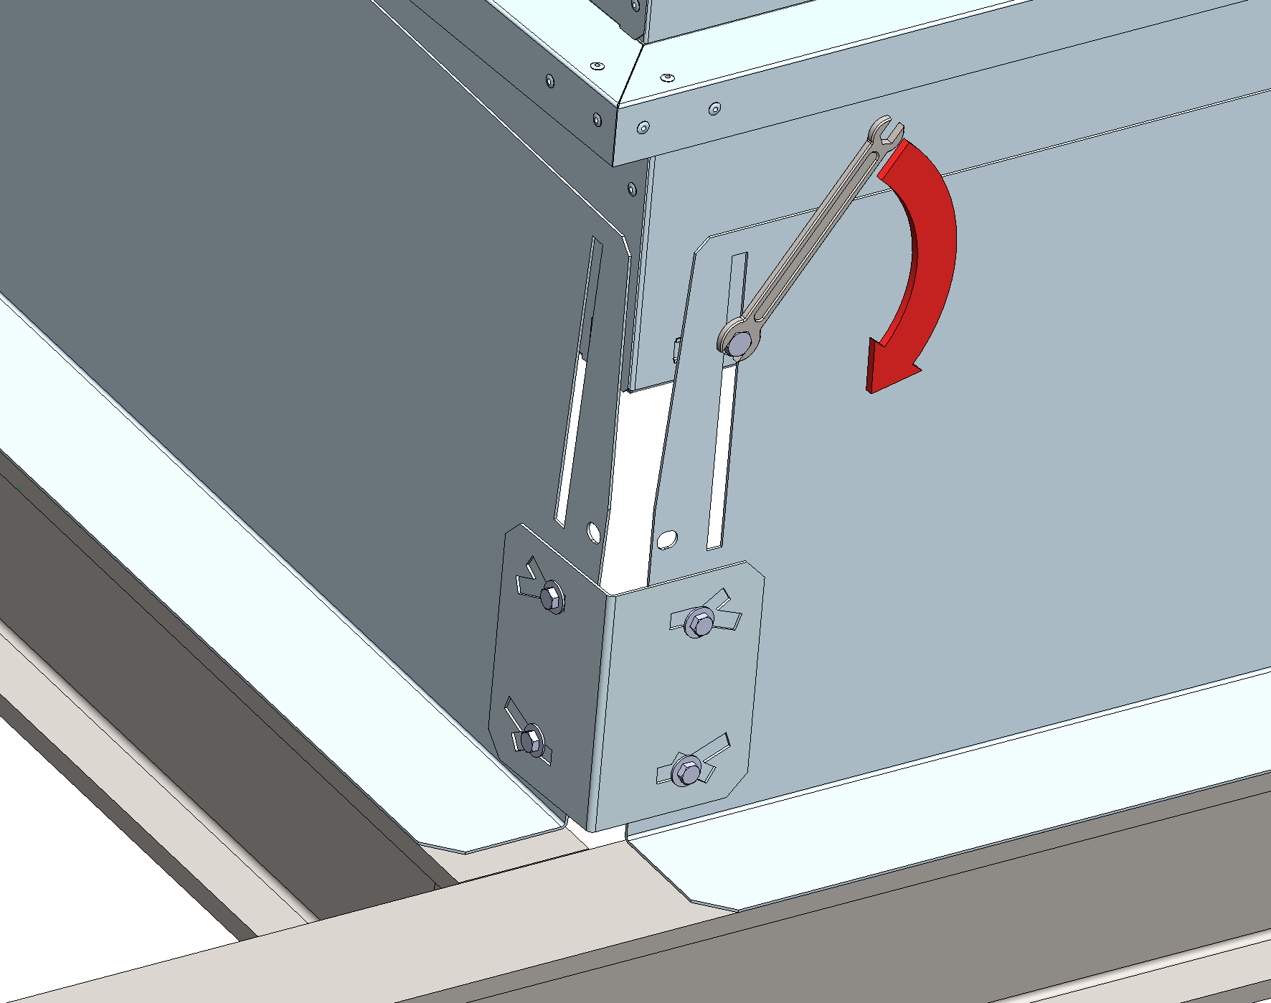
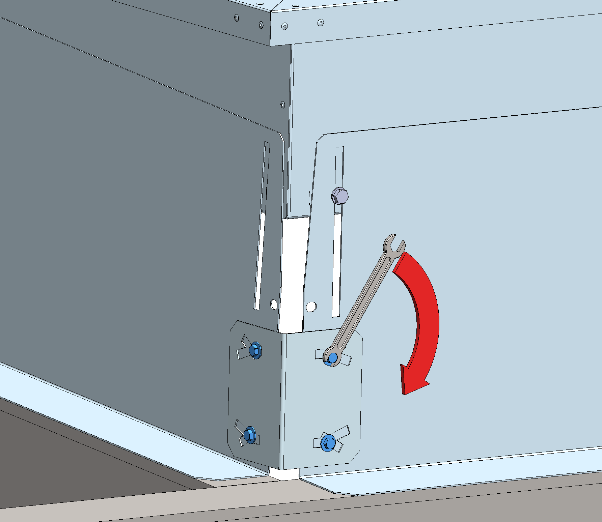
e-Baltic
ROOF CURB INSTALLATION
Once the roof curve is perfectly levelled, fix the adjustable angles by tightening all the screws at the joints and mud flaps.

Slide 21
e-Baltic
ROOF CURB INSTALLATION
When the frame is correctly positioned, secure the assembly with:
a disconnected stitched welded seam (20 to 30 mm every 200 mm)
200mm MAX
20 to 30mm

Slide 22
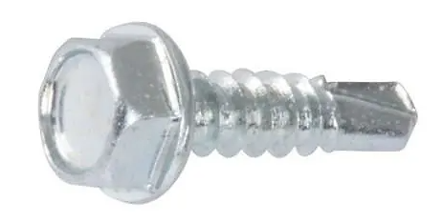
e-Baltic
ROOF CURB INSTALLATION
When the frame is correctly positioned, secure the assembly with:
a disconnected stitched welded seam (20 to 30 mm every 200 mm)
M6 self-taping screws in the outside pre-drilled holes.

Slide 23
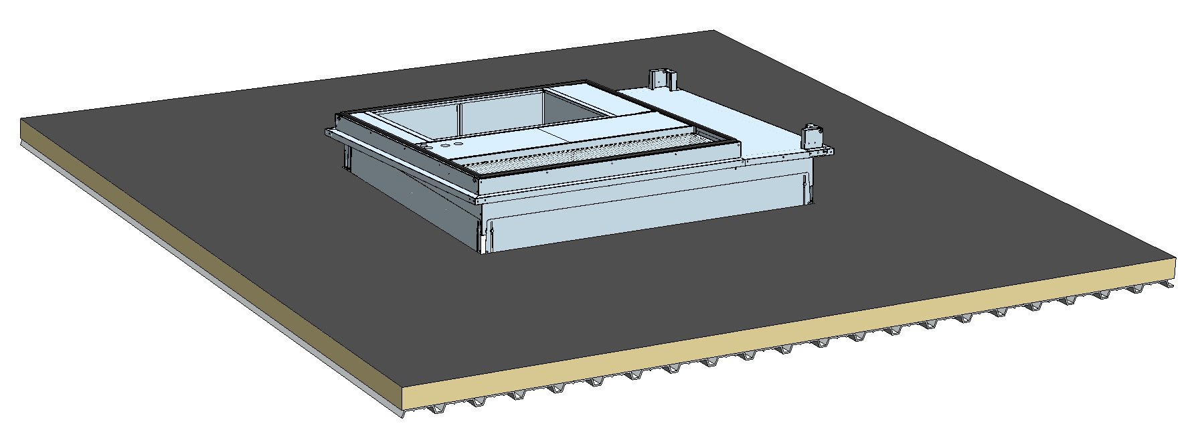
e-Baltic
ROOF CURB INSTALLATION
Reinstall the ceiling insulation.

Slide 24
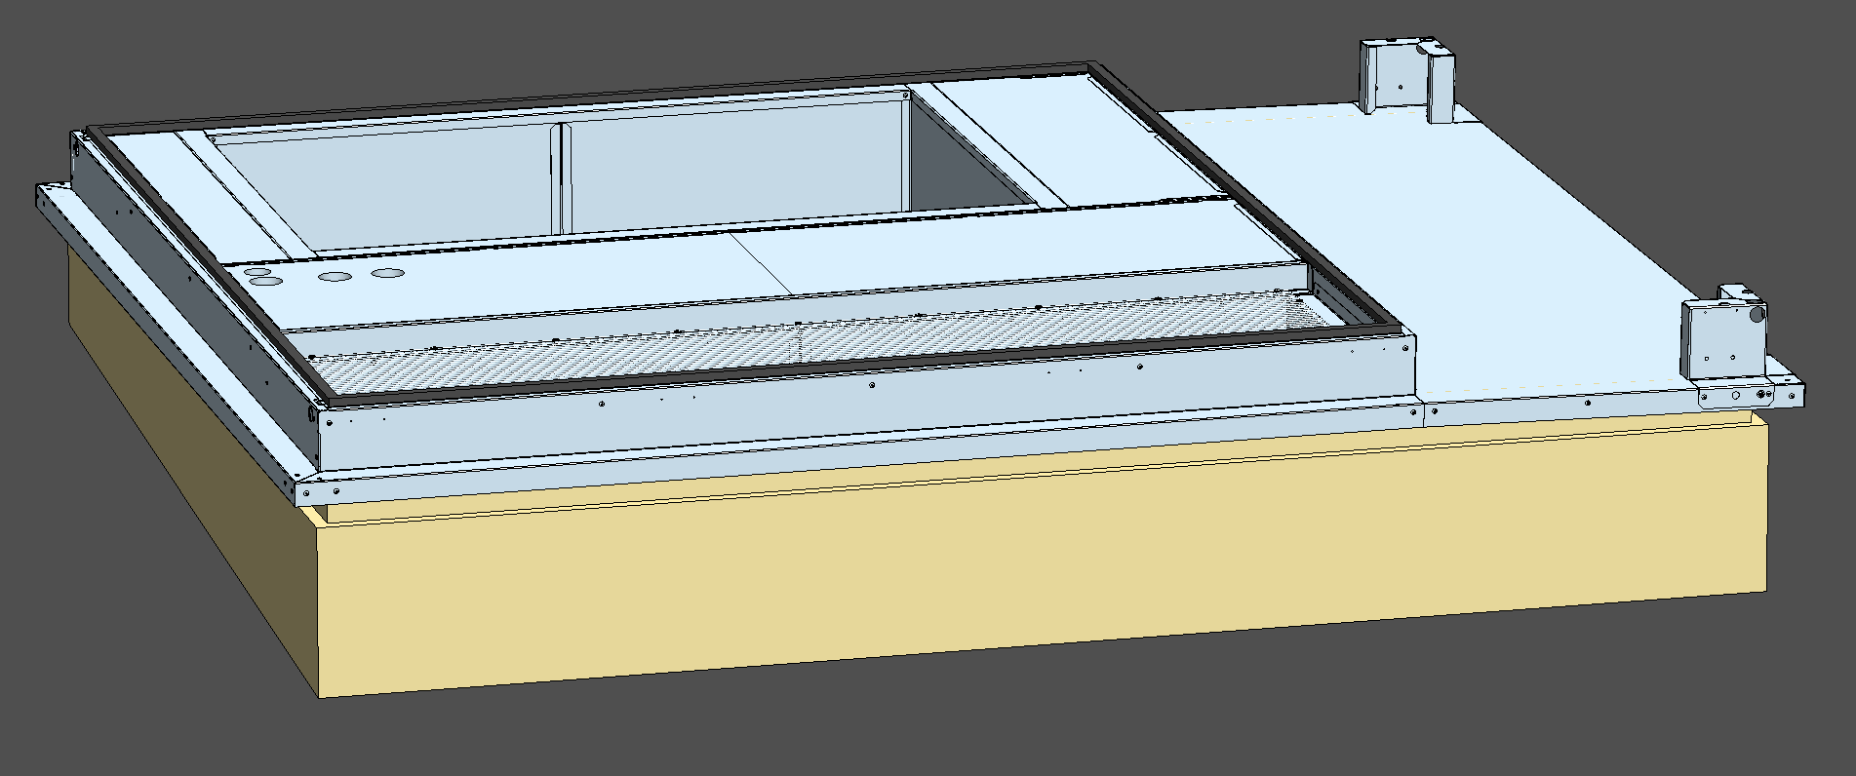
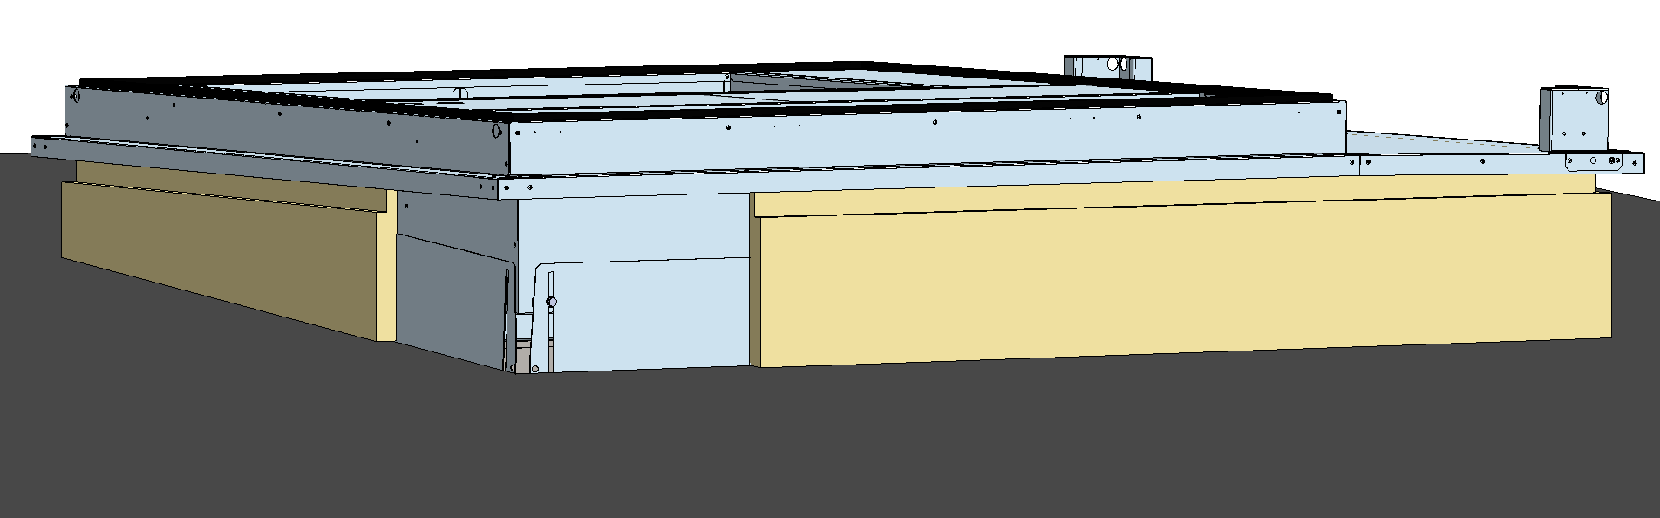
e-Baltic
ROOF CURB INSTALLATION
Install the insulation over the roof curb lateral panels.

Slide 25
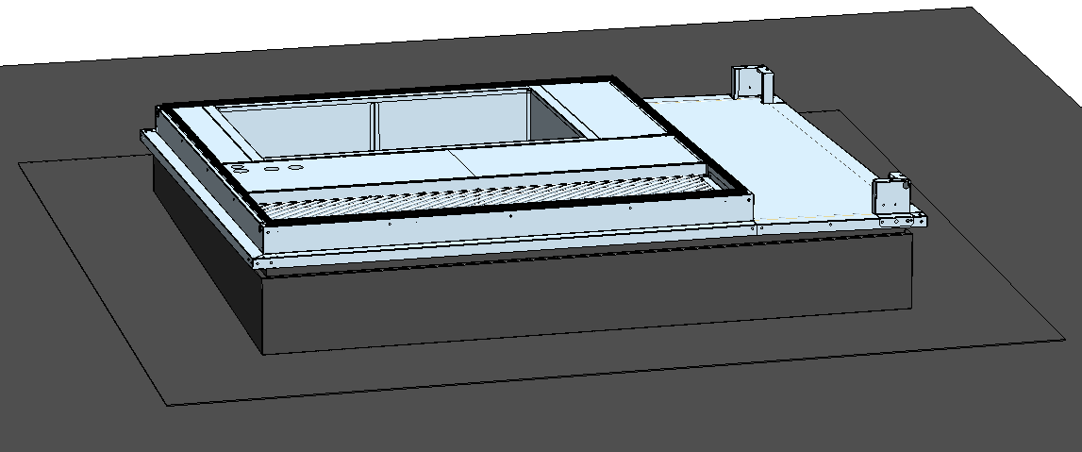
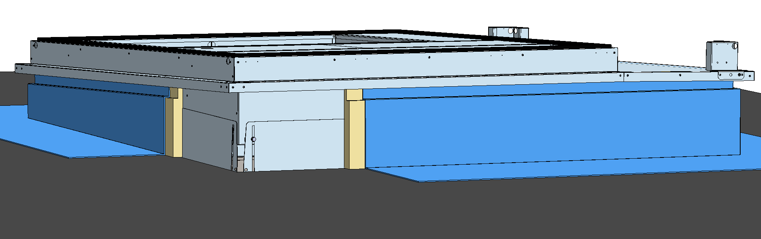
e-Baltic
ROOF CURB INSTALLATION
Seal the roof curb by completely covering its flaps and joints with sealant.

Slide 26
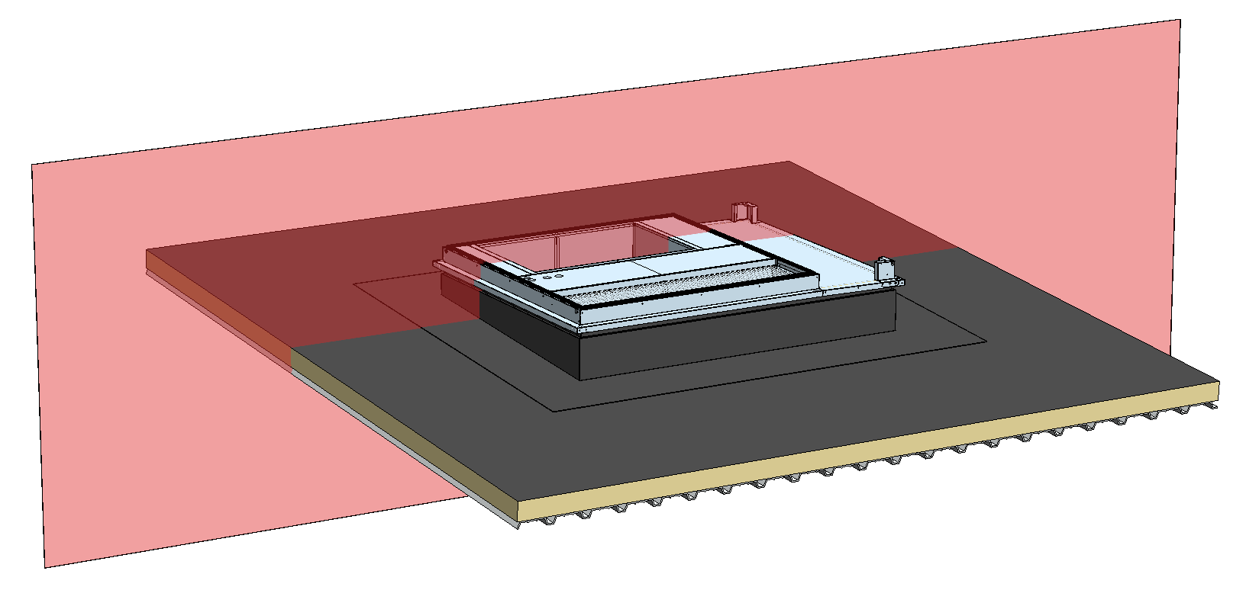
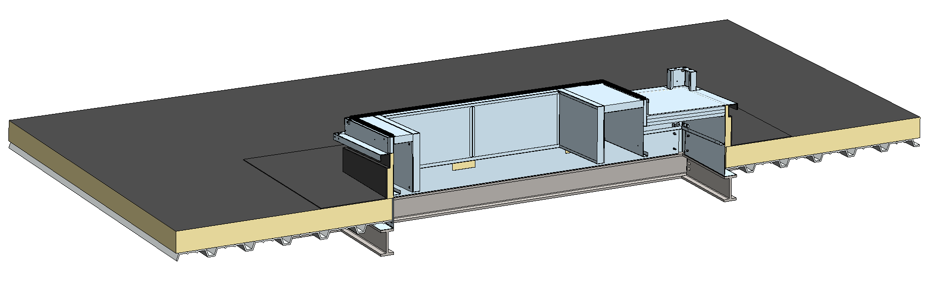
e-Baltic
ROOF CURB INSTALLATION

Slide 27
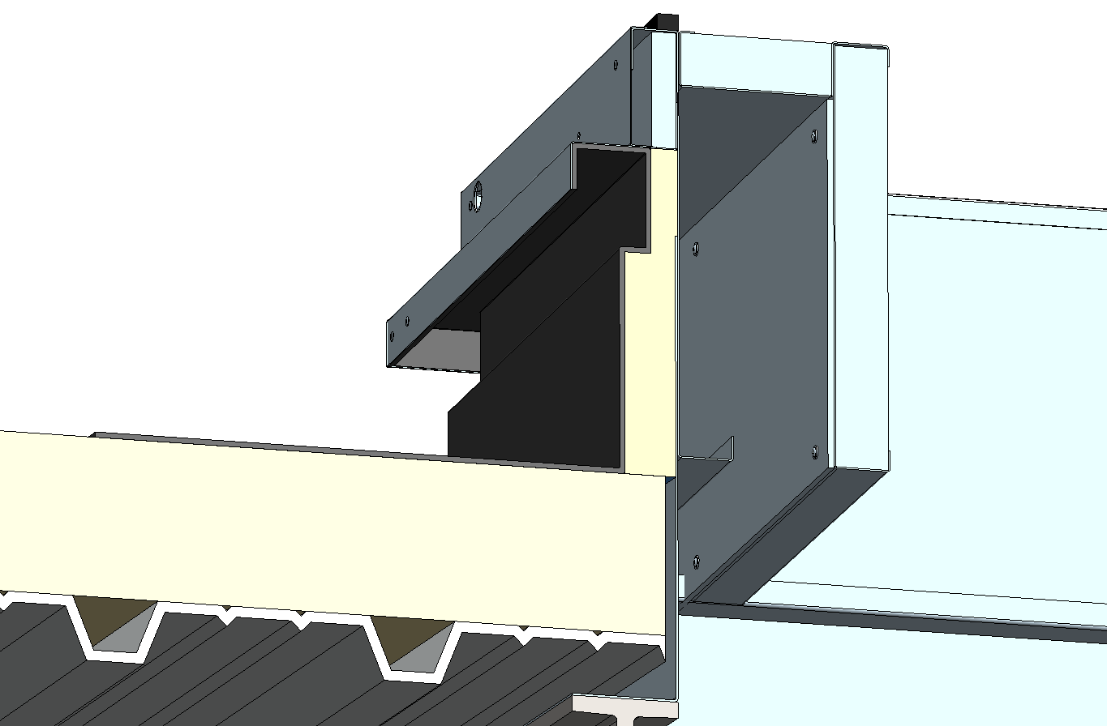
e-Baltic
ROOF CURB INSTALLATION
ROOF CURB
ROOF CURB INSULATION
SIDINGS
ROOF INSULATION
SEALING / FIRE BULKHEAD
MUD FLAPS
BUILDING FRAME

Slide 28
e-Baltic
ROOF CURB INSTALLATION
ROOF CURB
ROOF CURB INSULATION
ROOF CURB INSULATION
MAKE SURE TO INSTALL THE INSULATION OVER THE ROOF CURB LATERAL PANELS TO AVOID CONDENSATION.
SIDINGS
ROOF INSULATION
SEALING / FIRE BULKHEAD
MUD FLAPS
BUILDING FRAME

Slide 29
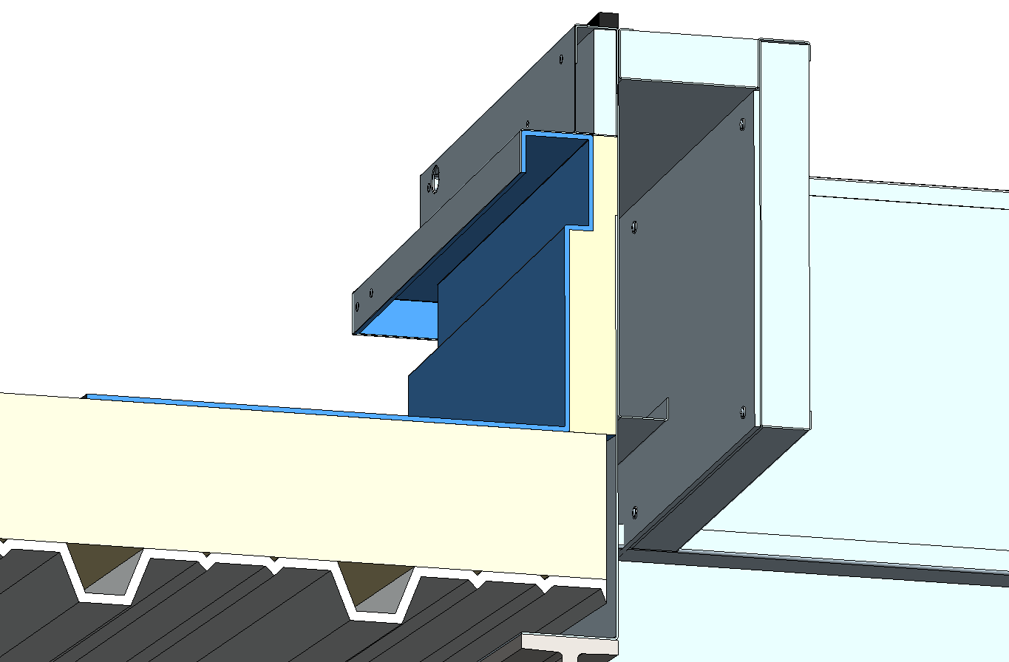
e-Baltic
ROOF CURB INSTALLATION
ROOF CURB
ROOF CURB INSULATION
SIDINGS
ROOF INSULATION
SEALING / FIRE BULKHEAD
MAKE SURE THAT THE ENTIRE ROOF CURB INSULATION IS COVERED BY THE SEALANT.
SEALING / FIRE BULKHEAD
MUD FLAPS
BUILDING FRAME

Slide 30
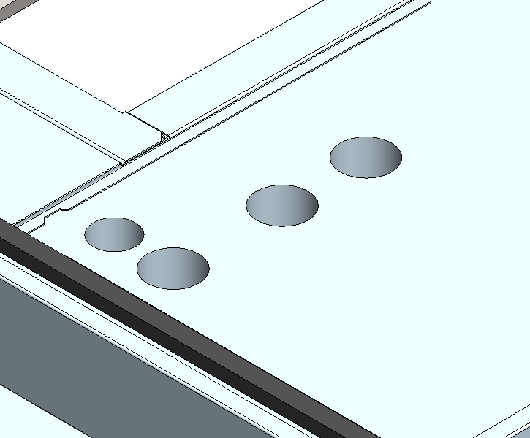
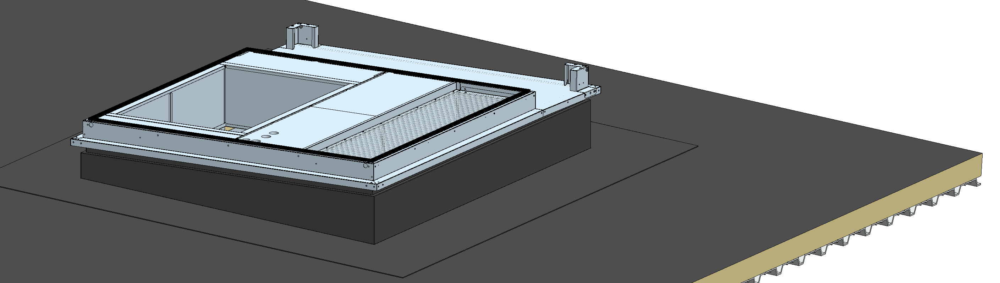
e-Baltic
ROOF CURB INSTALLATION
Preparing the electrical connection of the unit
HOLE FOR COMMUNICATION CABLE
HOLES FOR ADDITIONAL HEATING DEVICES CABLES
HOLE FOR POWER CABLE

Slide 31
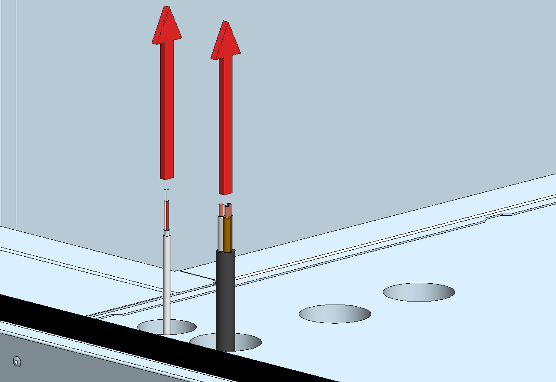
e-Baltic
ROOF CURB INSTALLATION
A waiting wiring harness (power supply and communication wires) must be pulled through the curb ultimately intended to connect in the rooftop electrical cabinet.

Slide 32
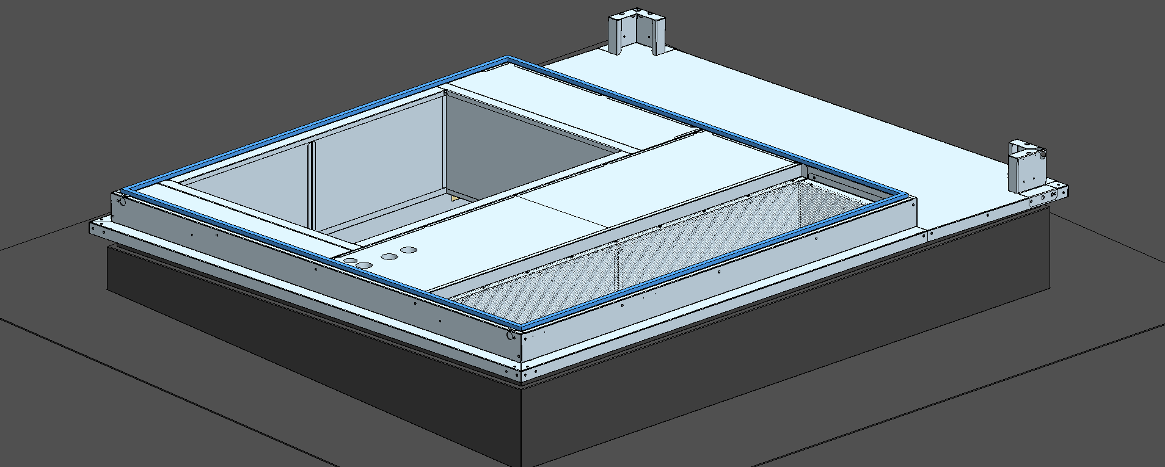
e-Baltic
ROOF CURB INSTALLATION
Make sure that the connecting rubber was not damaged during transport.
If necessary, this factory mounted rubber must be replaced or repaired before installing the rooftop.

Slide 33
e-Baltic
Rooftop installation

Slide 34
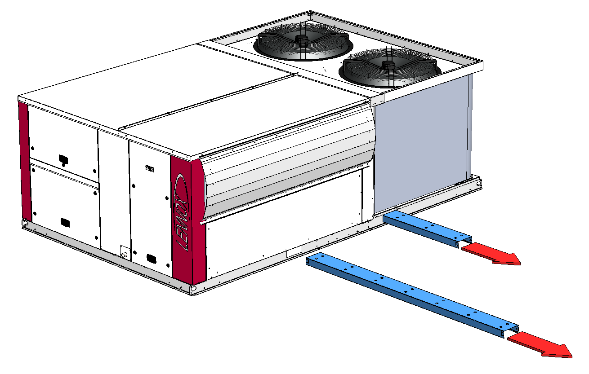
e-Baltic
ROOFTOP INSTALLATION
REMOVING THE FORKLIFT PROTECTION LOCATED UNDER THE MACHINE
Before the installation, remove the forklift protection sleeves located under the unit.
Take care not to hurt anybody when removing the forklift rails.
Place the machine in a safe area while removing the forklift rails from the unit.
WARNING: NEVER USE A FORKLIFT TO TRANSPORT THE UNIT WITHOUT THESE PROTECTIVE SLEEVES.

Slide 35
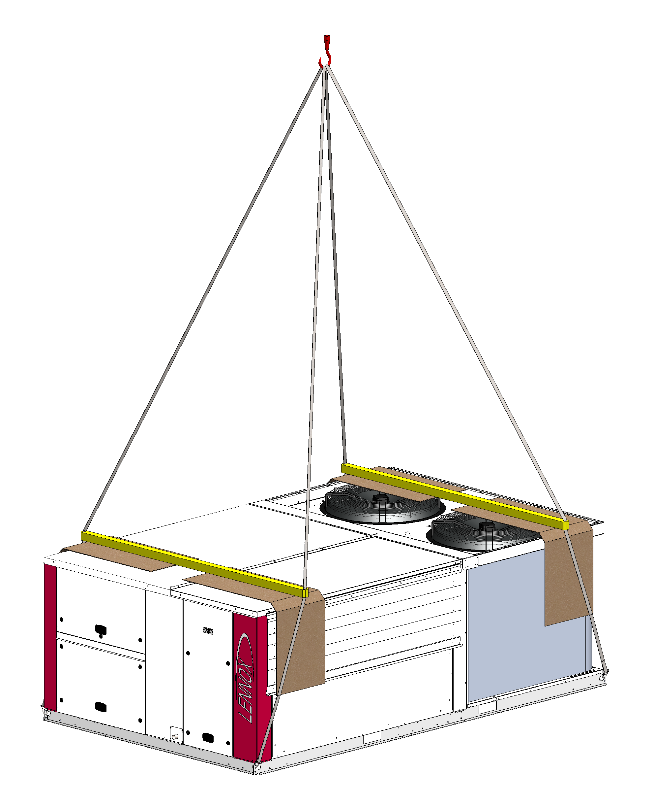
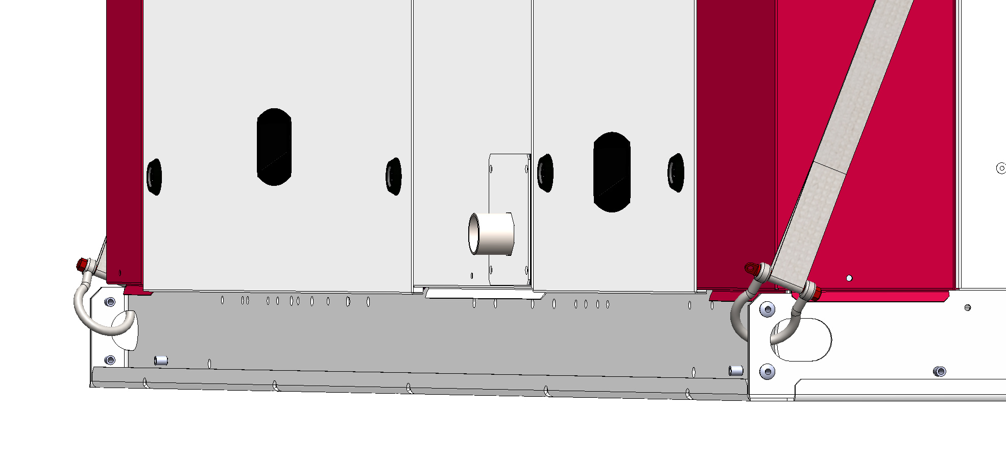
e-Baltic
ROOFTOP INSTALLATION
Lifting preparation
Place lifting shackles in each lifting lug located on each corner of the unit (some units might have 6 lifting lugs).
Ring shaft’s maximum diameter = 20 mm.

Slide 36
e-Baltic
ROOFTOP INSTALLATION
Lifting preparation
Use min. 5 m slings in each shackle.
5 m

Slide 37
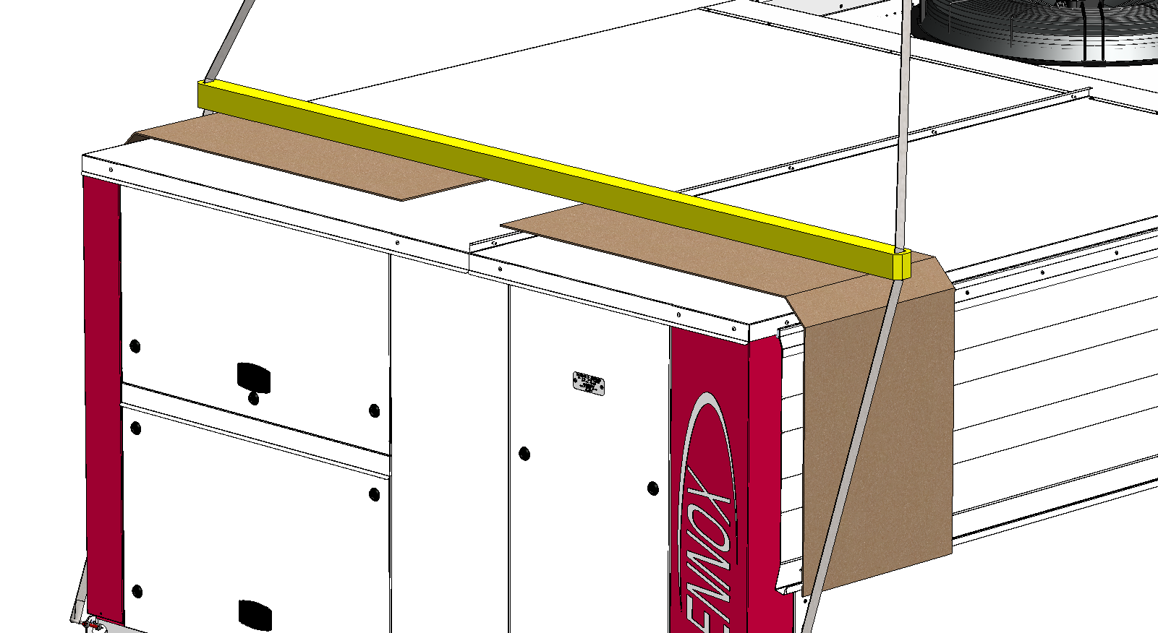
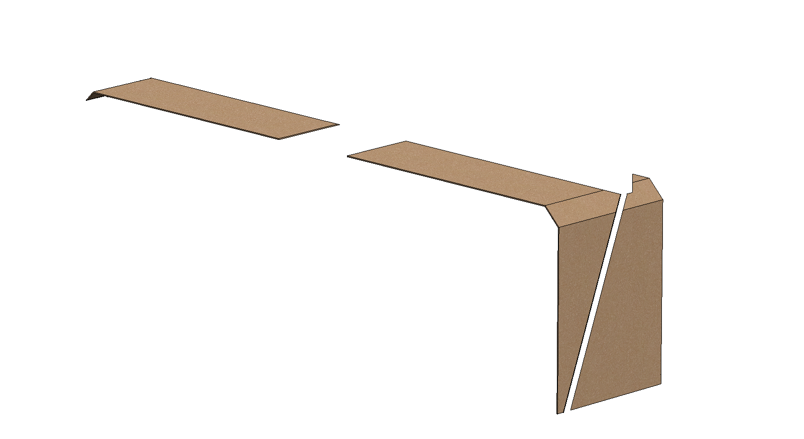
e-Baltic
ROOFTOP INSTALLATION
Lifting preparation
Use min. 5 m slings in each shackle.
Make sure to place a cardboard on each sling to protect the rooftop.

Slide 38
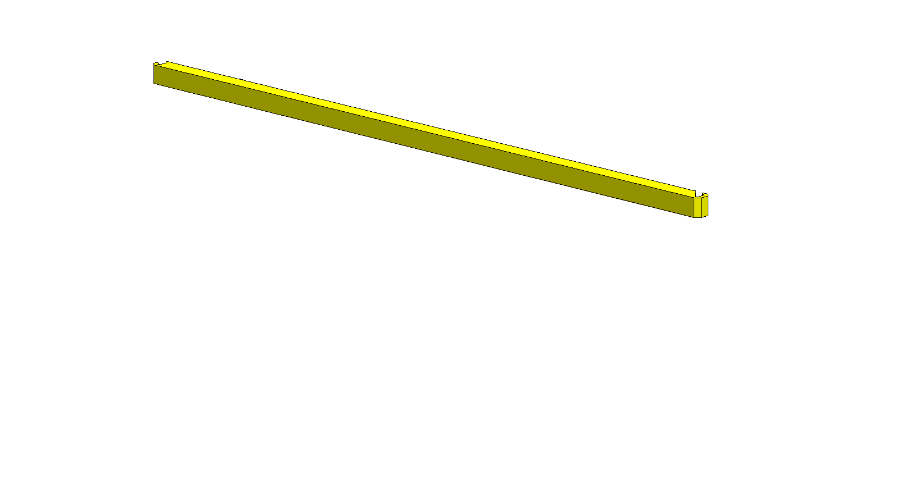
e-Baltic
ROOFTOP INSTALLATION
Lifting preparation
Use min. 5 m slings in each shackle.
Make sure to place a cardboard on each sling to protect the rooftop.
The unit must be lifted using spreader bars to prevent the slings from damaging the unit.
The spreader bars should be equal to the width of the unit.

Slide 39
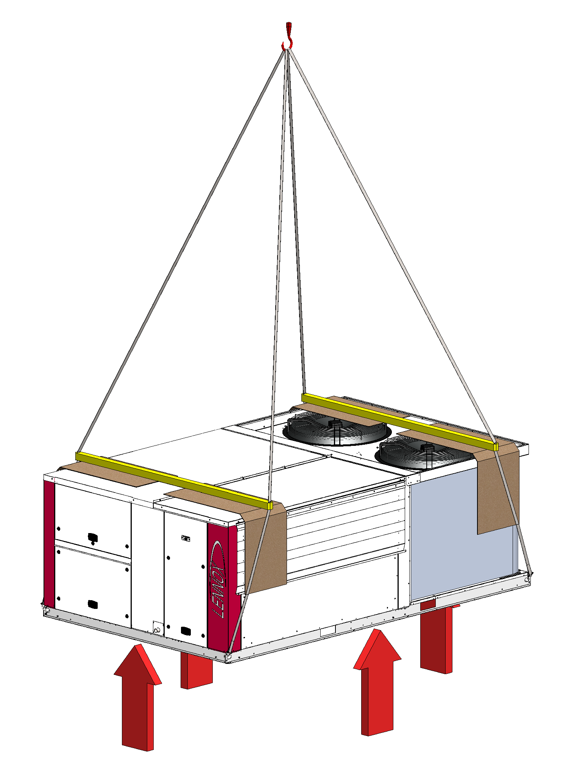

e-Baltic
ROOFTOP INSTALLATION
Gently and progressively put tension on the slings until the unit starts moving.
Make sure to move the unit in horizontal position

Slide 40
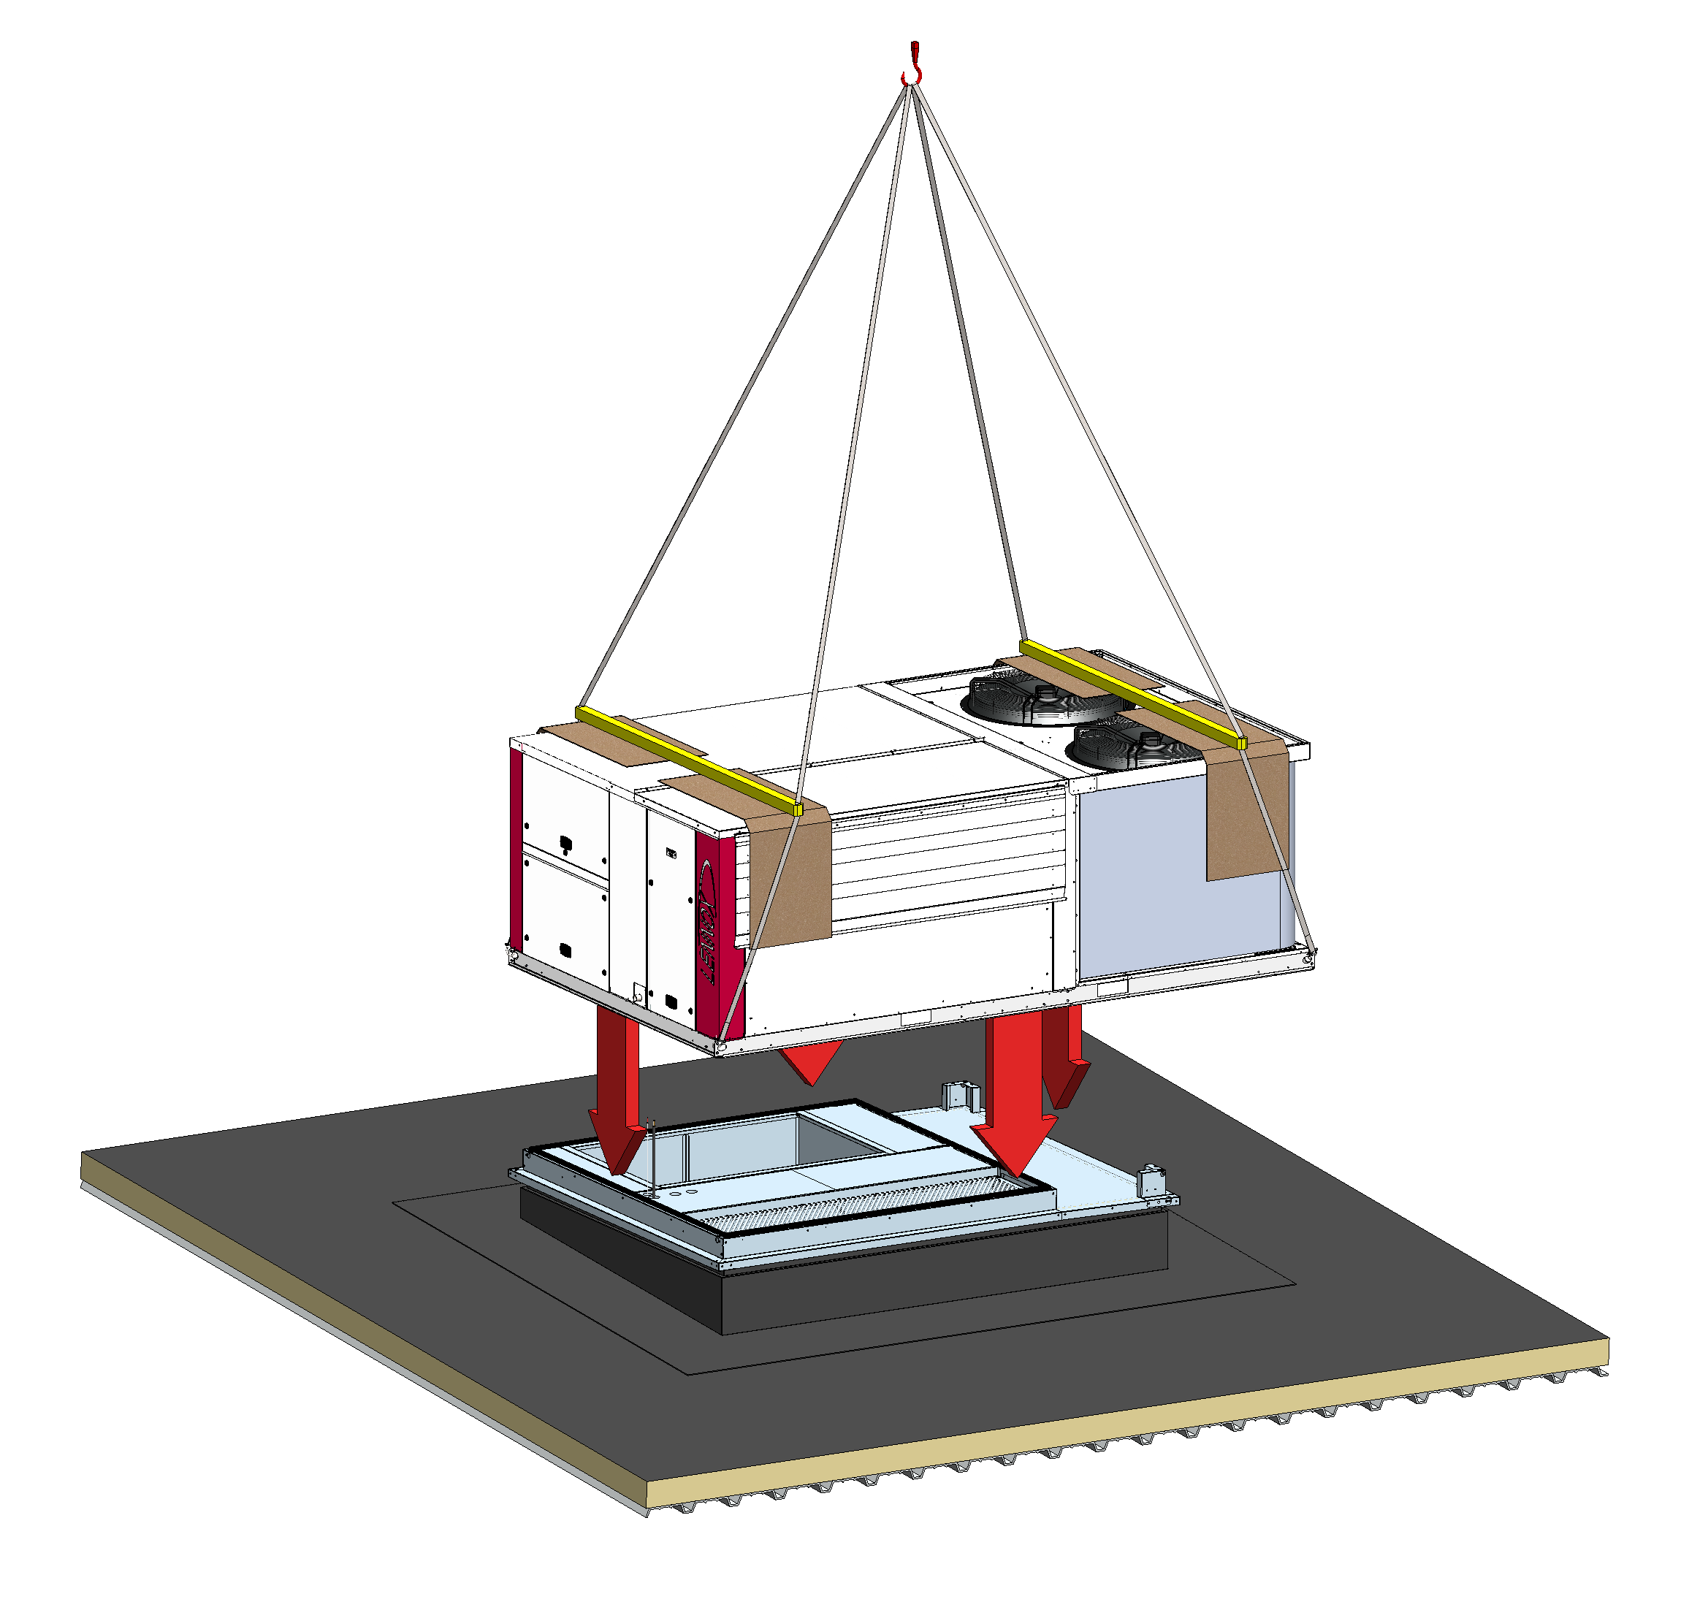
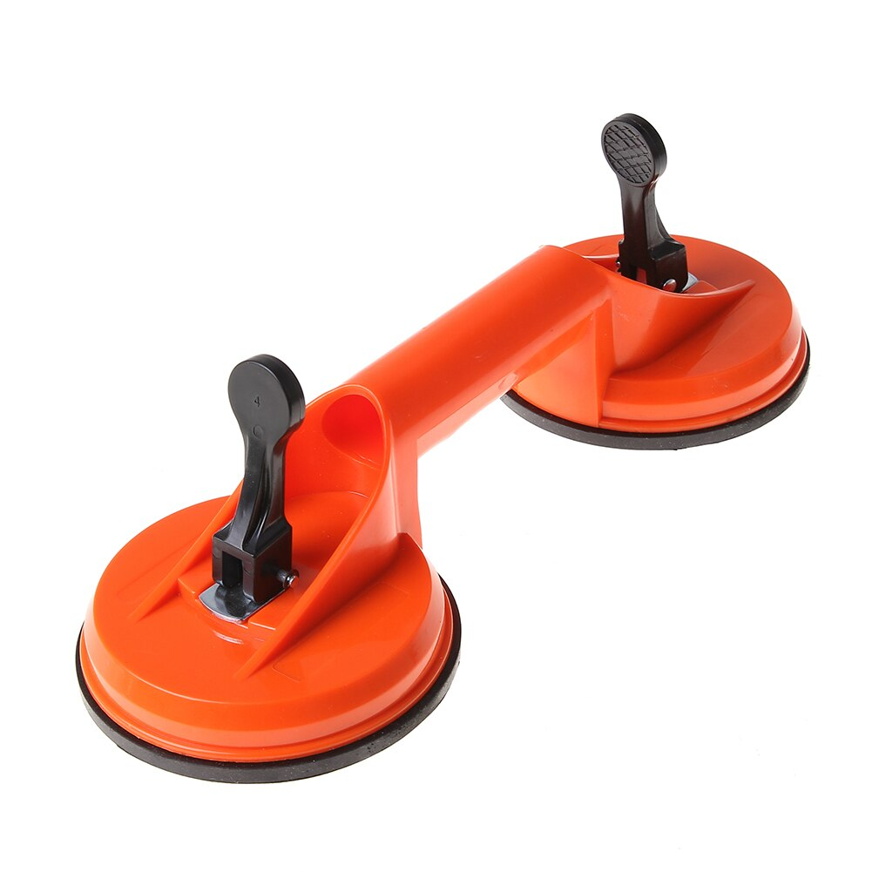
e-Baltic
ROOFTOP INSTALLATION
Move the unit to where it will be installed.
The crane operator and installer are on the roof and guiding the crane driver who has limited visibility.
Suction cup handles must be used to handle the unit and position it on the roof curb.

Slide 41
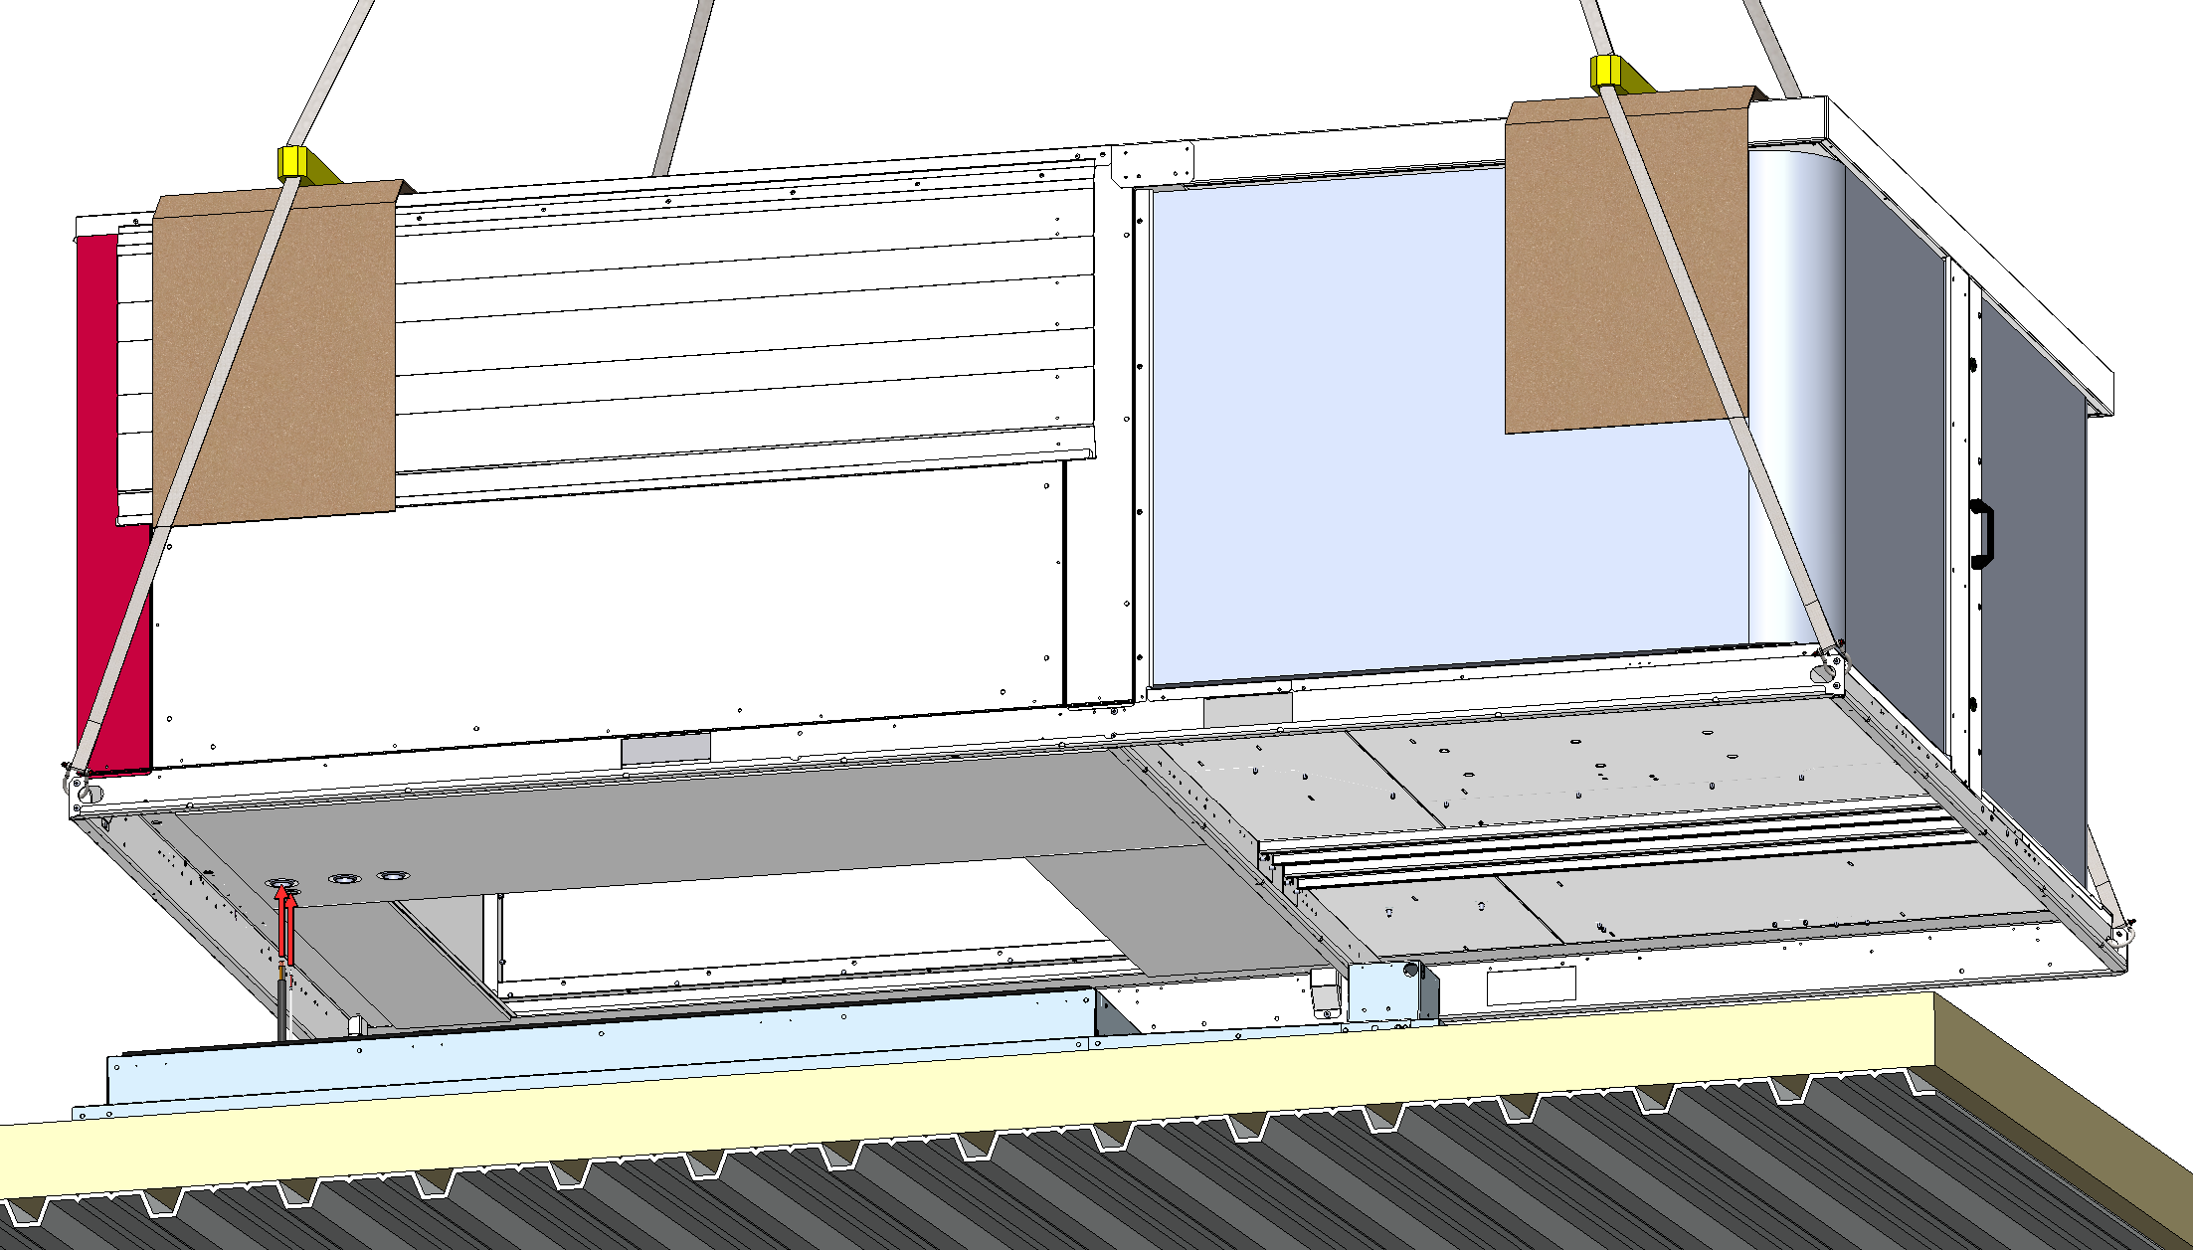
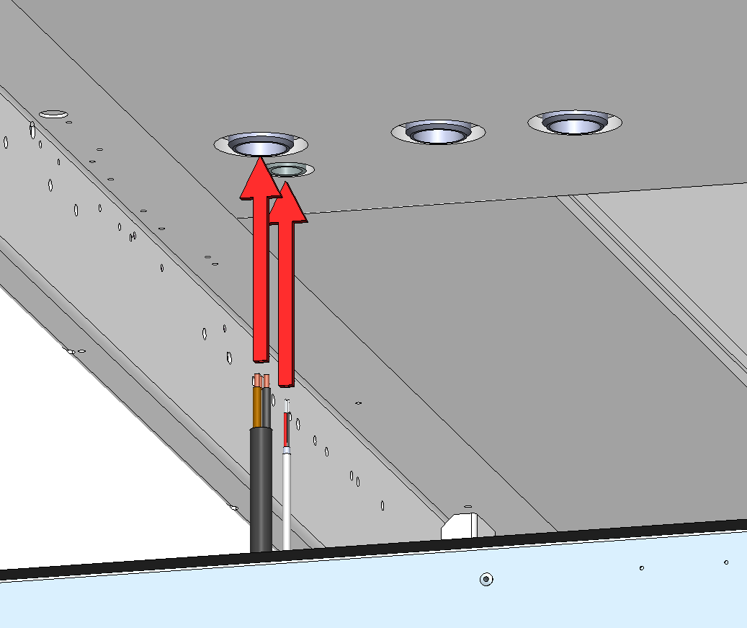
e-Baltic
ROOFTOP INSTALLATION
Pull the wiring harness (power supply and communication wires) through the rooftop base.

Slide 42
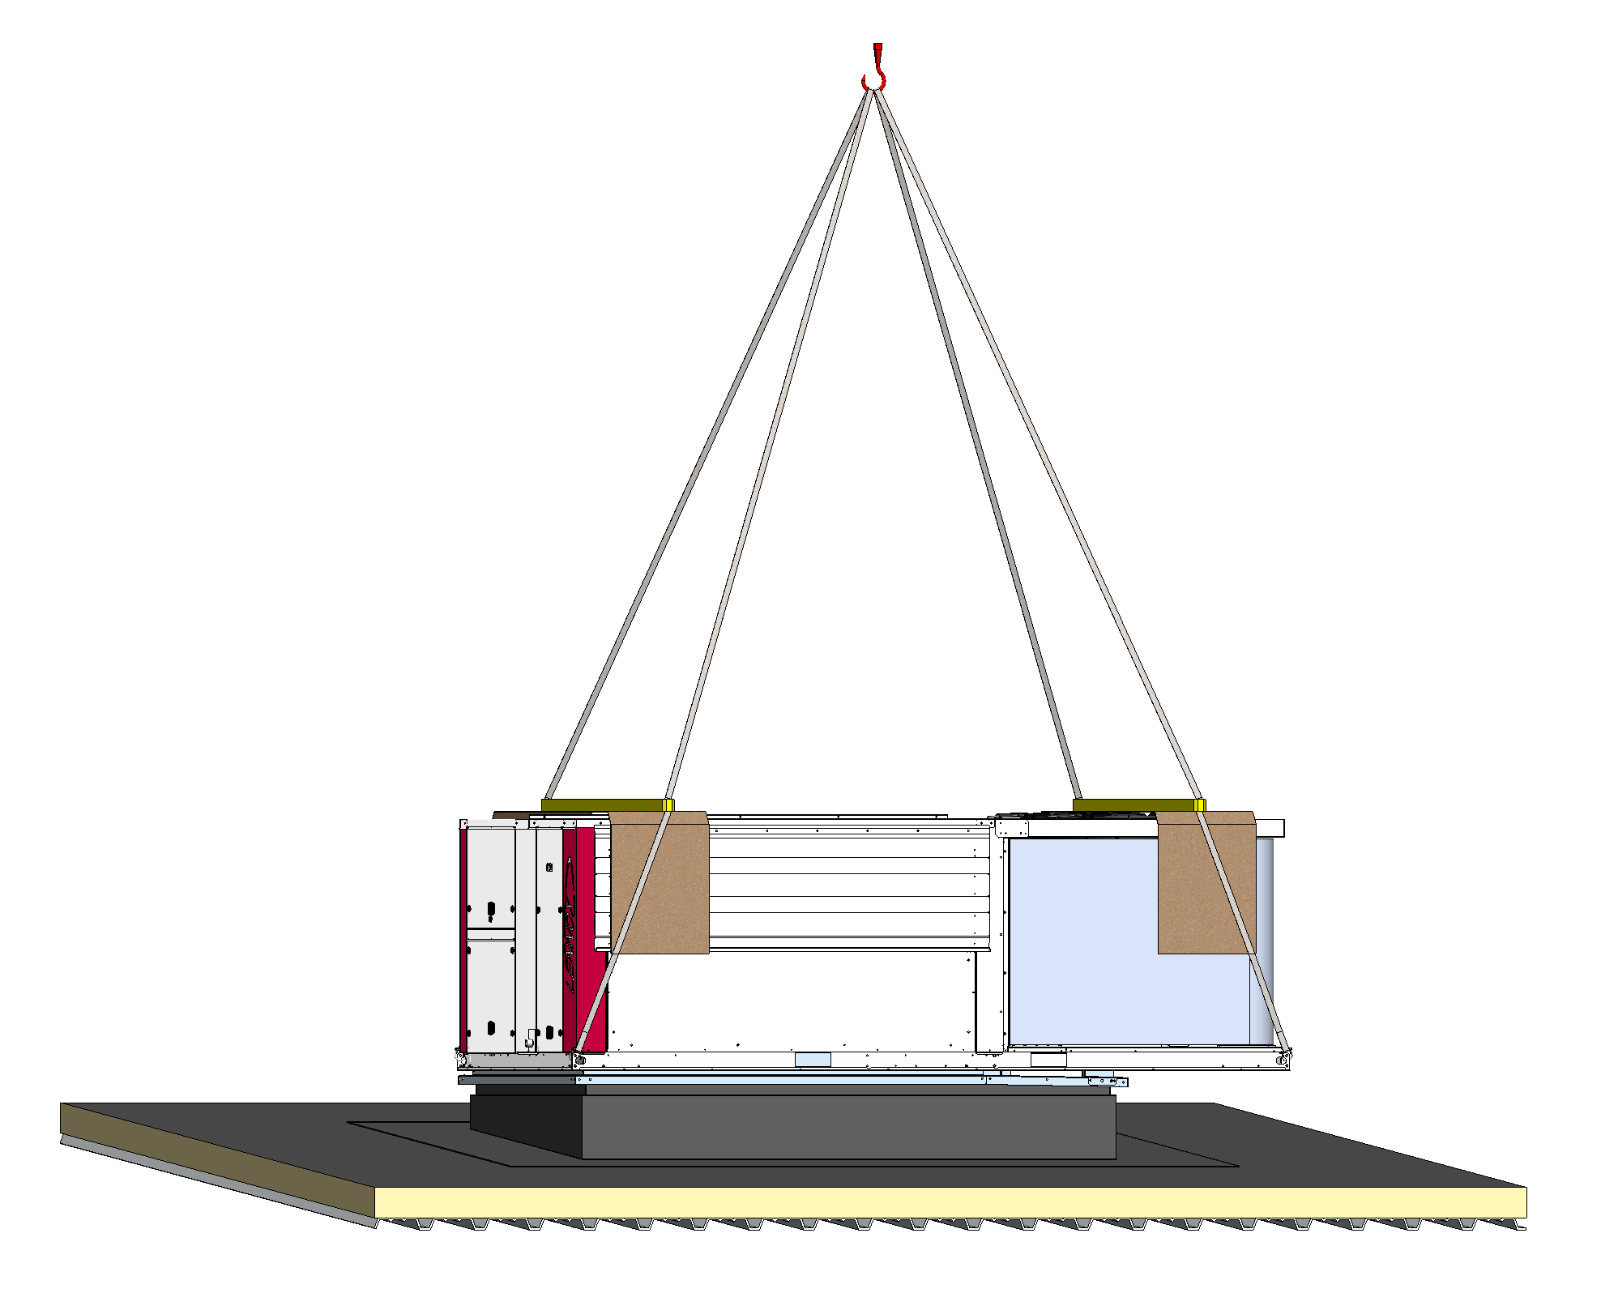
e-Baltic
ROOFTOP INSTALLATION
Carefully position the unit above the roof curb and remove the lifting cables and shackles.
Make sure the load is evenly distributed when positioning the rooftop above the roof curb.

Slide 43
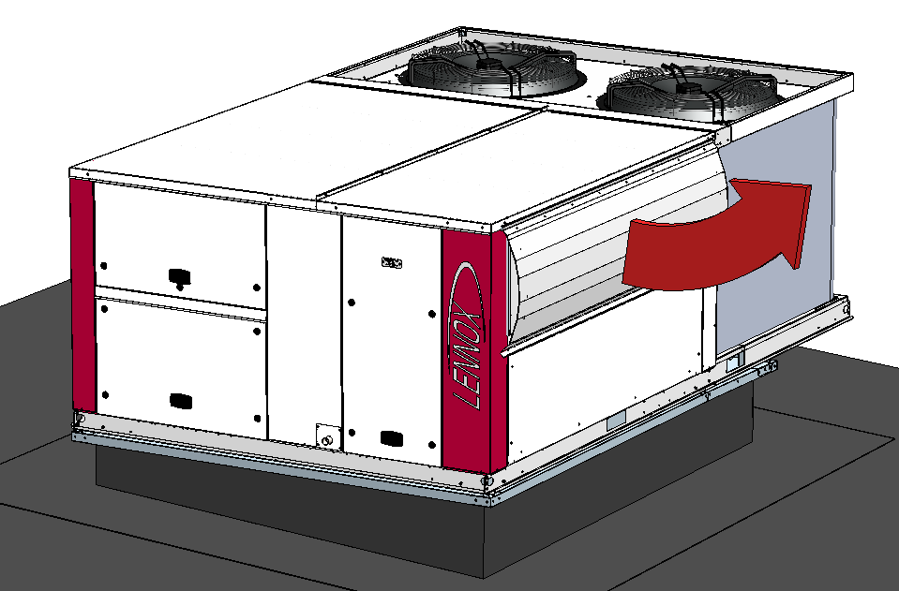


e-Baltic
ROOFTOP INSTALLATION
The fresh air hood has to be opened and secured during start-up.
It is delivered closed to avoid damage during transportation.
Raise the fresh air hood.

Slide 44


e-Baltic
ROOFTOP INSTALLATION
The fresh air hood has to be opened and secured during start-up.
It is delivered closed to avoid damage during transportation.
Raise the fresh air hood.
Unfold both lateral plates.

Slide 45

e-Baltic
ROOFTOP INSTALLATION
The fresh air hood has to be opened and secured during start-up.
It is delivered closed to avoid damage during transportation.
Raise the fresh air hood.
Unfold both lateral plates.
Check the proper position of the black seal on the top of the hood cover and fix the hood to both lateral plates with self-taping screws (delivered in the spare part box).

Slide 46



e-Baltic
ROOFTOP INSTALLATION
Make sure the drainage provided for the condensate is installed and tightened with a hose clamp.

Slide 47
e-Baltic
Rooftop wiring process

Slide 48


e-Baltic
ROOFTOP WIRING PROCESS
Open the 2 indicated doors.

Slide 49


e-Baltic
ROOFTOP WIRING PROCESS
Remove the indicated metal plate from the rooftop.

Slide 50



e-Baltic
ROOFTOP WIRING PROCESS
Drill the plate to the diameter of the cable glands.
It is recommended to only use one cable per cable gland.
Place the cable glands on the plate.
POWER CABLE
COMMUNICATION CABLE

Slide 51


e-Baltic
ROOFTOP WIRING PROCESS
Pass both cables through the glands and reposition the plate.

Slide 52

e-Baltic
ROOFTOP WIRING PROCESS
1
Detail of the cables coming from the roof curb and passing through the plate.
2

Slide 53

e-Baltic
ROOFTOP WIRING PROCESS
Pull the Communication Cable through the cable gland, to the rooftop’s control cabinet.

Slide 54


e-Baltic
ROOFTOP WIRING PROCESS
On the control cabiet, connect the Communication Cable to the eCLIMATIC control.

Slide 55

e-Baltic
ROOFTOP WIRING PROCESS
BMS card connection for Building Automation system (LonWorks / BacNet / ModBus).
J14 port for master-slave communication between units

Slide 56


e-Baltic
ROOFTOP WIRING PROCESS
Separate the internal wires of the Power Cable and pull them through the 3 phases relay.
Pull the 3 Power Wires through the oblong cable gland, to the rooftop’s control cabinet.

Slide 57


e-Baltic
ROOFTOP WIRING PROCESS
Connect the 3 Power Wires below the power box of the electrical panel.

Slide 58
e-Baltic
Ductwork installation

Slide 59

e-Baltic
DUCKWORK INSTALLATION
Install the air ducts on the supply and return ports of the roof curb.
Make sure to install the ducts on the ROOF CURB, not on the ceiling beams.
SUPPLY DUCT

Slide 60

e-Baltic
DUCKWORK INSTALLATION
Install the air ducts on the supply and return ports of the roof curb.
Make sure to install the ducts on the ROOF CURB, not on the ceiling beams.
SUPPLY DUCT

Slide 61

e-Baltic
DUCKWORK INSTALLATION
Install the air ducts on the supply and return ports of the roof curb.
Make sure to install the ducts on the ROOF CURB, not on the ceiling beams.
RETURN DUCT

Slide 62

e-Baltic
DUCKWORK INSTALLATION
Install the air ducts on the supply and return ports of the roof curb.
Make sure to install the ducts on the ROOF CURB, not on the ceiling beams.
SUPPLY DUCT
RETURN DUCT

Slide 63

e-Baltic
DUCKWORK INSTALLATION
Install the air ducts on the supply and return ports of the roof curb.
Make sure to install the ducts on the ROOF CURB, not on the ceiling beams.
RETURN DUCTS
SUPPLY DUCTS

Slide 64
e-Baltic
Start Up

Slide 65

e-Baltic
START-UP
The unit is pre-loaded with refrigerant from factory
The unit is 100% factory pre-tested
A certified Lennox-trained technician will:
  check the unit’s settings, components, and controls
  perform a refrigerant leak test
  and validate the warranty
The unit can be connected to LennoxCloud ensuring 24/7 monitoring and control
Power must be on 24 hours before intended start-up

Slide 66
DISCLAIMER

Slide 67
e-Baltic
DISCLAIMER
USE AT YOUR OWN RISK:
Only individuals with appropriate licenses, training, and qualifications can install or repair heating, ventilation, and air-conditioning equipment. As such, this manual is intended for only licensed, trained, and otherwise qualified individuals. Use this information at your own risk. Any injury, damage, or loss that may result from use of the tools, equipment, and products depicted, or the information and content contained in, this manual is the sole responsibility of the user.
NO WARRANTY:
This manual, and any information provided herein, is provided “AS IS.” Lennox does not make any specific representations or warranties about this manual or any instructions or guidance contained in this manual. For example, Lennox does not make any warranties about: (a) the content provided in this manual; (b) any specific features of this manual, or its accuracy, reliability, or ability to meet your needs. The information in this manual is subject to change without notice.
LIMITATION OF LIABILITY:
Lennox specifically DISCLAIMS LIABILITY FOR INCIDENTAL OR CONSEQUENTIAL DAMAGES and assumes no responsibility or liability for any loss or damage suffered by any person as a result of the use or misuse of any of the information or content on this manual. Lennox assumes or undertakes NO LIABILITY for any loss or damage suffered as a result of the use, misuse or reliance on the information and content on this manual.

Slide 68
THANK YOU!

