Slide 1
e-Baltic
RECOVERY MODULE
INSTALLATION PROCESS
PLATE HEAT EXCHANGER

Slide 2
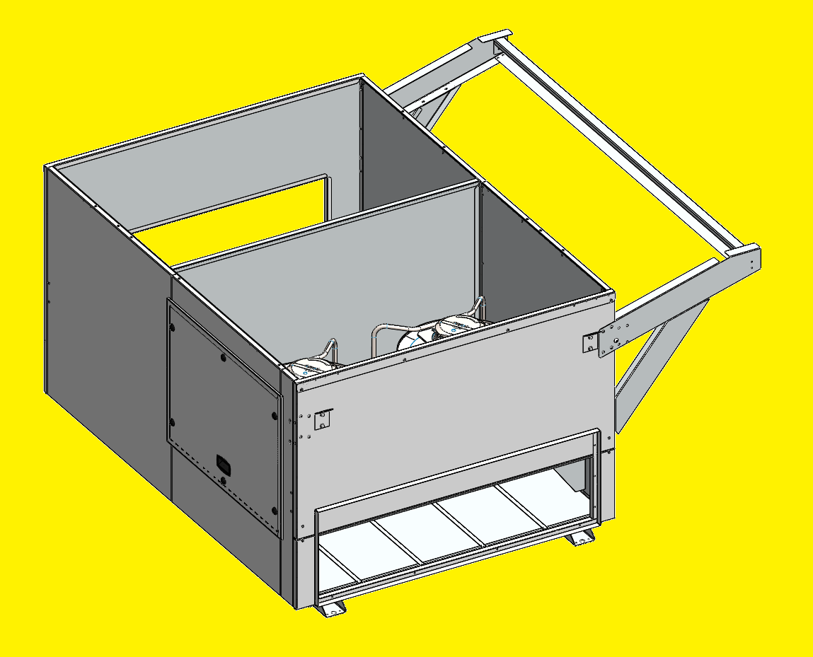
RECOVERY MODULE INSTALLATION
FLOW CURB
Make sure to install the Flow Curb in a flat and horizontal structure to avoid mechanical constraint during the installation process.
It must be fixed to the building structure

Slide 3
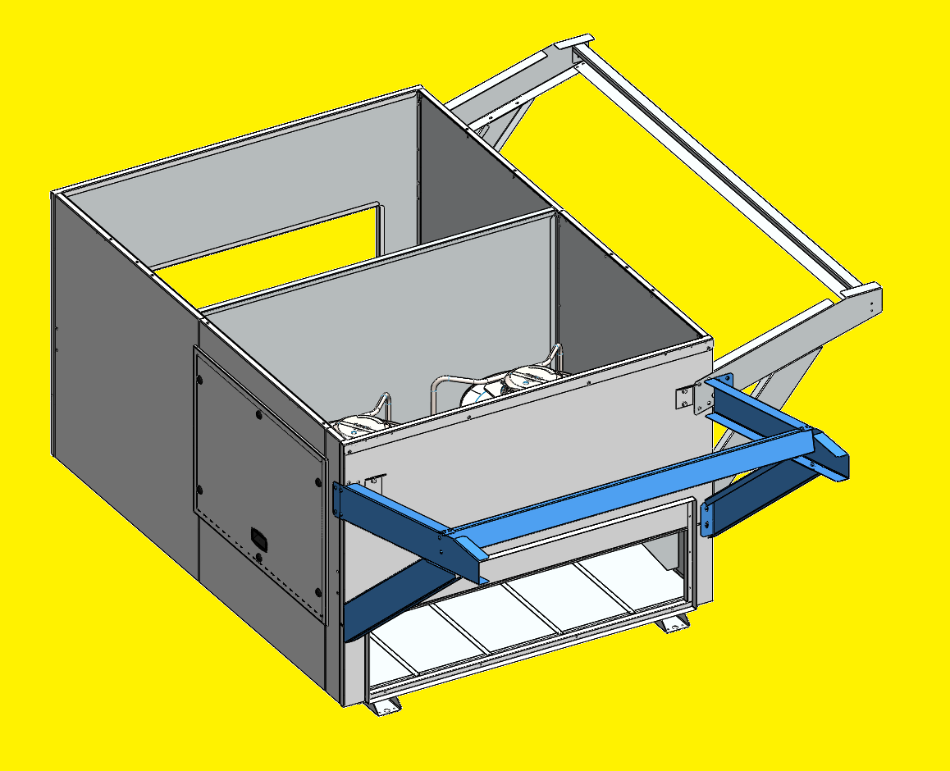
RECOVERY MODULE INSTALLATION
FLOW CURB
Once the Flow Curb is installed, fix the brackets (5 pieces) on the curb with 24 screws (6x16mm), before installing the rooftop.

Slide 4
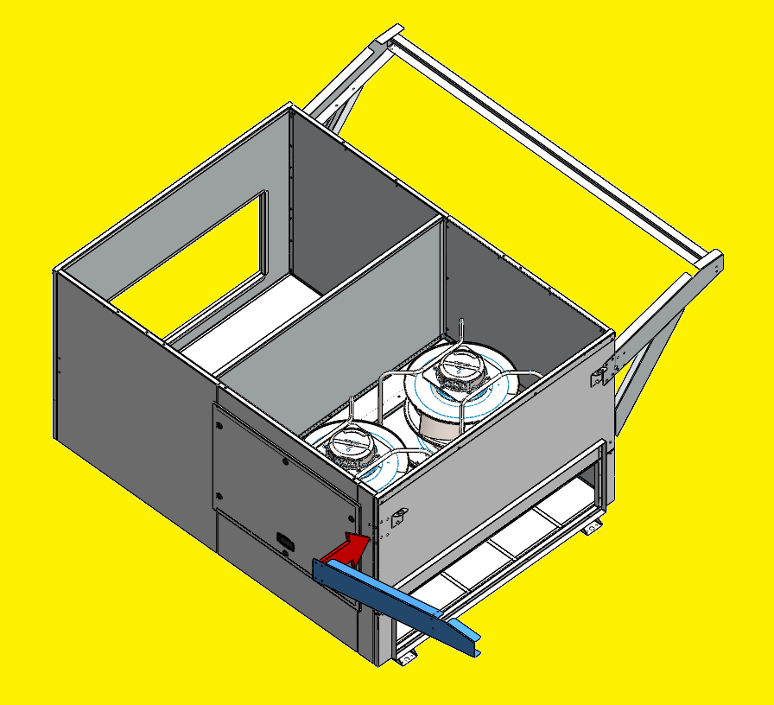
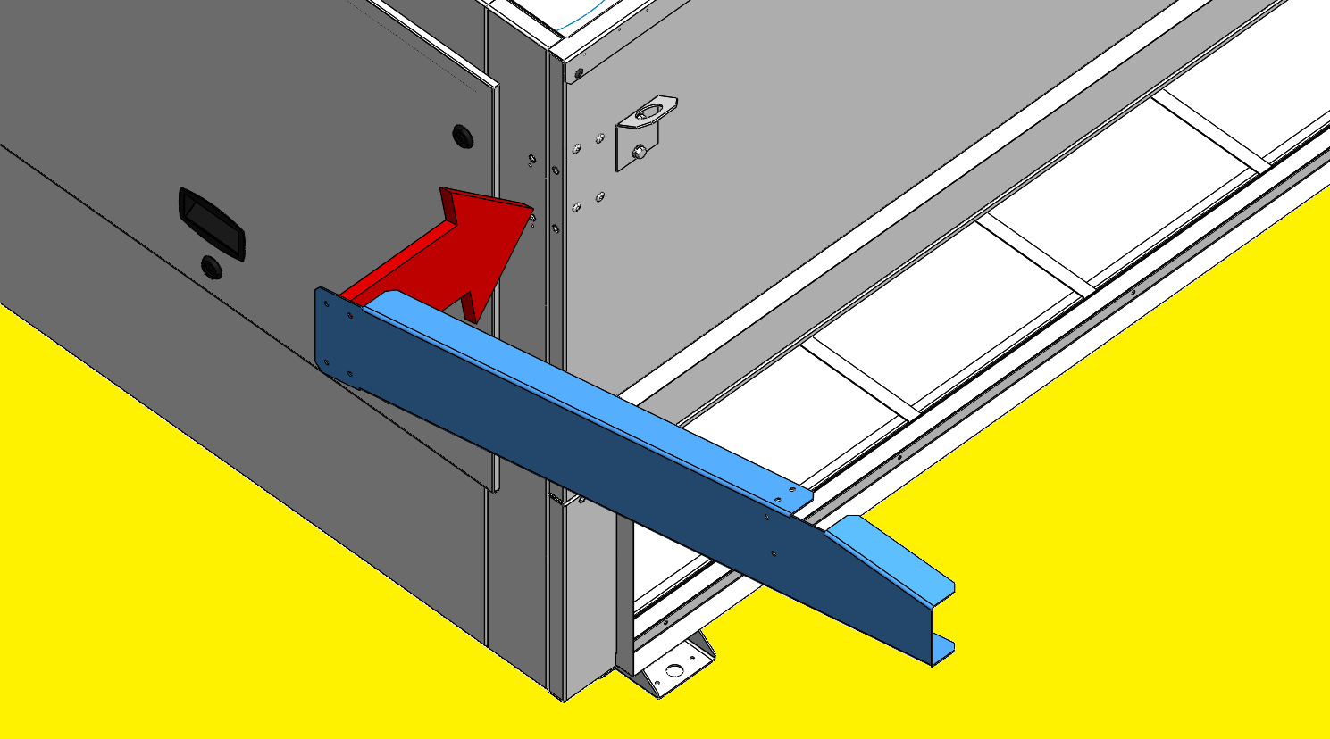
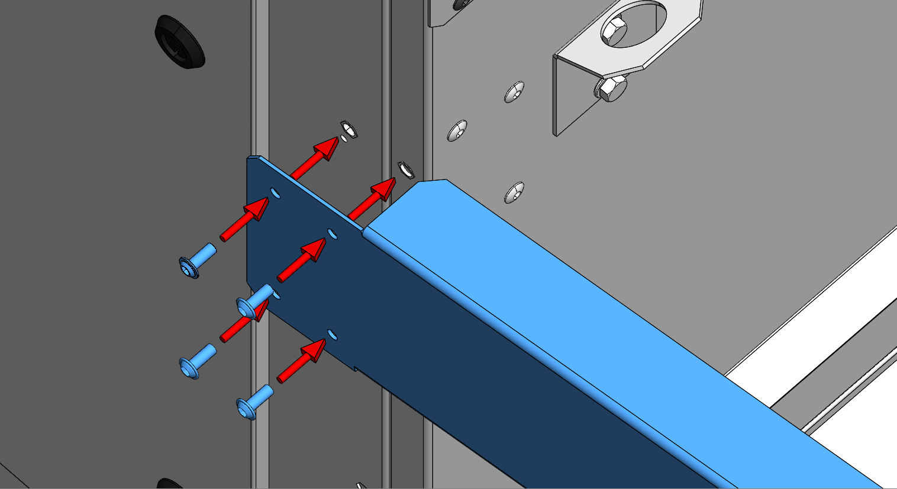
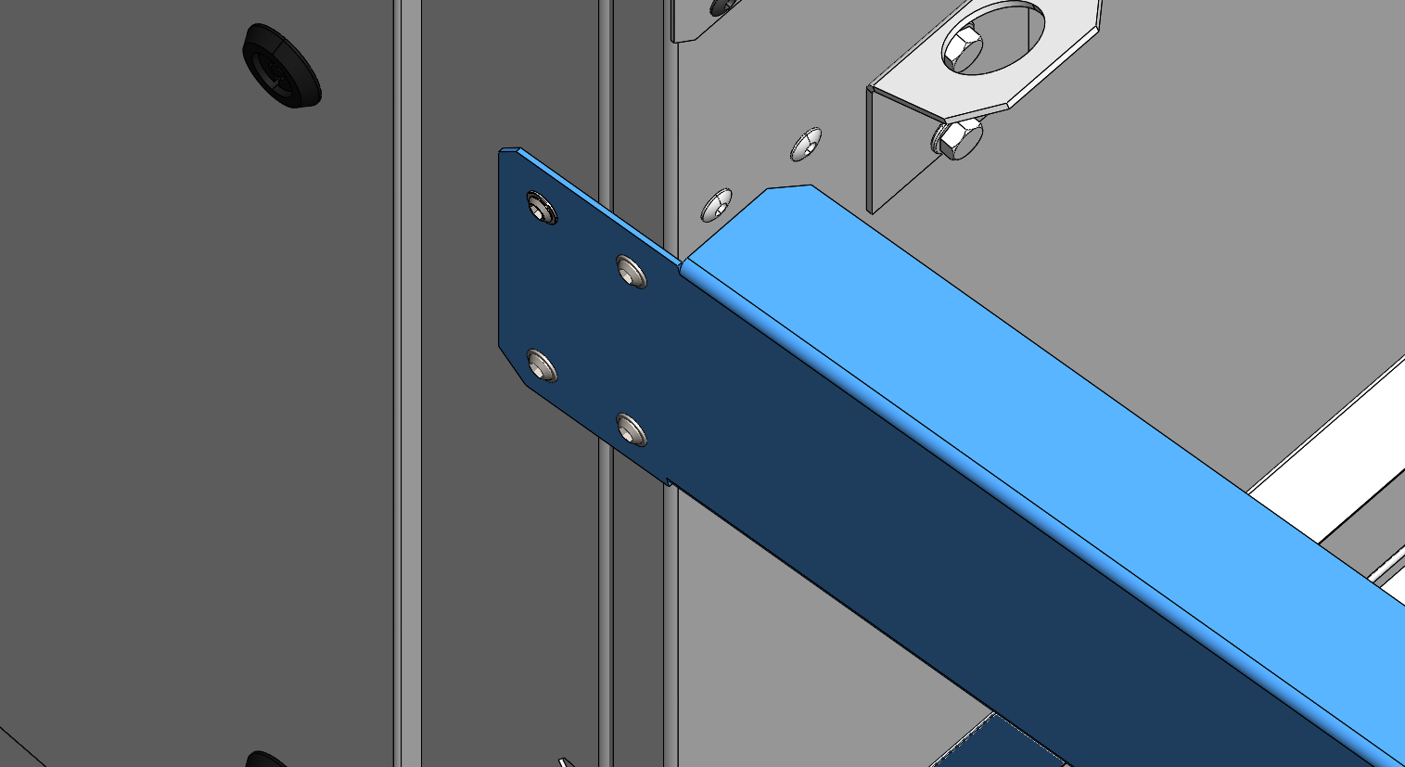
RECOVERY MODULE INSTALLATION
FLOW CURB
1st Bracket:
4 screws (6x16mm)

Slide 5
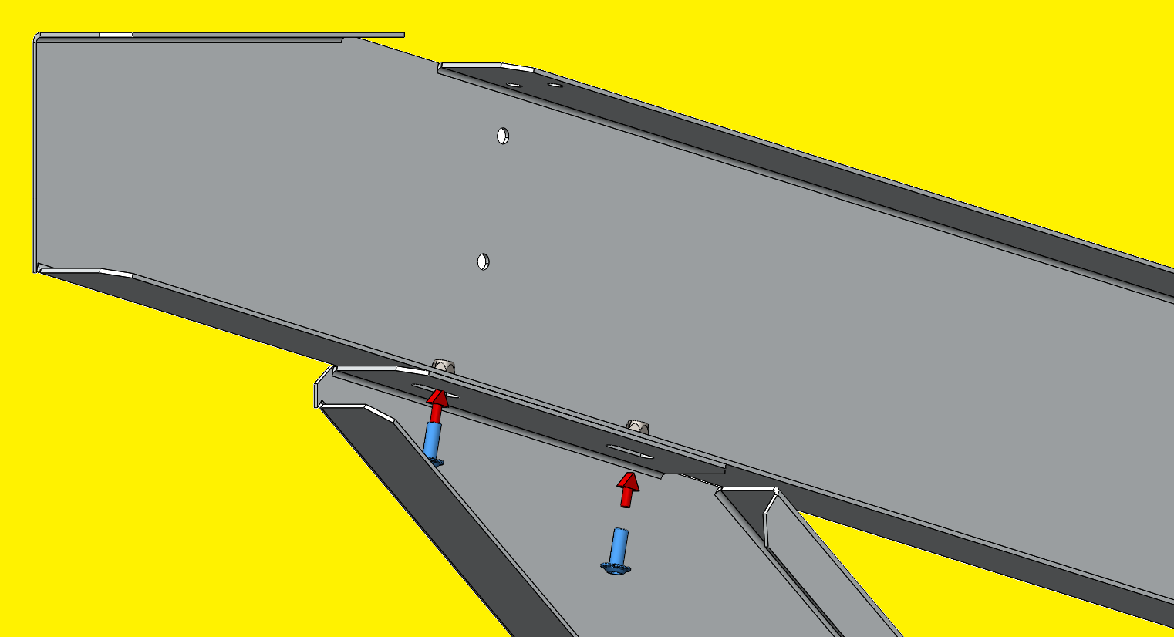
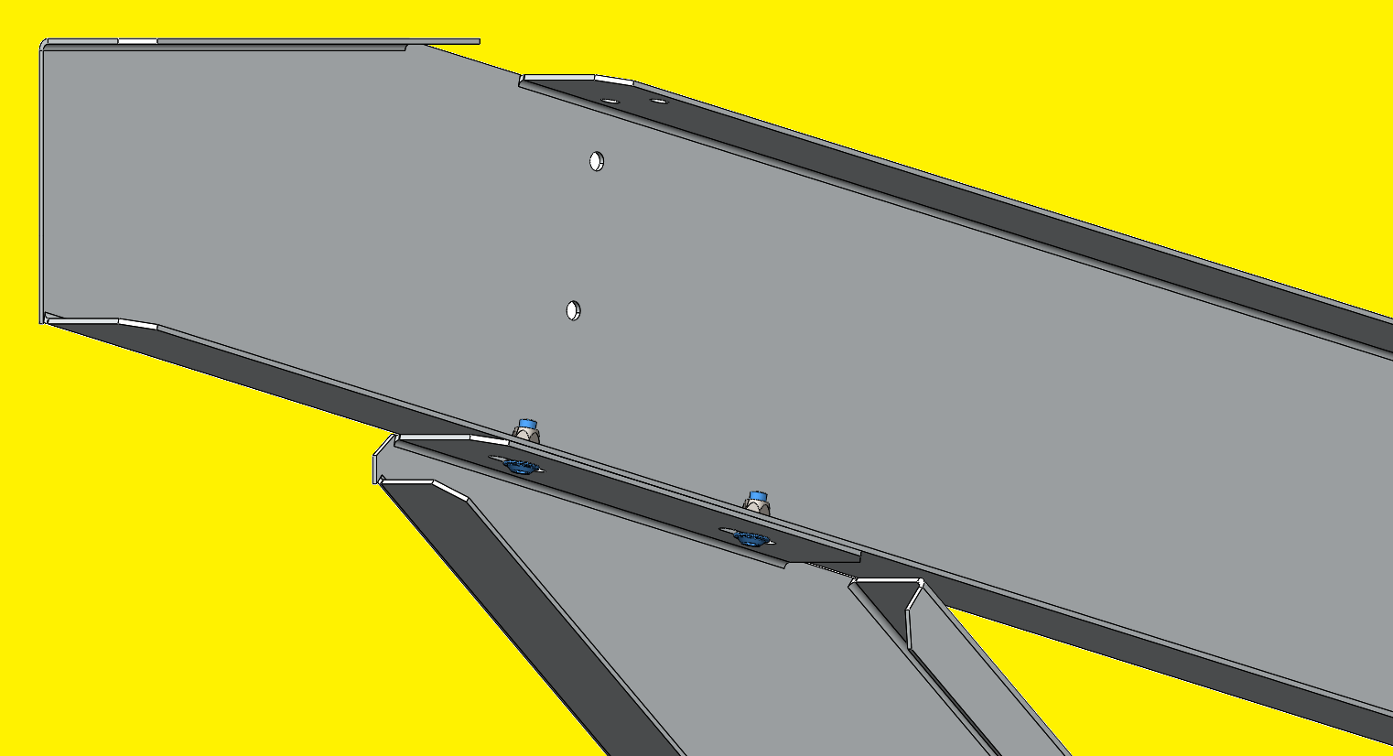
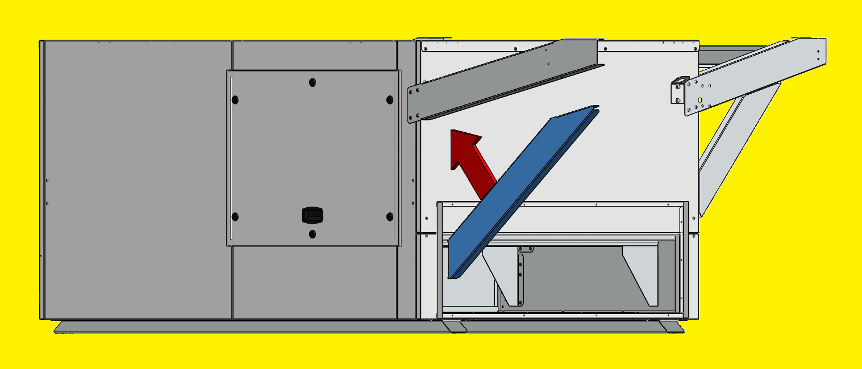
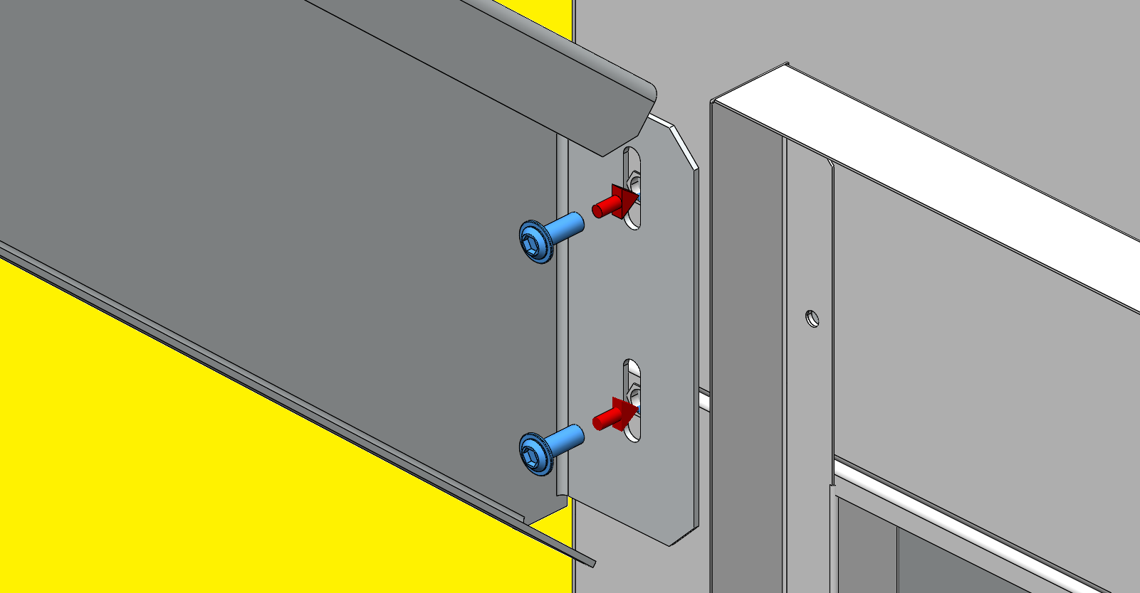
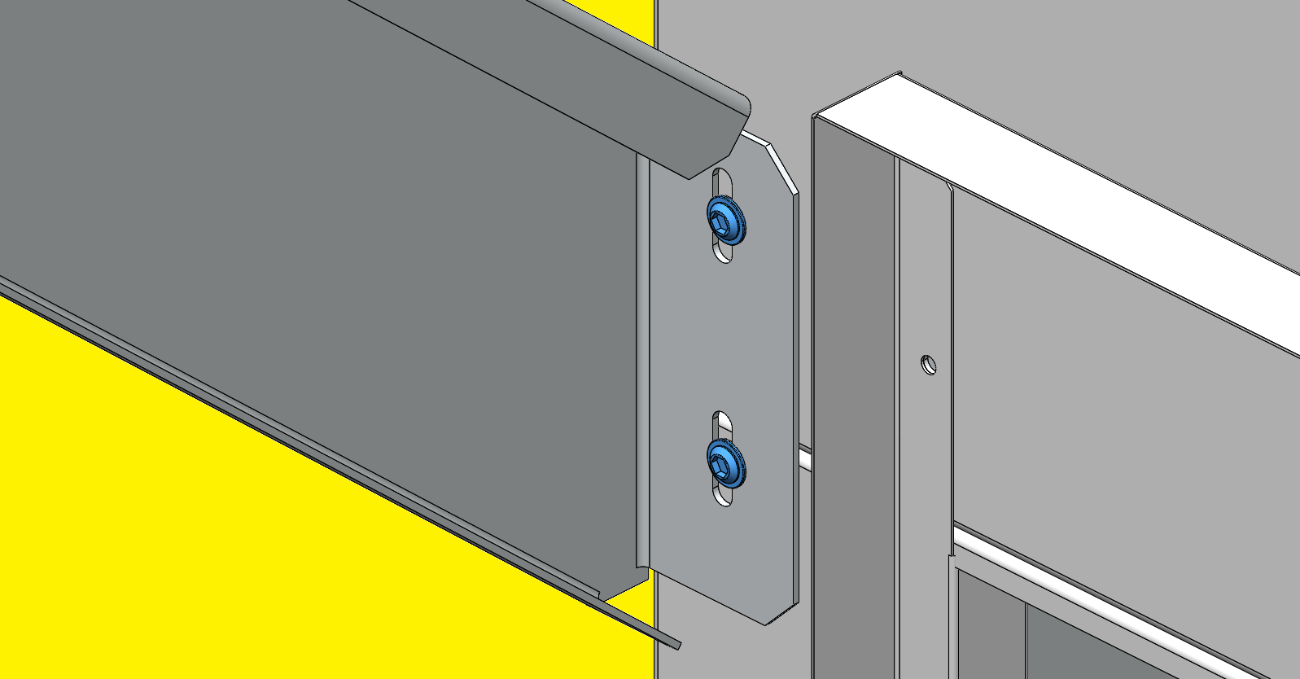
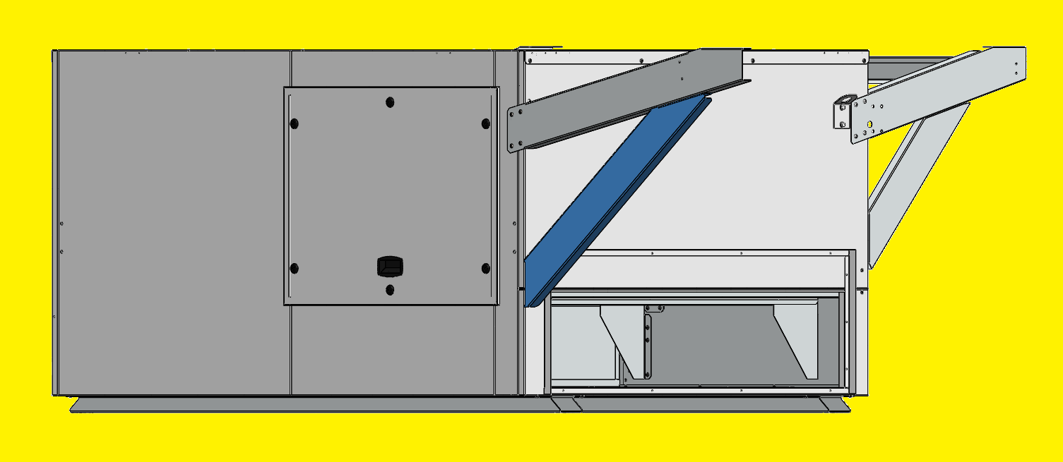
RECOVERY MODULE INSTALLATION
FLOW CURB
2nd Bracket:
4 screws (6x16mm)

Slide 6
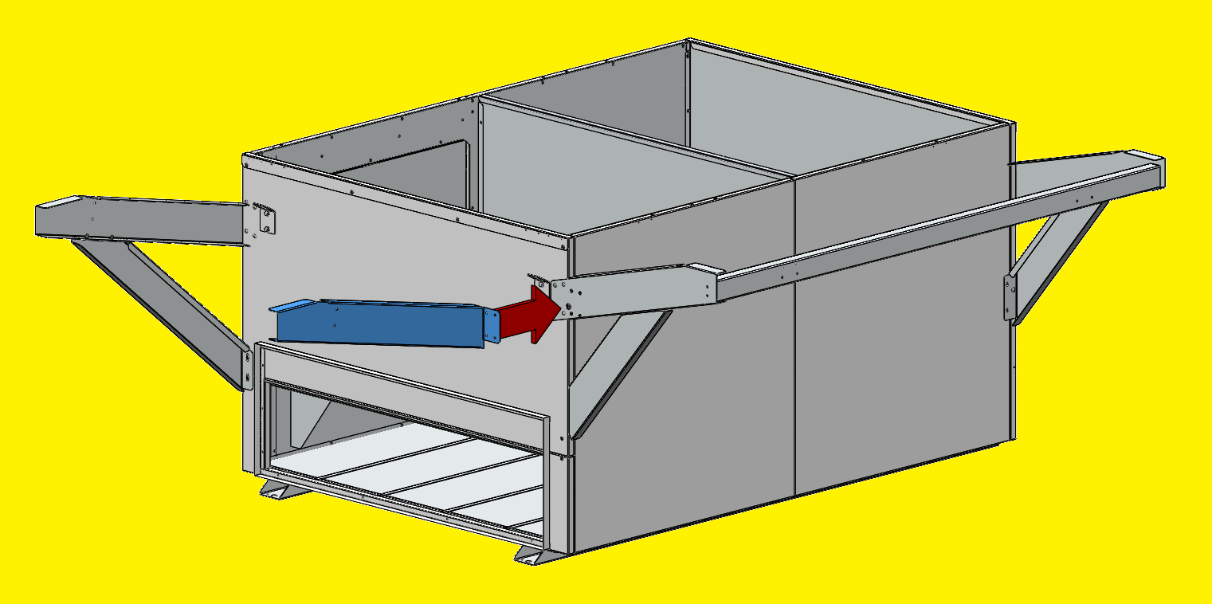
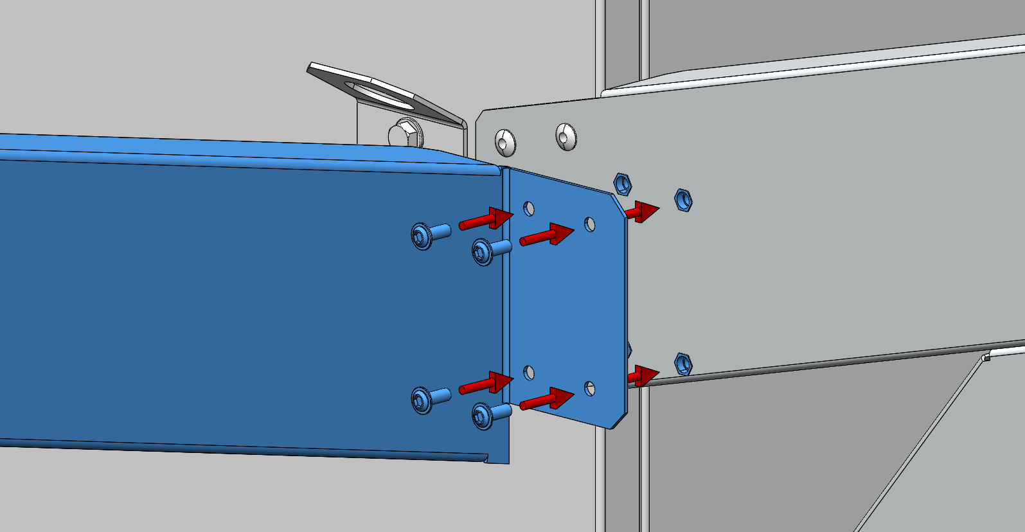
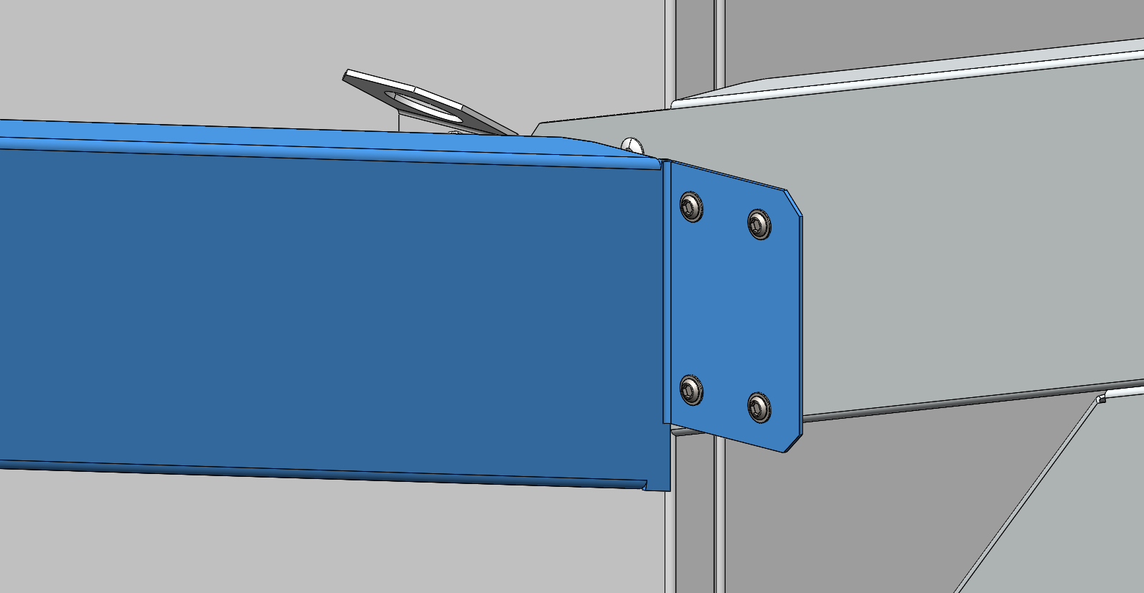
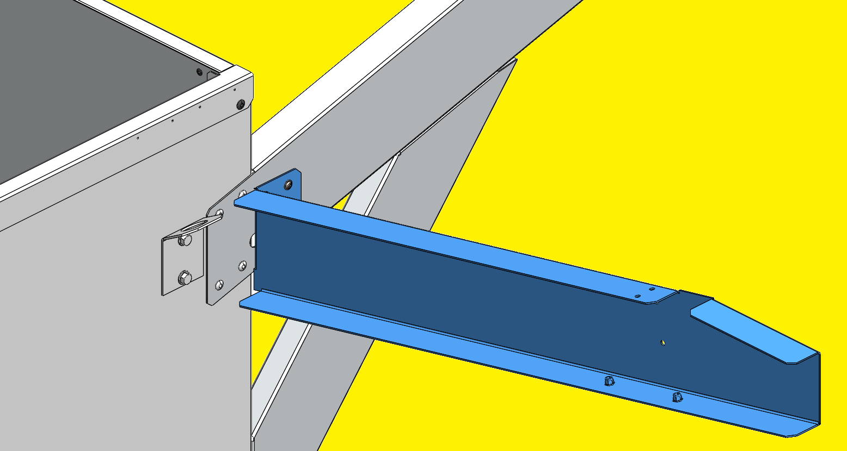
RECOVERY MODULE INSTALLATION
FLOW CURB
3rd Bracket:
4 screws (6x16mm)

Slide 7
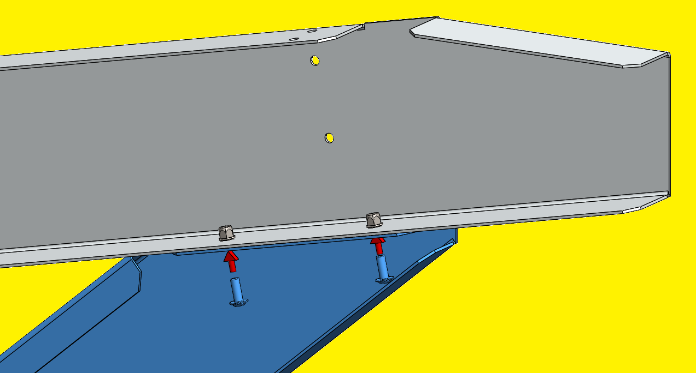

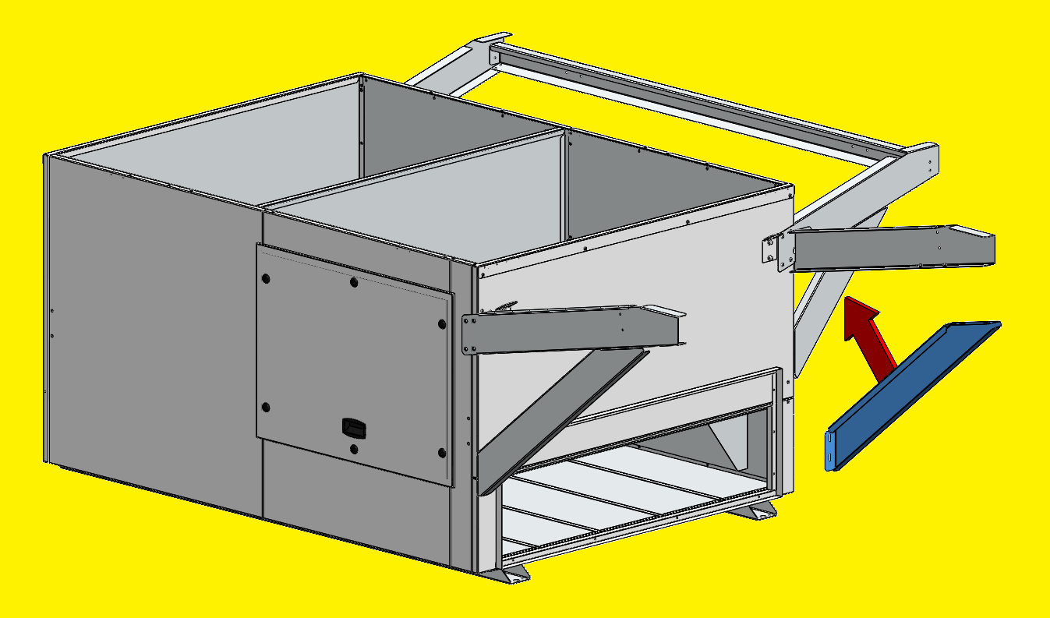
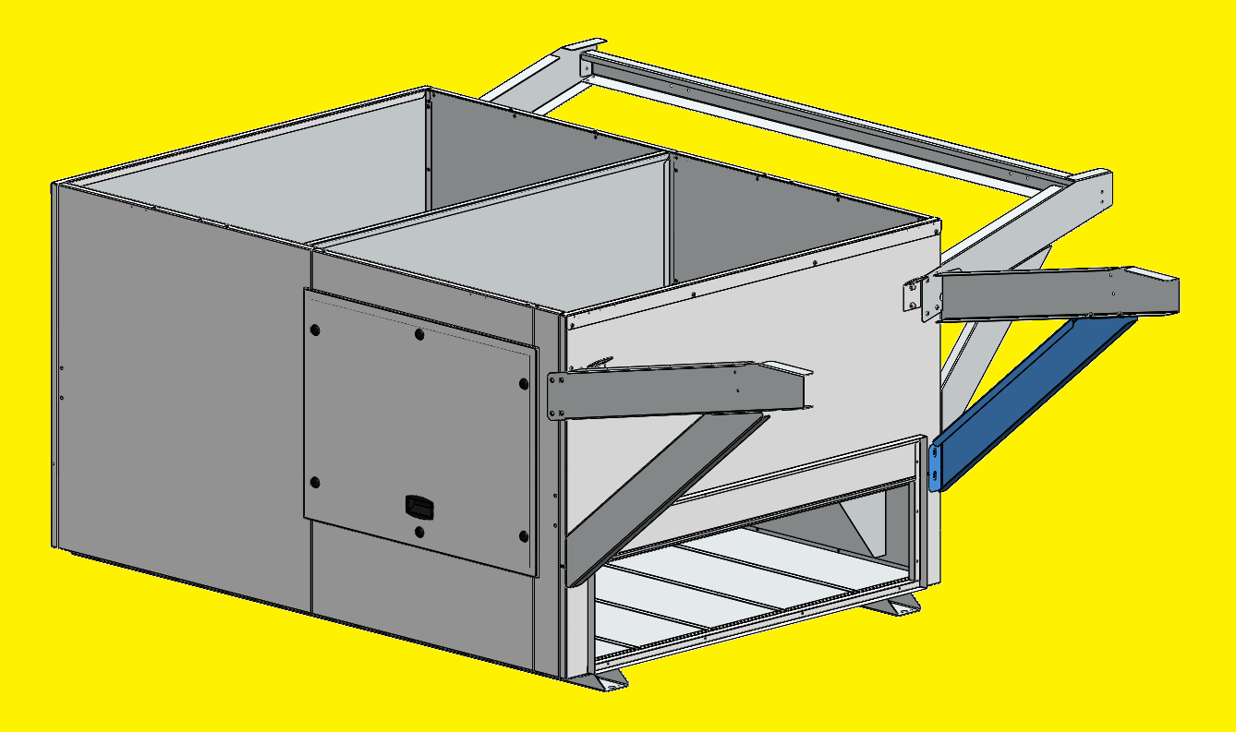
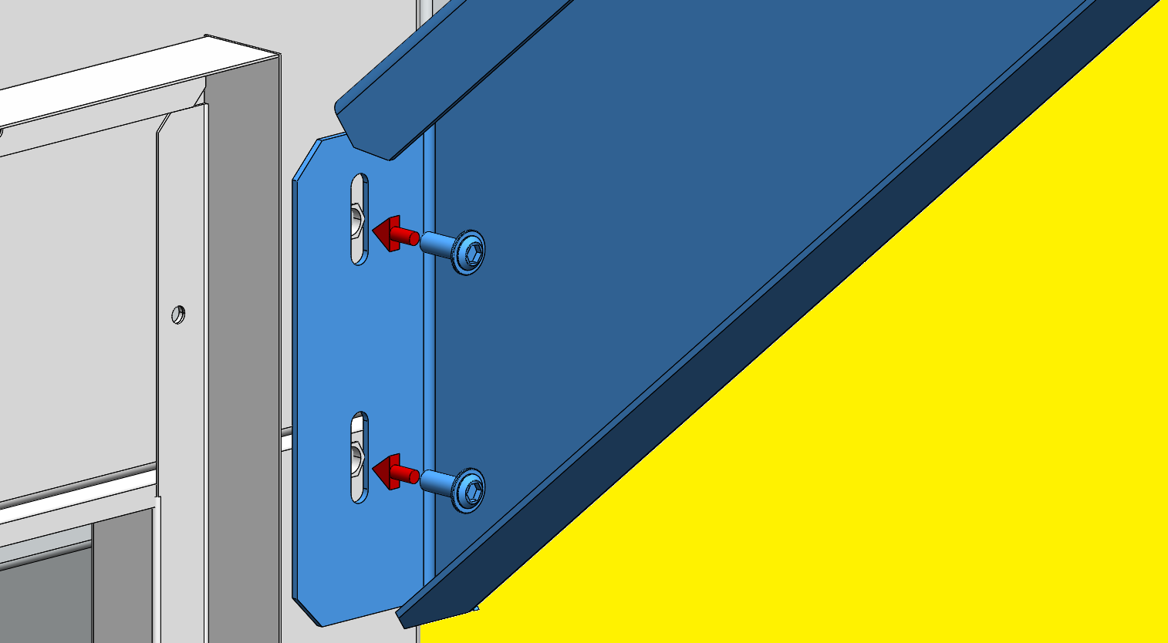
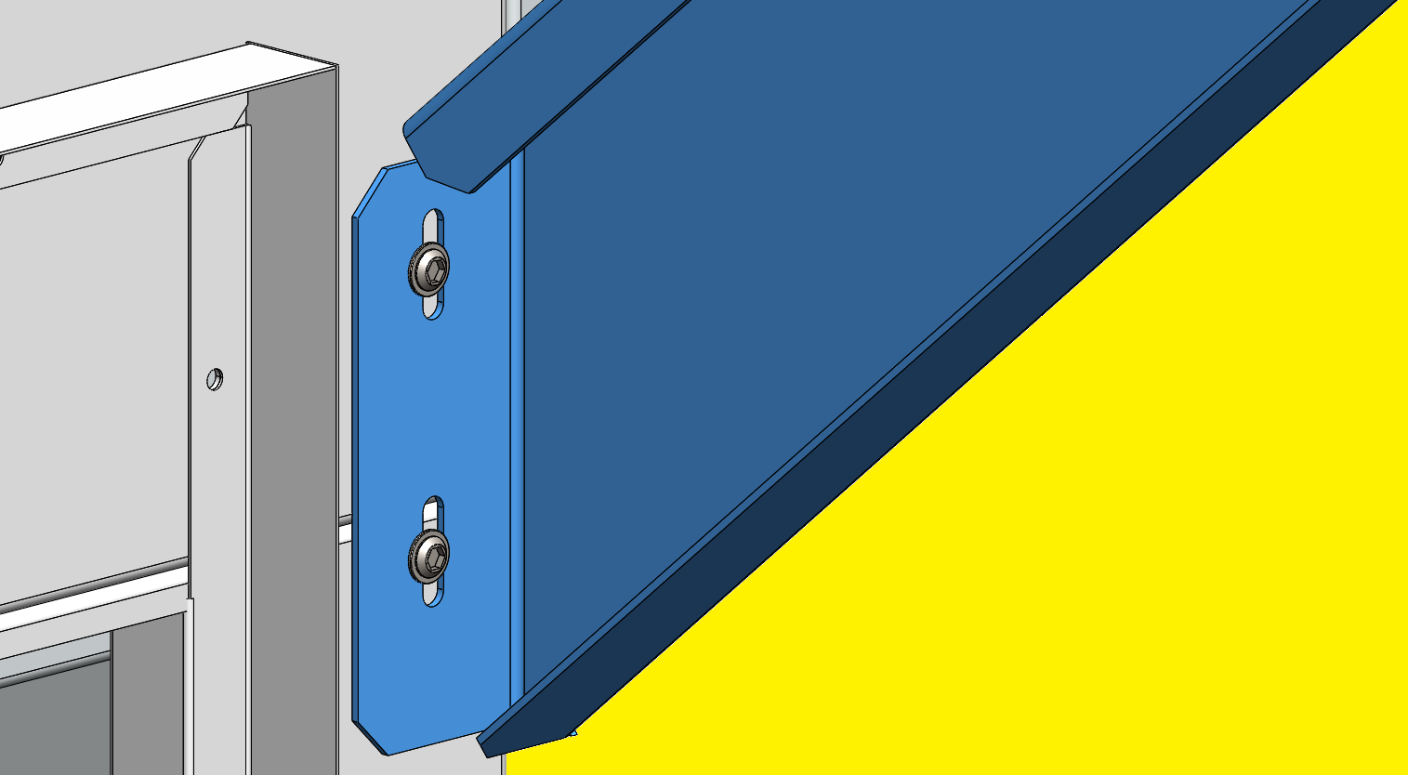
RECOVERY MODULE INSTALLATION
FLOW CURB
4th Bracket:
4 screws (6x16mm)

Slide 8
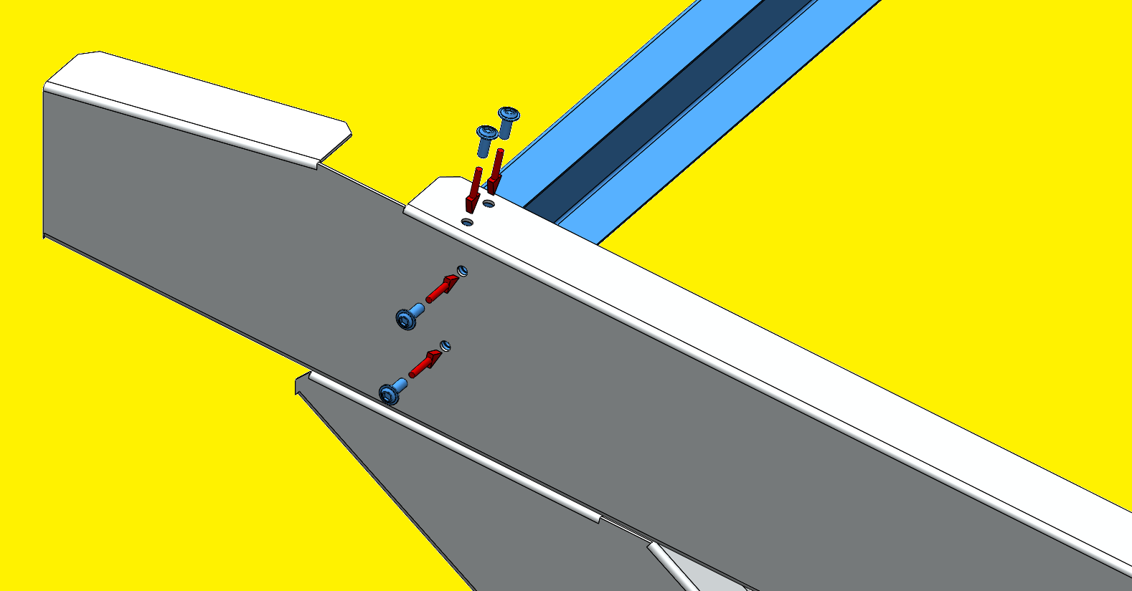
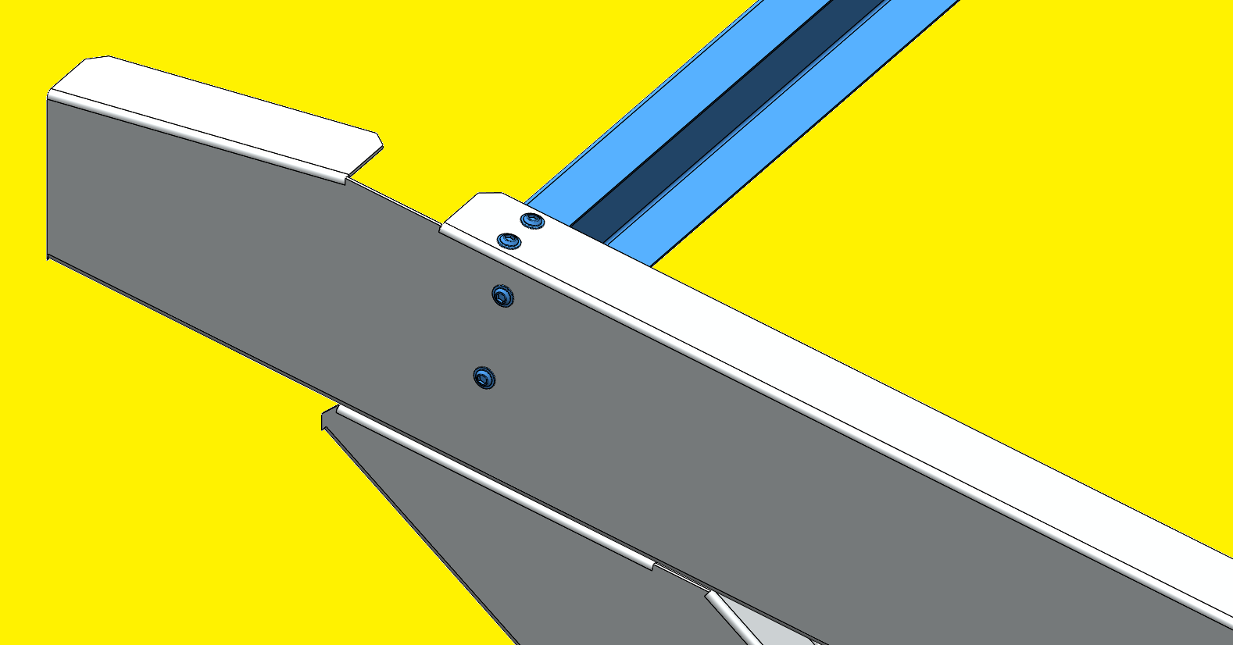
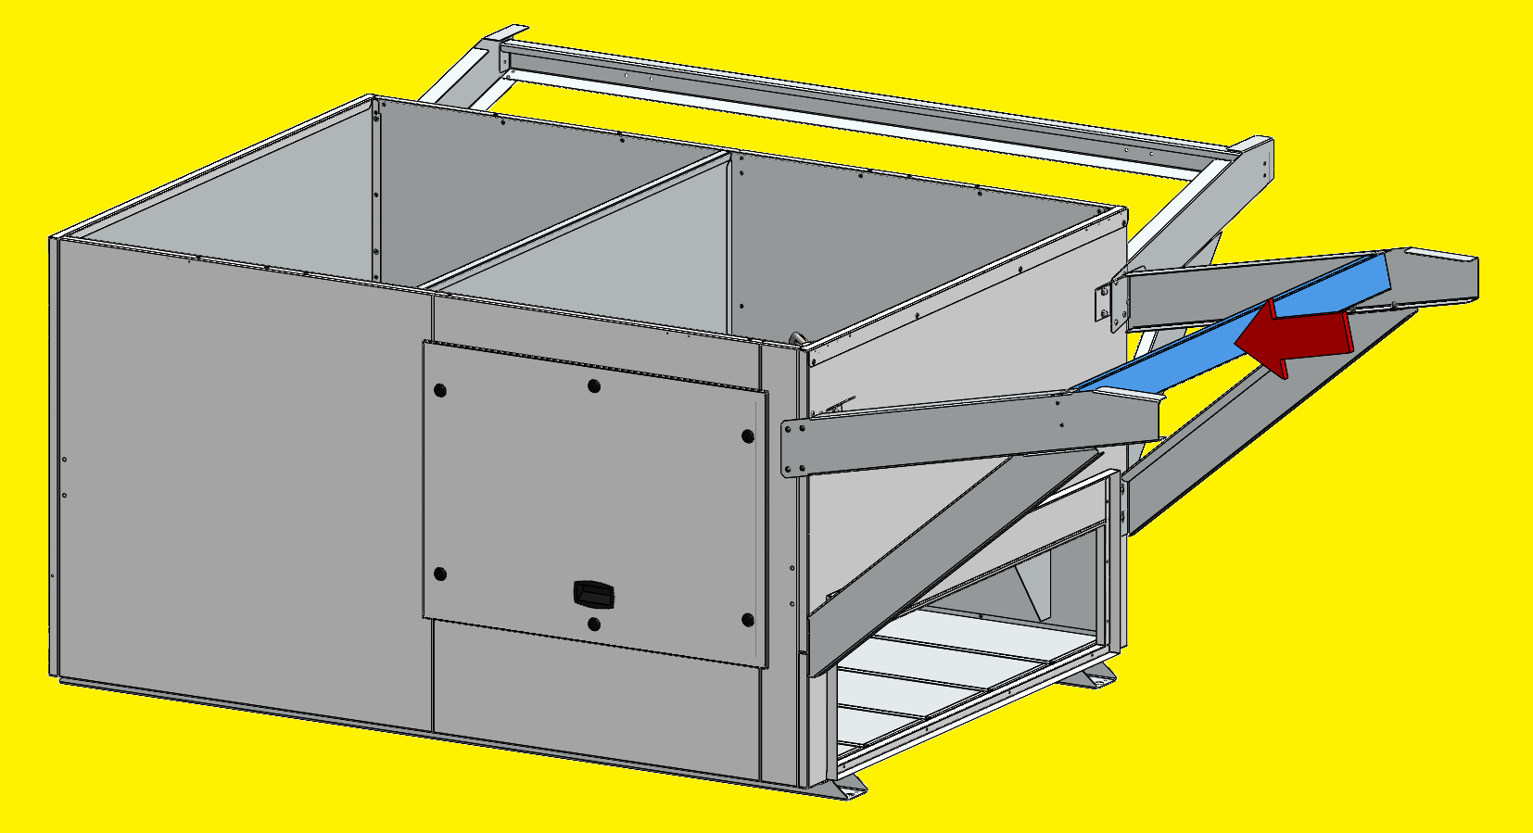
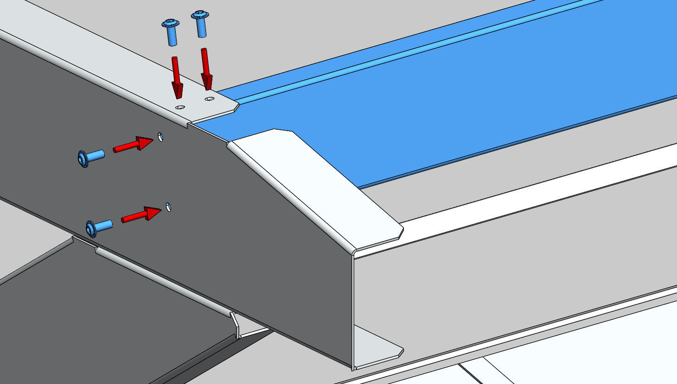
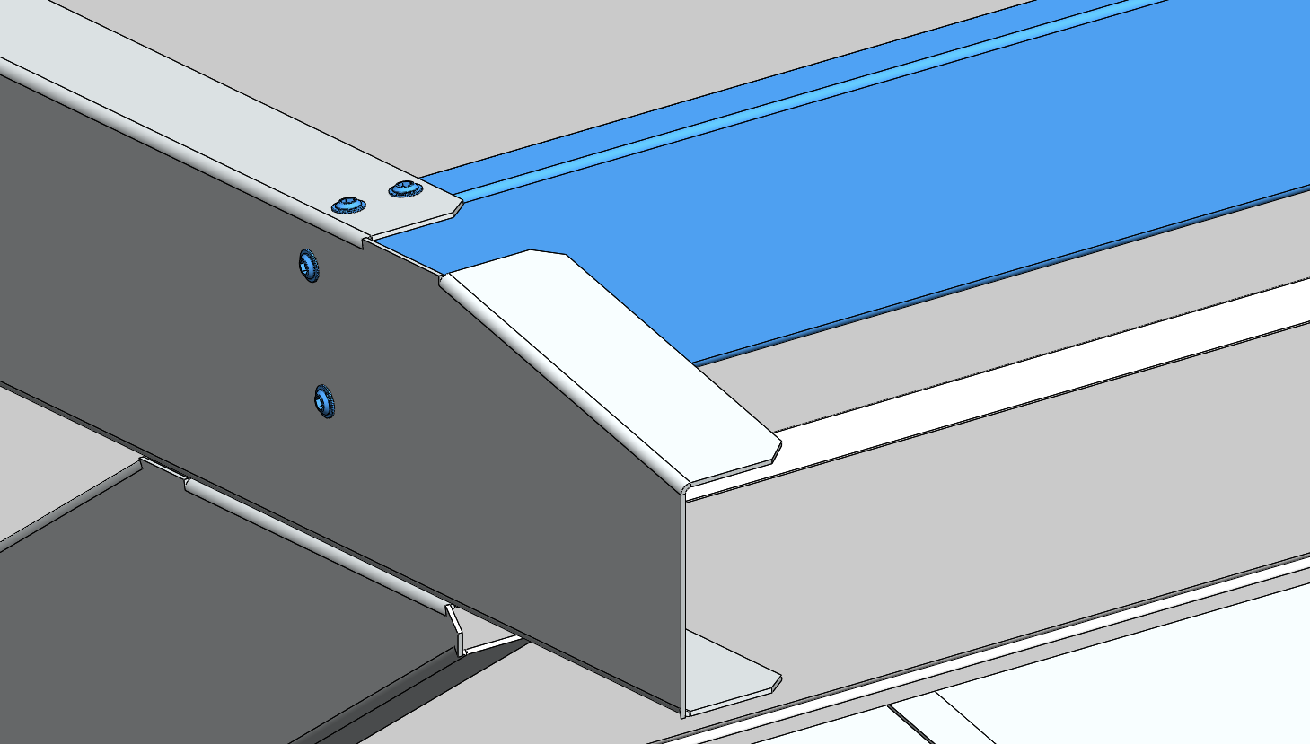
RECOVERY MODULE INSTALLATION
FLOW CURB
5th Bracket:
8 screws (6x16mm)

Slide 9
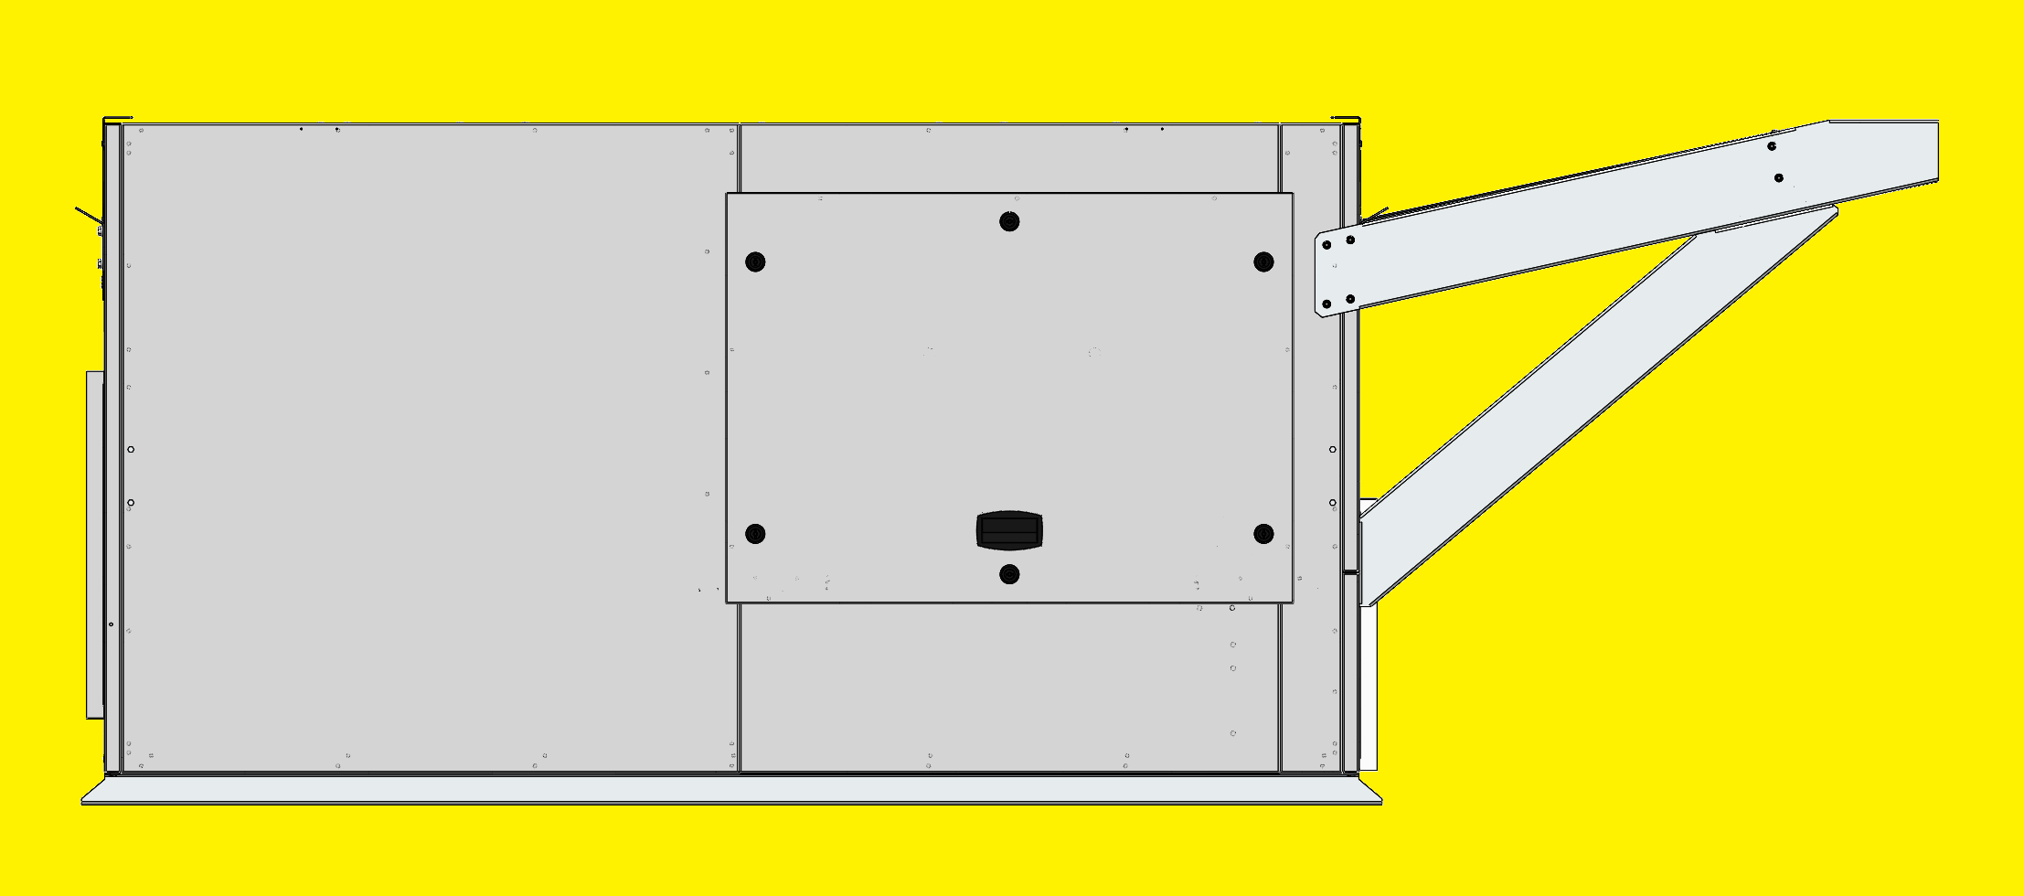
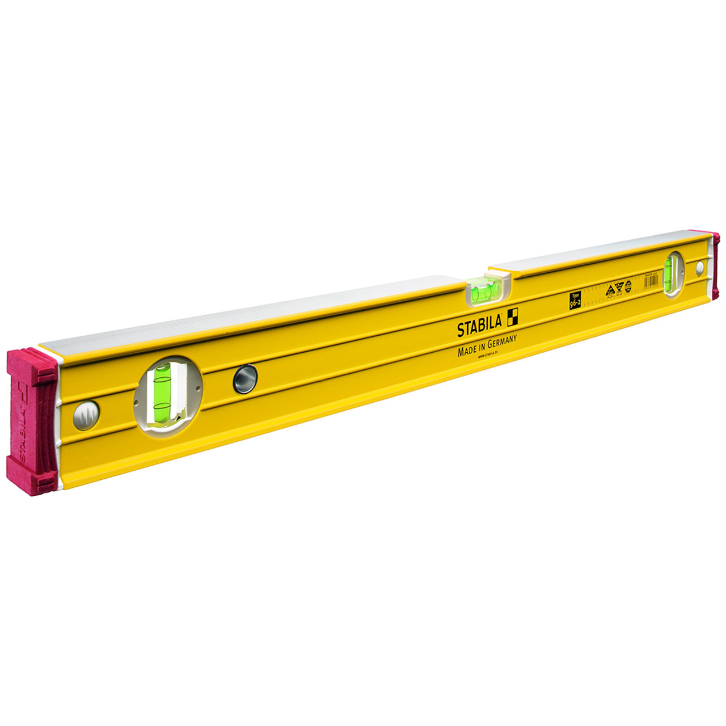
RECOVERY MODULE INSTALLATION
FLOW CURB
Adjust the position of both attachment brackets so that they are at least 5 mm above the support surface (without the foam) and tighten all the bracket bolts;
5 mm minimum
Make sure to use a spirit level for this alignment.

Slide 10
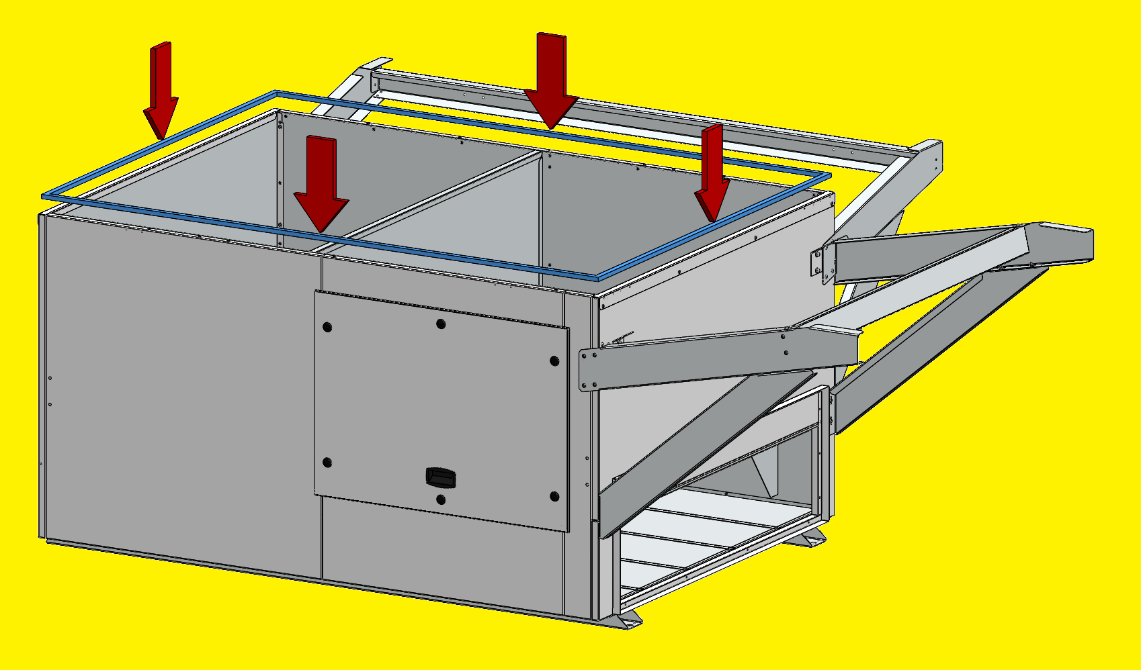
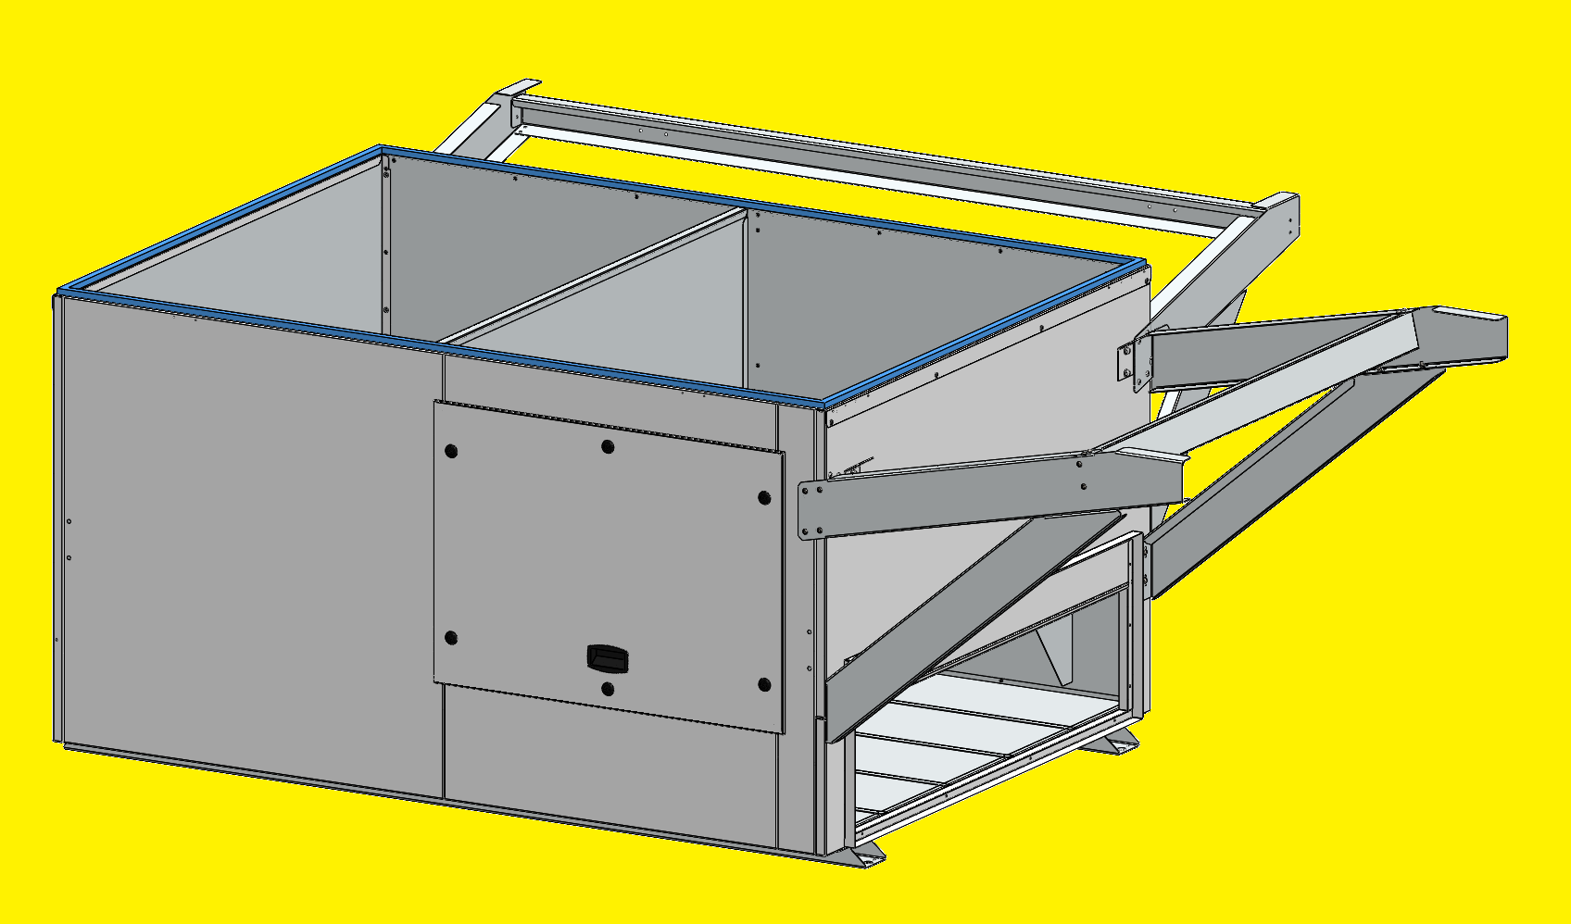
RECOVERY MODULE INSTALLATION
FLOW CURB
Install the Foam on the upper part of the Flow-curb.

Slide 11
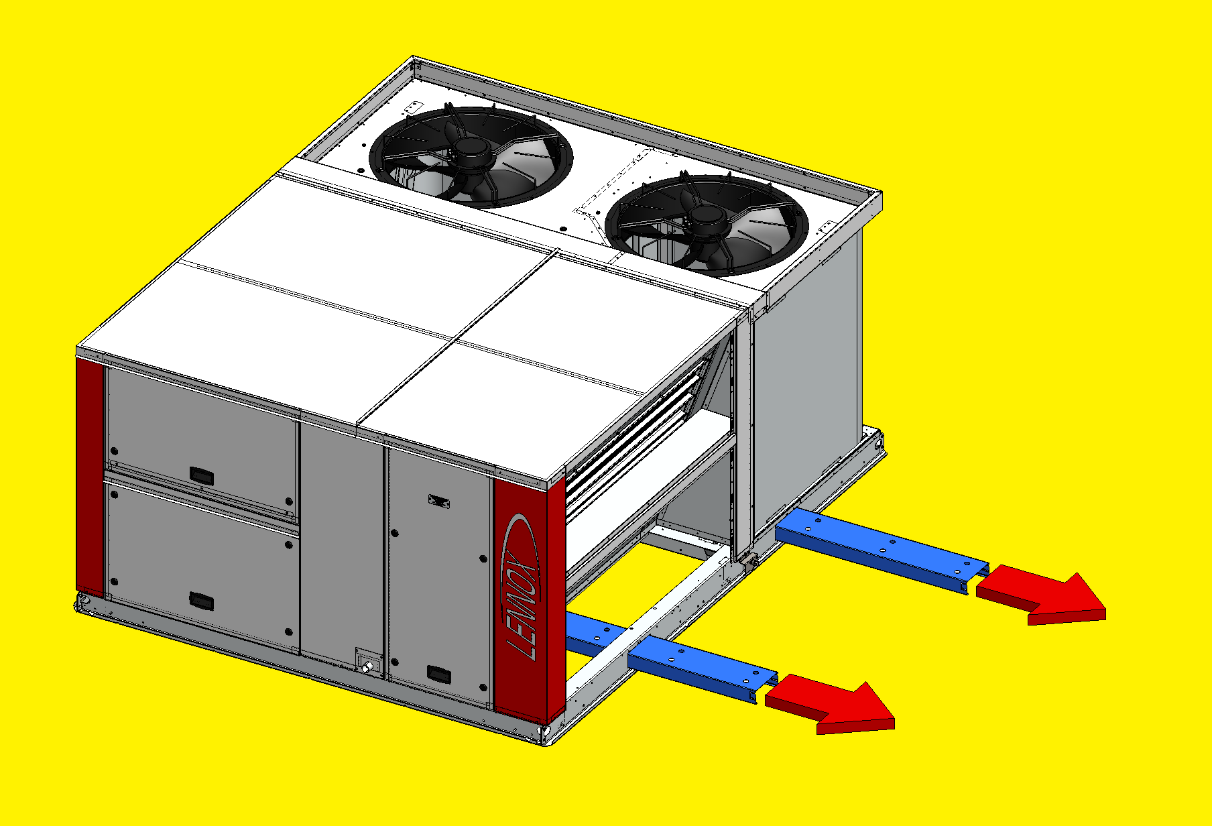

RECOVERY MODULE INSTALLATION
ROOFTOP
On the Rooftop, remove the forklift protections before lifting it.
The Rooftop cannot be installed above the Flow Curb with the forklift protections.

Slide 12
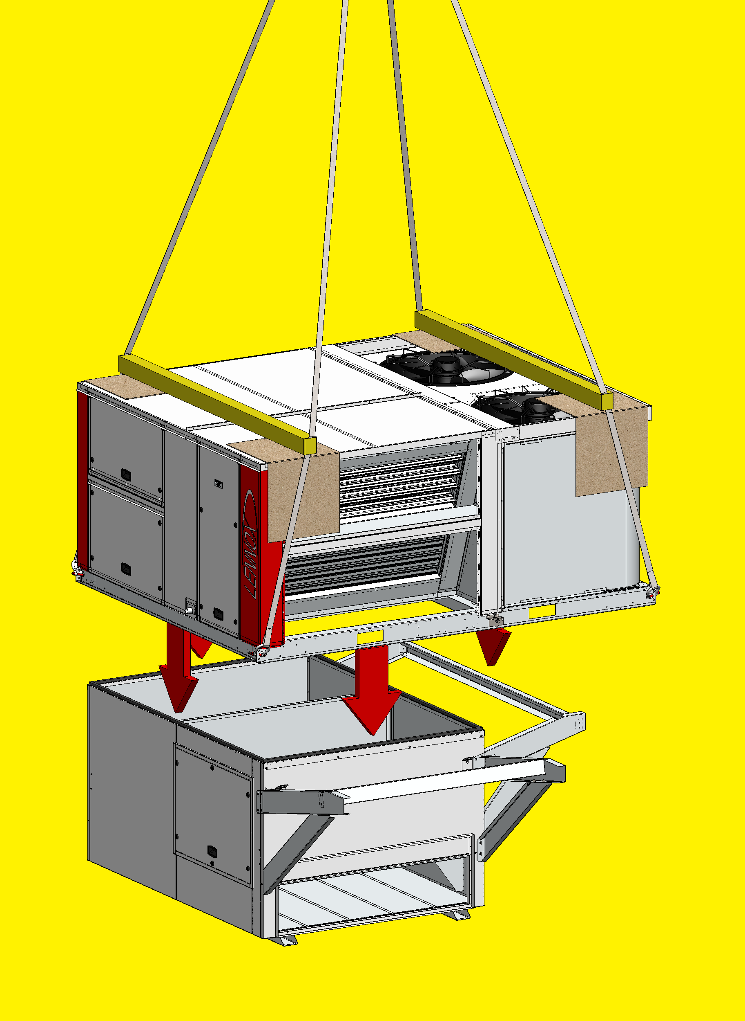
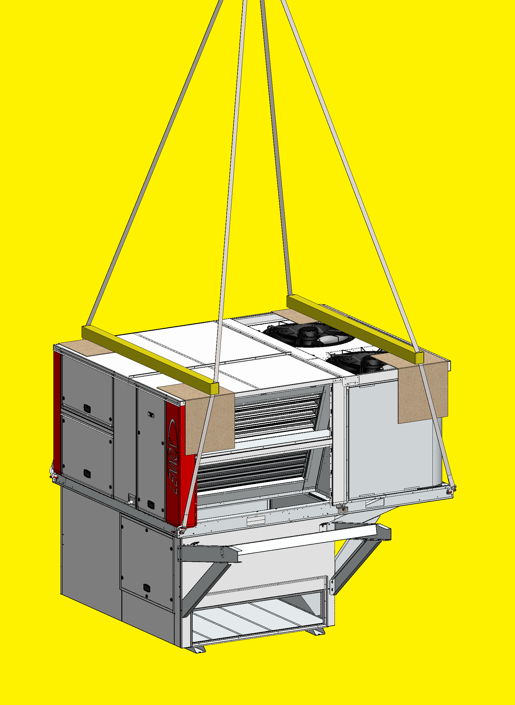
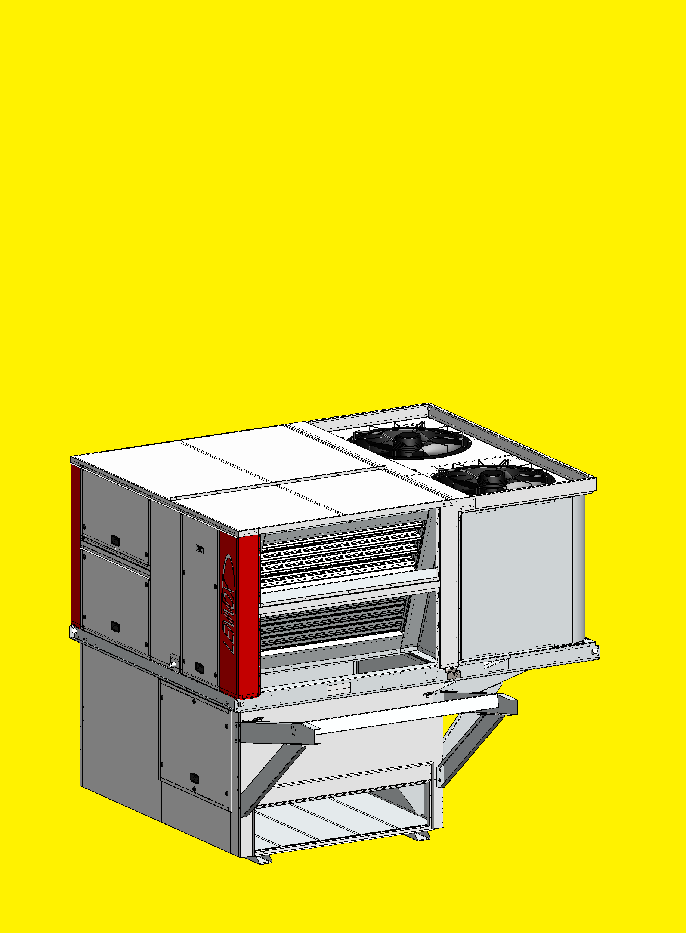
RECOVERY MODULE INSTALLATION
ROOFTOP
Lift the Rooftop and carefully install it above the Flow Curb.

Slide 13
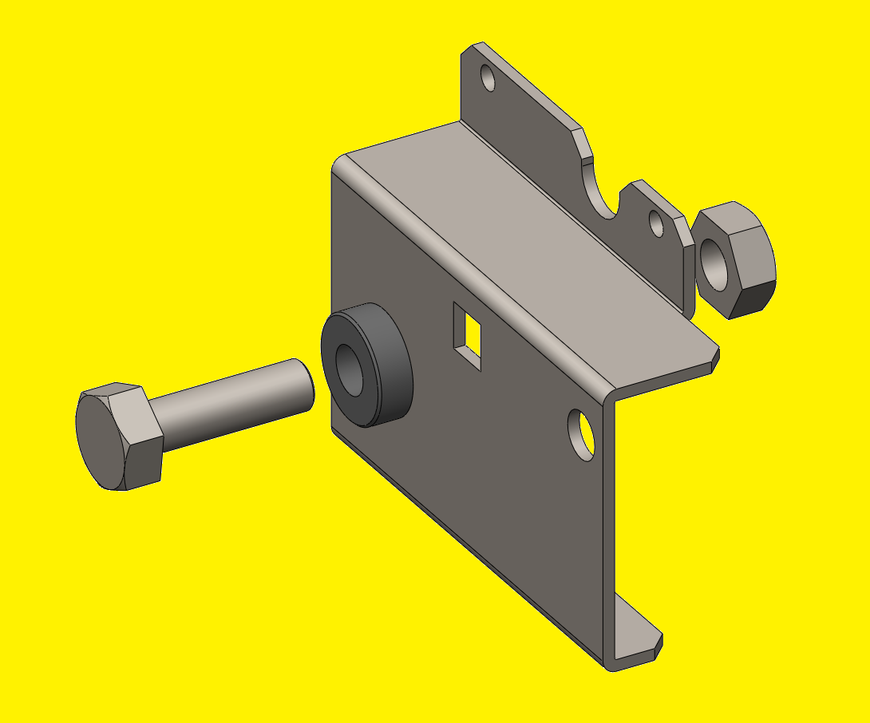
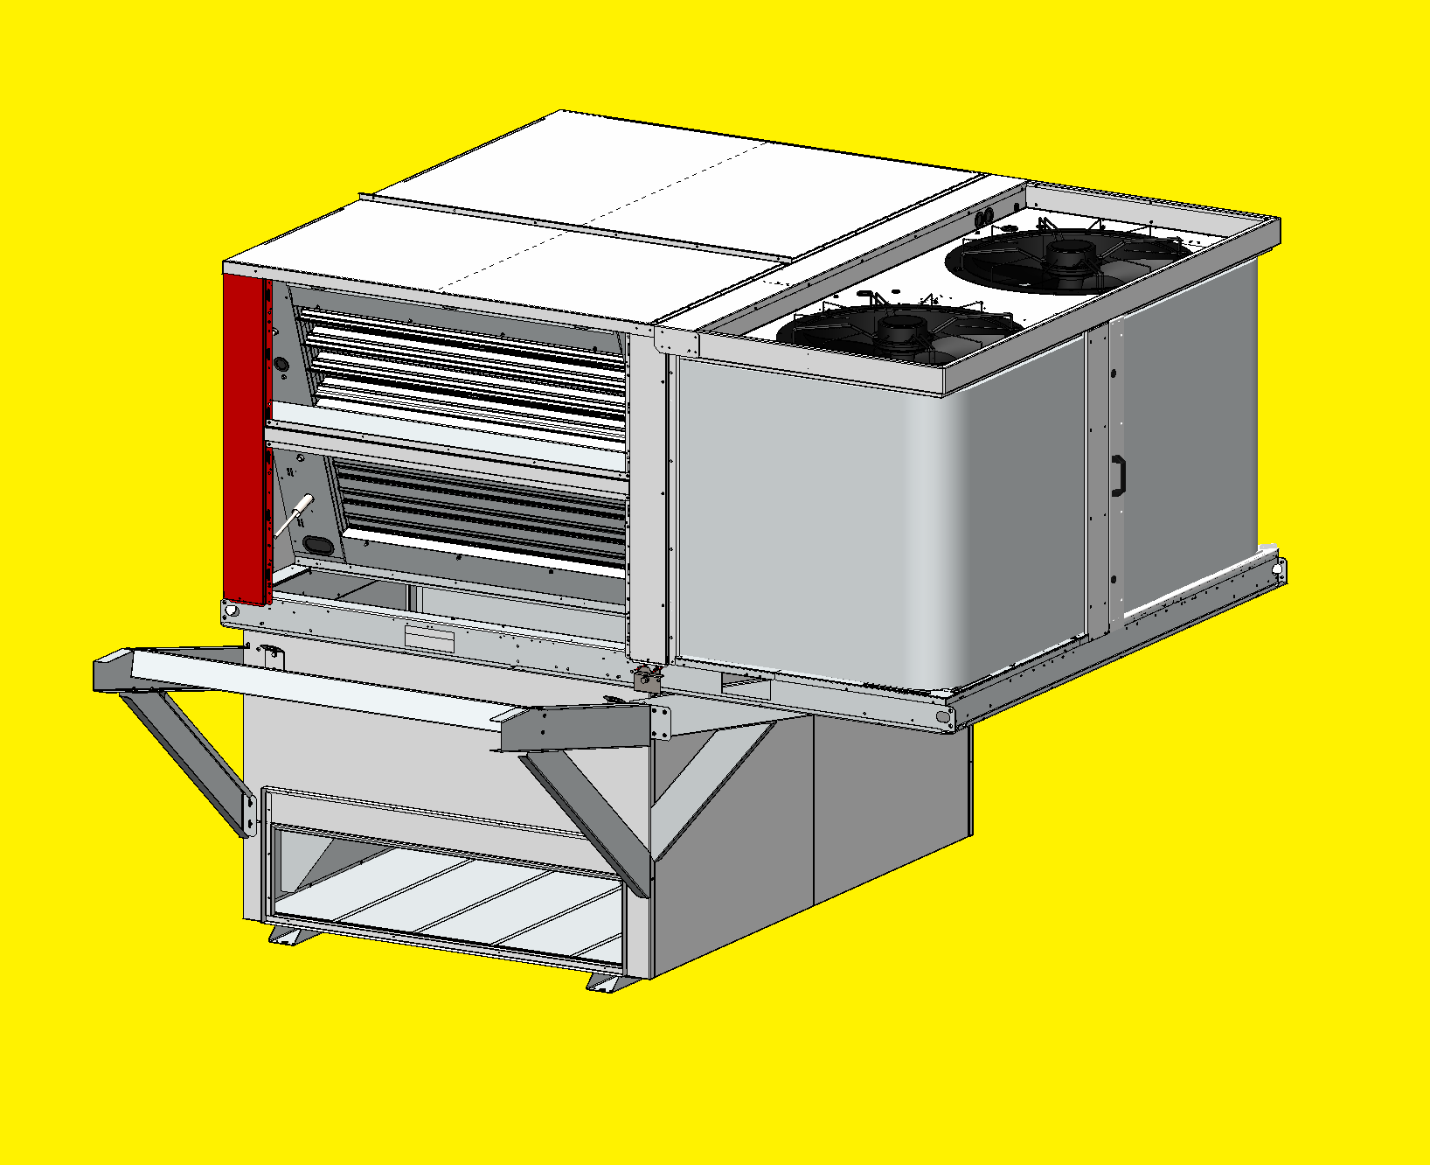
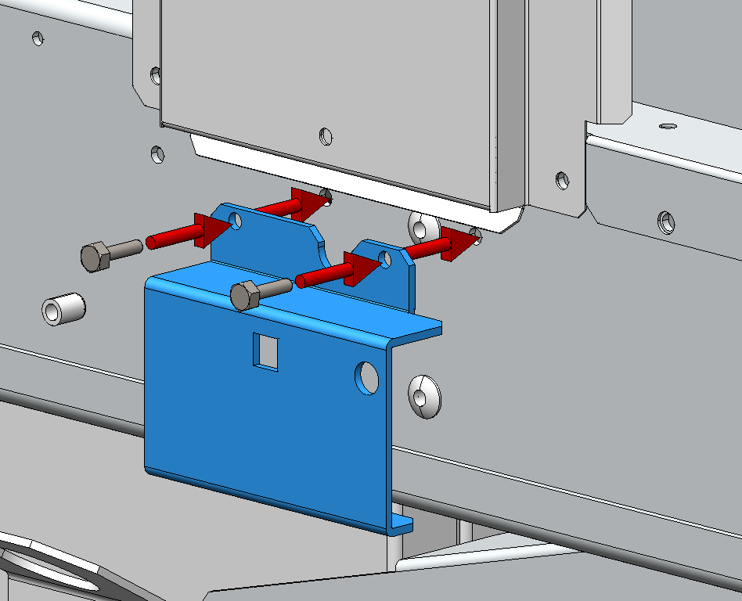
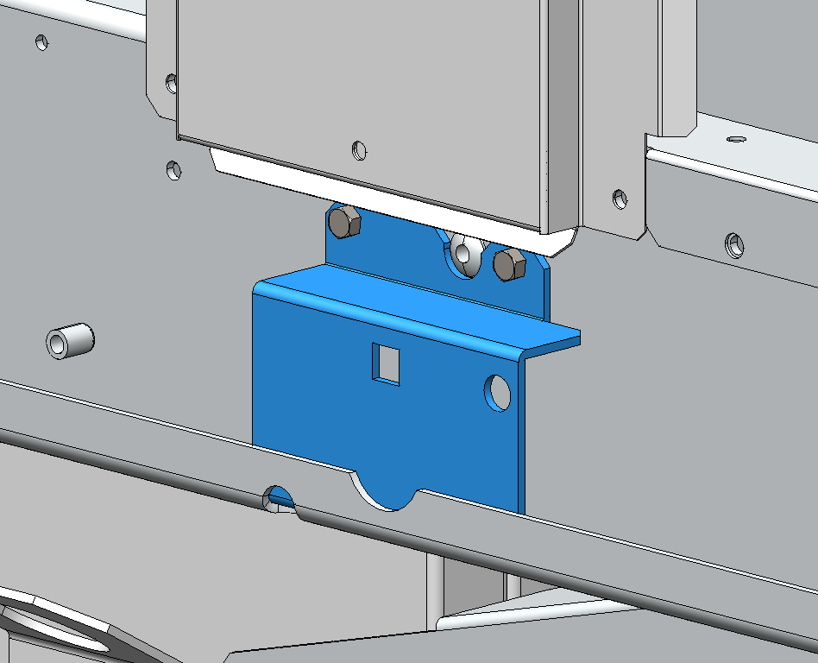
RECOVERY MODULE INSTALLATION
ROOFTOP
In case of C-Box, the Lower Plate Set must be installed on the Rooftop base frame with 2 bolts.
The Lower Plate Set is factory fitted with rivets, except on C-Box.
Lower Plate Set
Make sure to remove the bolt, washer and nut from the set before installing it.

Slide 14
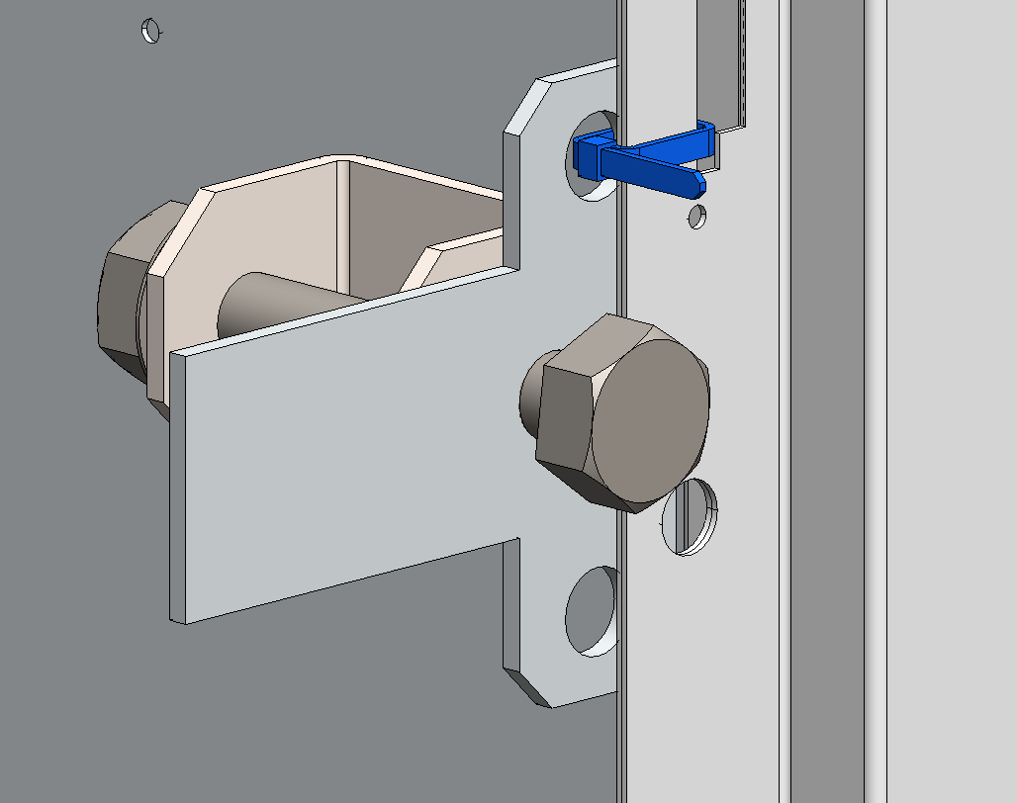
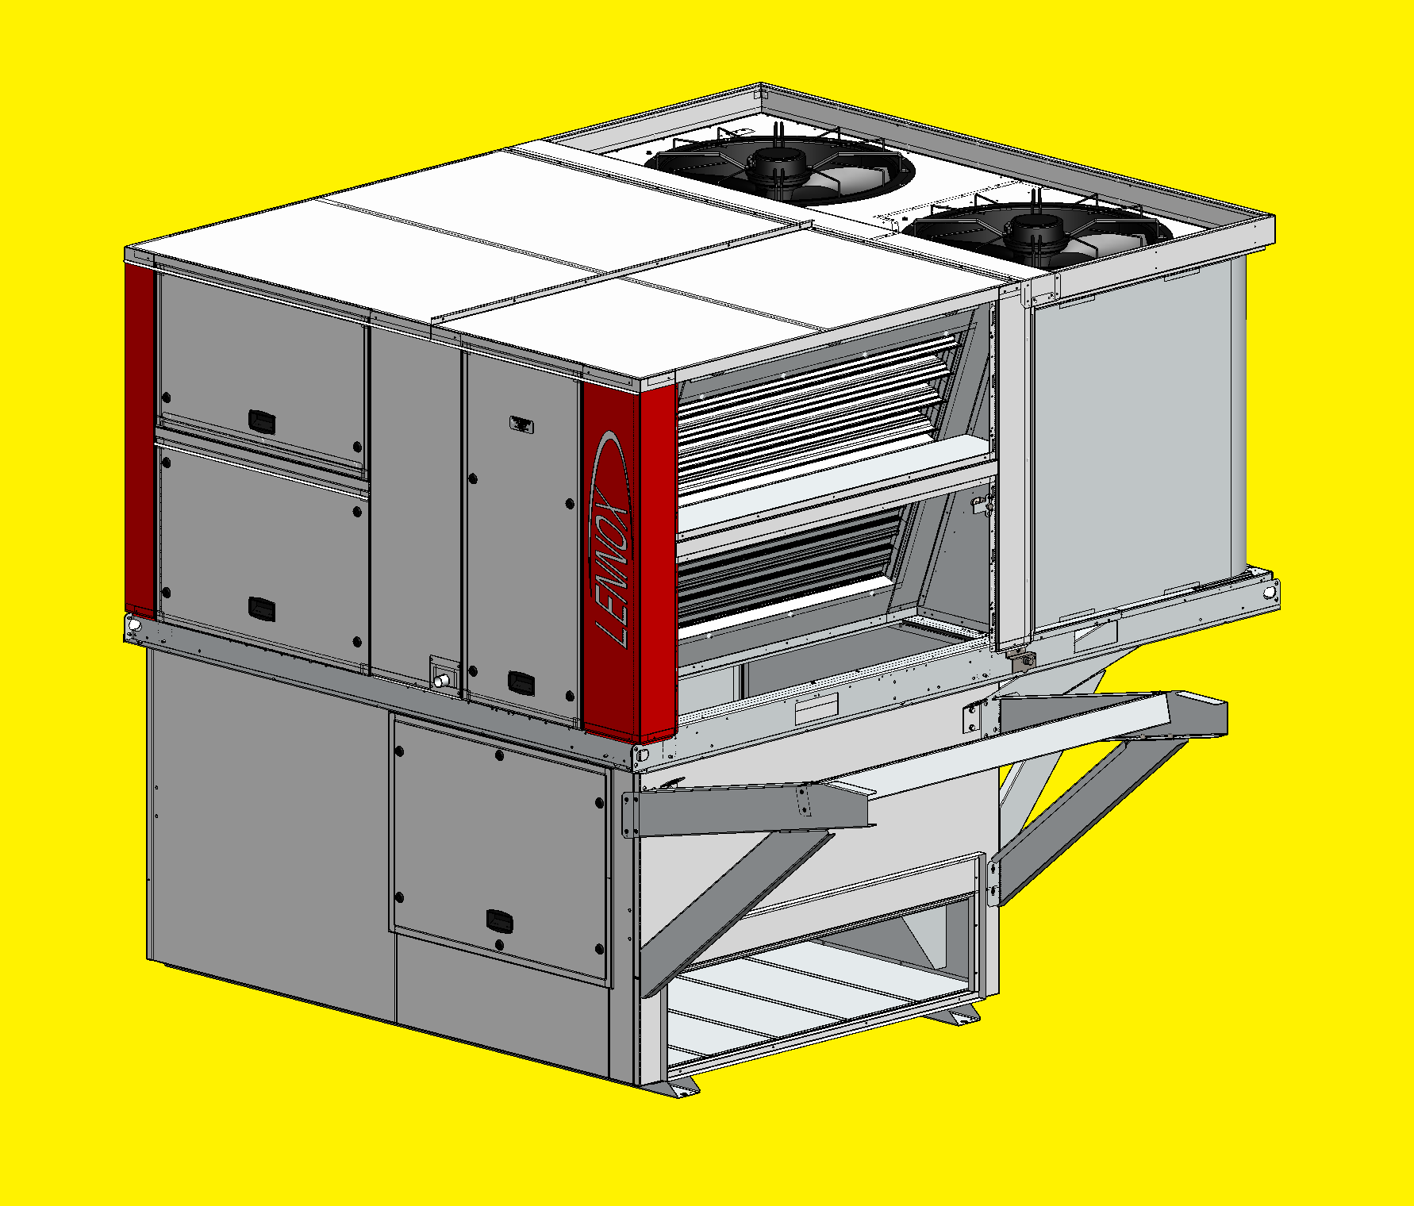
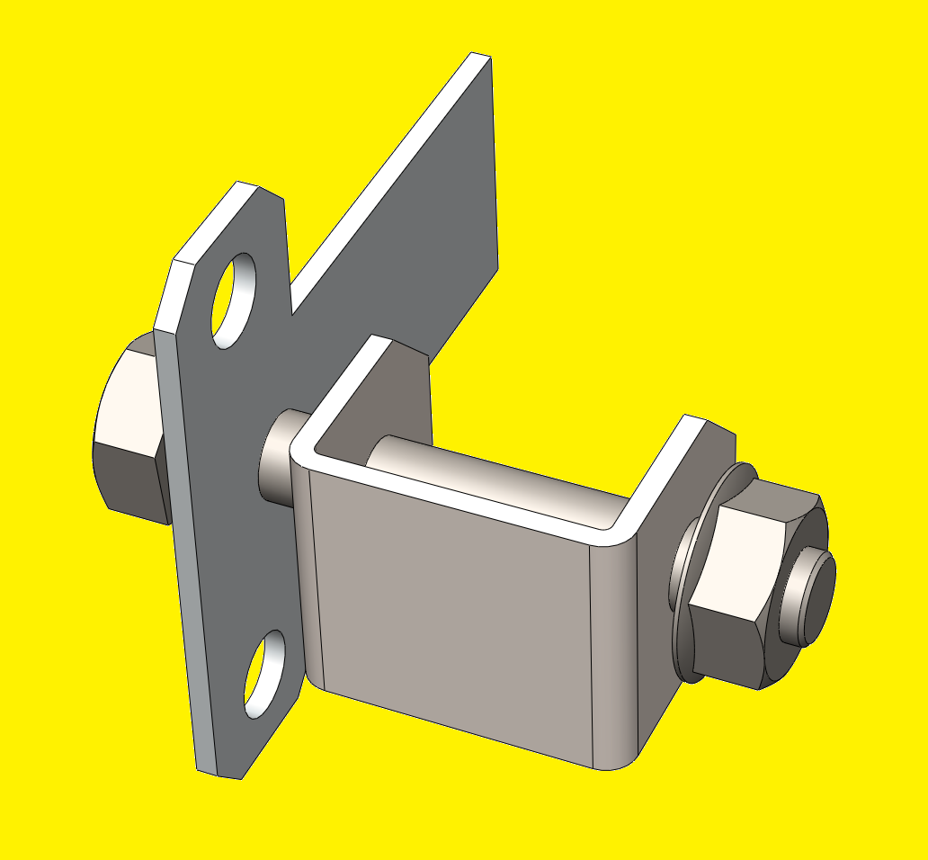
RECOVERY MODULE INSTALLATION
ROOFTOP
Remove the T-Plate Set from the Rooftop by cutting the clamp.
Cut the clamp
T-Plate
U-Plate
Bolt 10x70mm
Nut

Slide 15
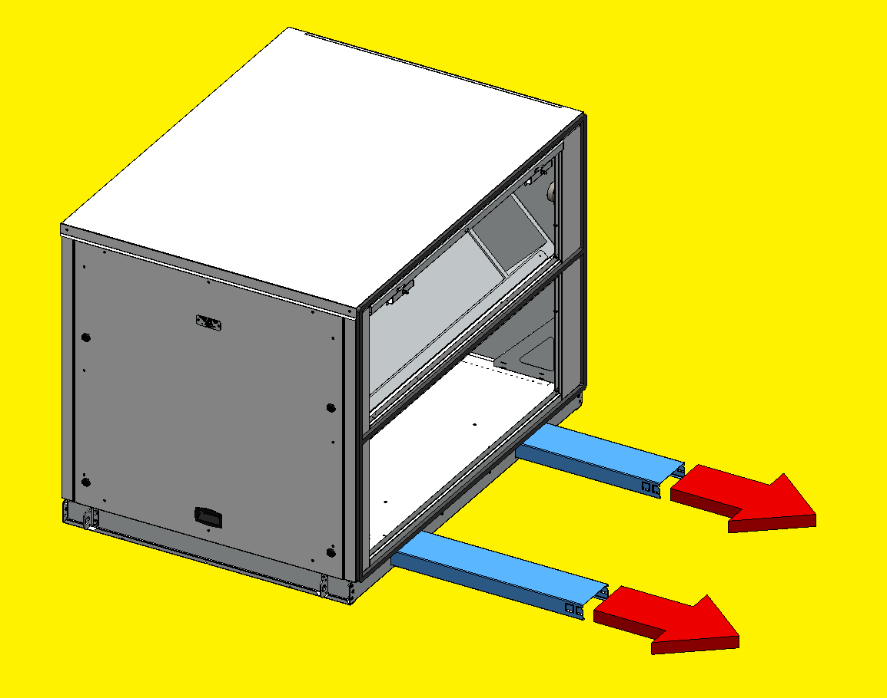
RECOVERY MODULE INSTALLATION
HEAT RECOVERY MODULE
On the Heat Recovery Module, remove the forklift protections before lifting it.

Slide 16
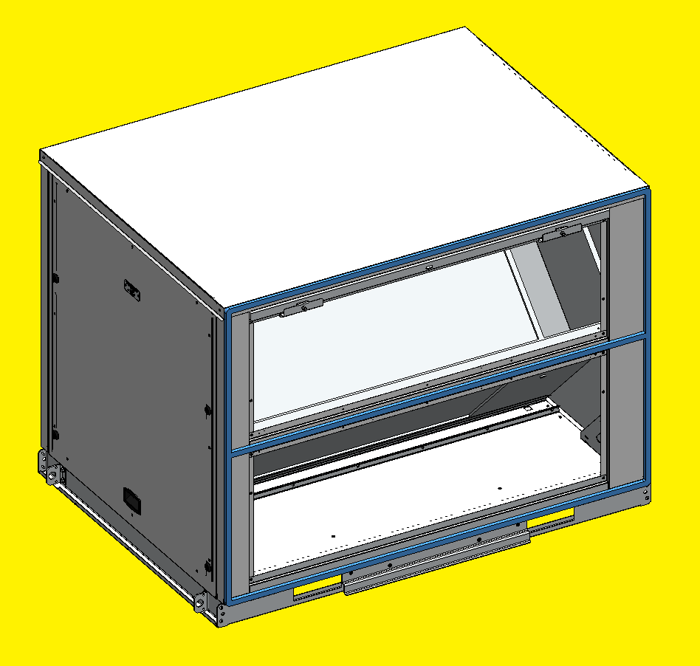
RECOVERY MODULE INSTALLATION
HEAT RECOVERY MODULE
Make sure that the Foam is not damaged
(20x15 mm thick).

Slide 17
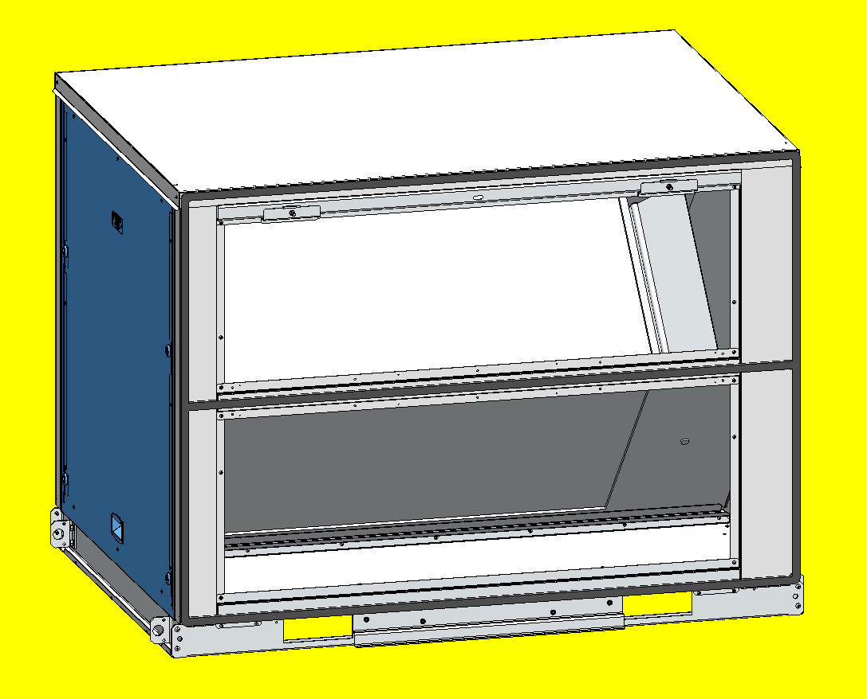
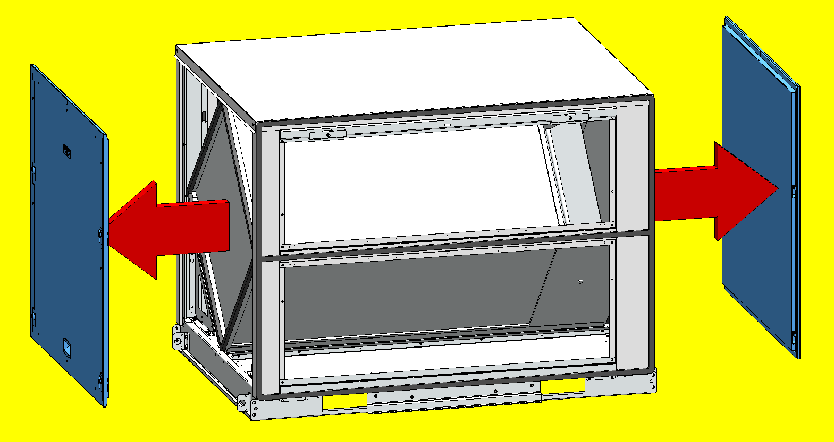
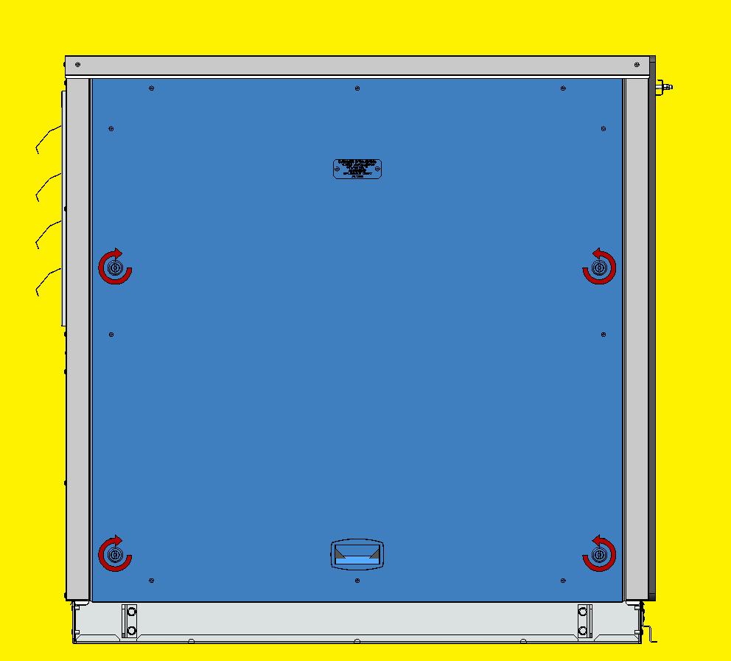
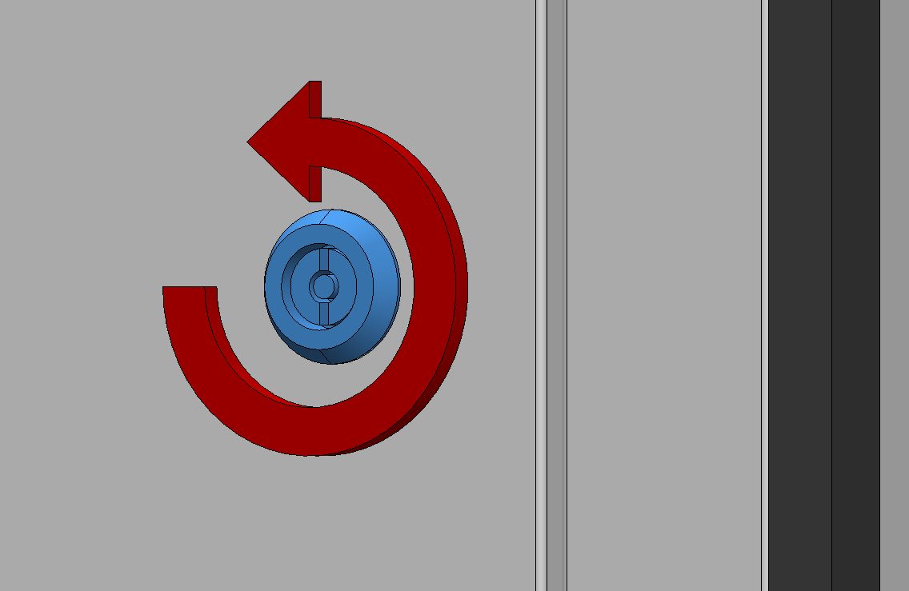
RECOVERY MODULE INSTALLATION
HEAT RECOVERY MODULE
Unlock the 4 latches on each Side Door and remove them.

Slide 18
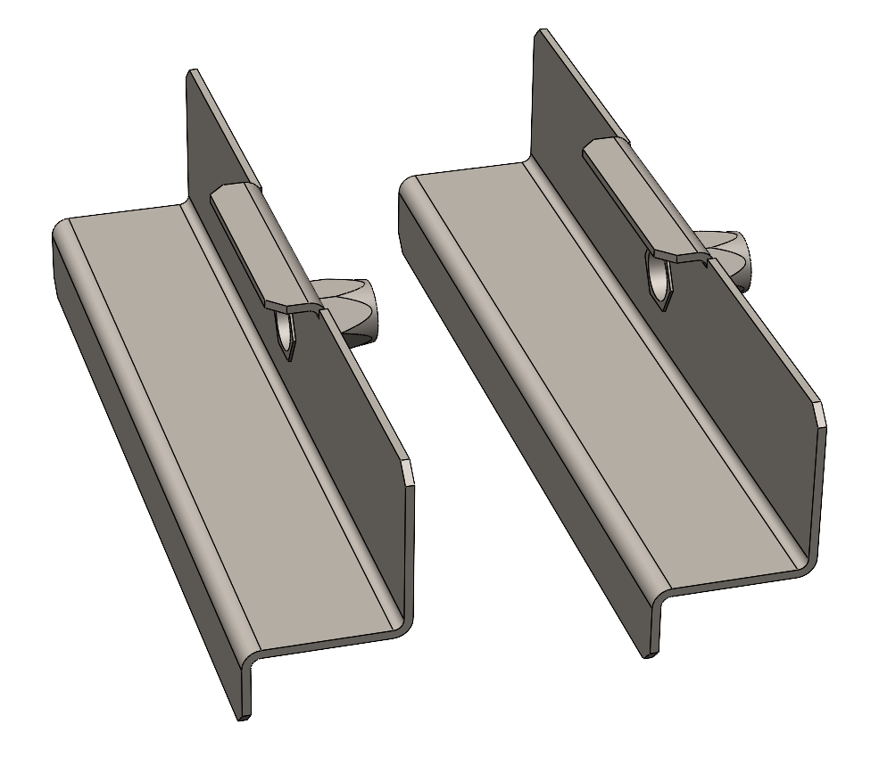
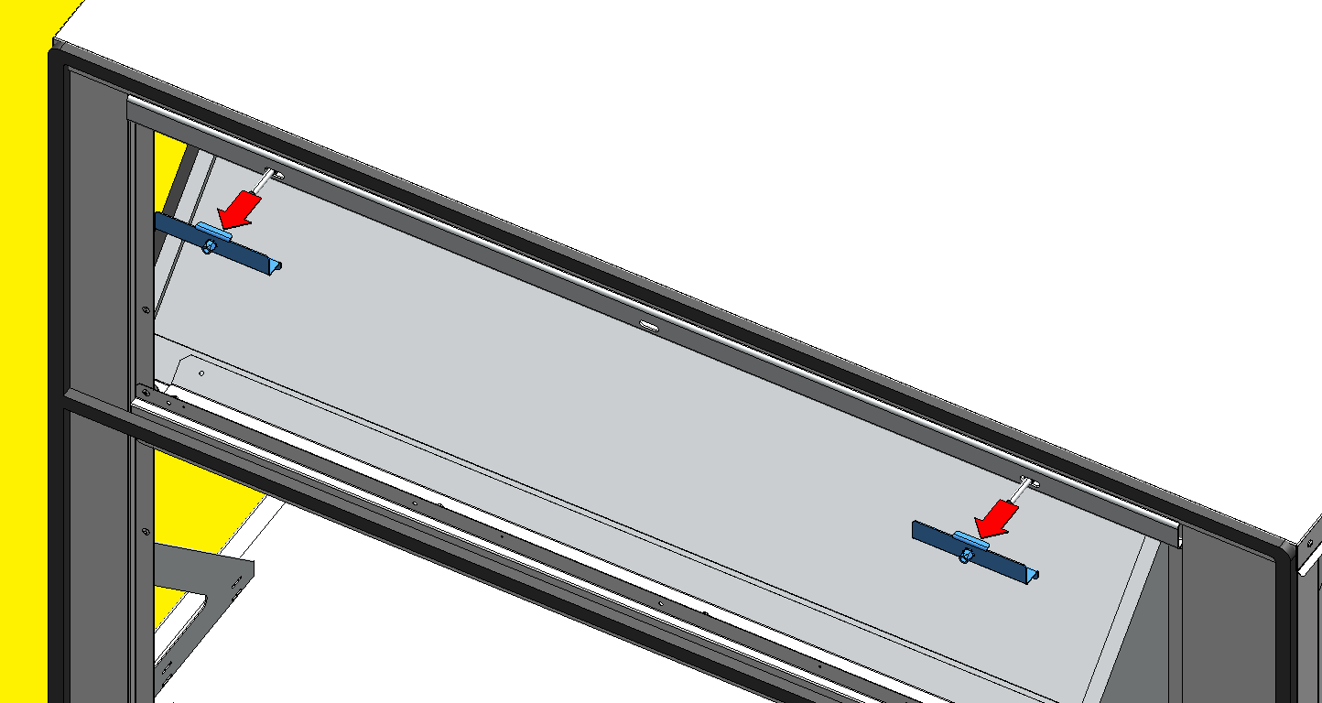
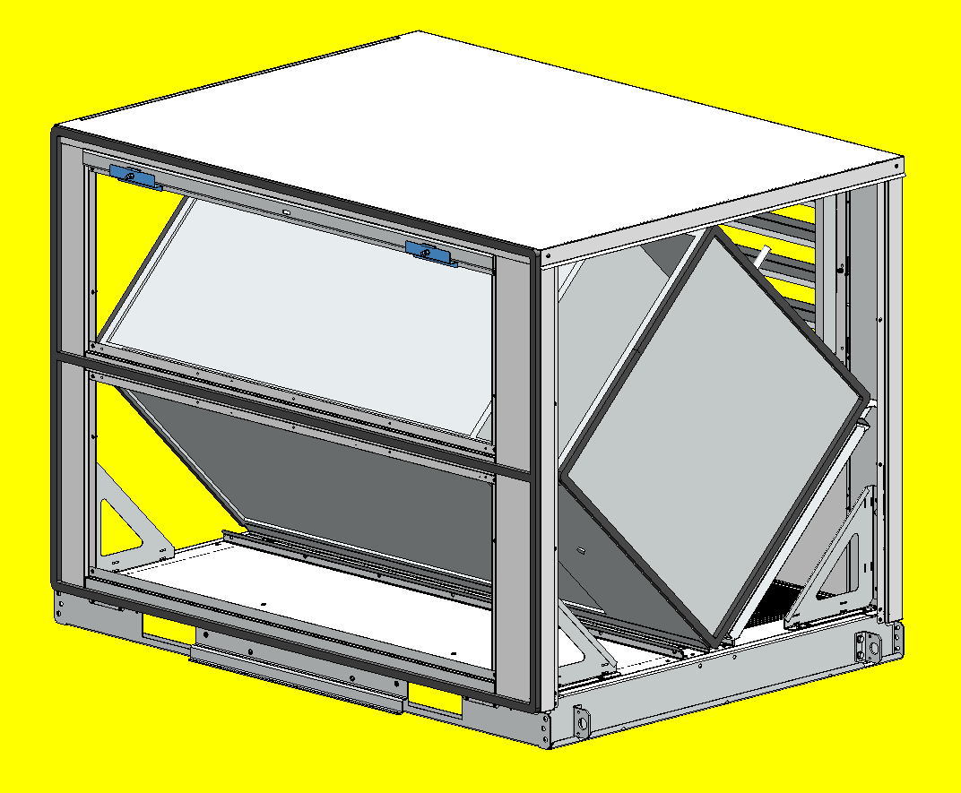
RECOVERY MODULE INSTALLATION
HEAT RECOVERY MODULE
Remove the
2 Upper Mounting Bars from the Heat Recovery Module.

Slide 19





RECOVERY MODULE INSTALLATION
HEAT RECOVERY MODULE
Place the two Upper Mounting Bars through the two top slots of the Rooftop.

Slide 20


RECOVERY MODULE INSTALLATION
HEAT RECOVERY MODULE
Lift the Heat Recovery Module and carefully position it over the Flow Curb brackets.
Make sure to not damage the brackets and gaskets of the heat recovery module during this process.

Slide 21



RECOVERY MODULE INSTALLATION
HEAT RECOVERY MODULE
Make sure to properly position the Lower Mounting Bar from the heat recovery module on the Rooftop base frame.
LOWER MOUNTING BAR

Slide 22




RECOVERY MODULE INSTALLATION
HEAT RECOVERY MODULE
Fix the bolt from the Lower Plate Set trough the Heat Recovery Module base frame.
Make sure to position the plastic washer between the HR base frame and the Lower Plate.
PLASTIC WASHER
Lower Plate Set

Slide 23





RECOVERY MODULE INSTALLATION
HEAT RECOVERY MODULE
Slide the T-plate into the Rooftop lifting lug.
ROOFTOP LIFTING LUG
T-PLATE

Slide 24



RECOVERY MODULE INSTALLATION
HEAT RECOVERY MODULE
Place the U-plate between the Rooftop and the Recovery Module base frames.

Slide 25


RECOVERY MODULE INSTALLATION
HEAT RECOVERY MODULE
Place a bolt (10x70mm) through the T-Plate and the U-Plate and secure it with a nut.

Slide 26



RECOVERY MODULE INSTALLATION
HEAT RECOVERY MODULE
Place 2 bolts (8x60mm) between the Heat Recovery Module and the 2 Upper Mounting Bars, previously placed on the Rooftop.

Slide 27



RECOVERY MODULE INSTALLATION
HEAT RECOVERY MODULE
Finally tighten the heat recovery module with the 4 bolts to compress the foam:
2 bolts on the Upper Mounting Bars
1 bolt on the Lower Plate Set
1 bolt on the T-Plate Set
2 bolts
1 bolt

Slide 28


RECOVERY MODULE INSTALLATION
HEAT RECOVERY MODULE
Finally tighten the heat recovery module with the 4 bolts to compress the foam:
2 bolts on the Upper Mounting Bars
1 bolt on the Lower Plate Set
1 bolt on the T-Plate Set
1 bolt

Slide 29
RECOVERY MODULE INSTALLATION
HEAT RECOVERY MODULE
Finally tighten the heat recovery module with the 4 bolts to compress the foam:
2 bolts on the Upper Mounting Bars
1 bolt on the Lower Plate Set
1 bolt on the T-Plate Set
Make sure that the foam from the Heat Recovery Module is compressed to 8mm (average)

Slide 30


RECOVERY MODULE INSTALLATION
HEAT RECOVERY MODULE
For the air pressure switch, connect and tighten the 2 Spade-Tips on terminal 1 and 3 (no polarity).

Slide 31
RECOVERY MODULE INSTALLATION
HEAT RECOVERY MODULE
For the actuator, assembly the two parts of the connector

Slide 32


RECOVERY MODULE INSTALLATION
HEAT RECOVERY MODULE
Reassemble both Side Doors of the heat recovery module.

Slide 33
THANK YOU!

